Slide 1
Using Action Learning to Inspire Compassionate Professional Practices
An interdisciplinary Action Learning Set (ALS):
Justin Haroun – Centre for Resilience
Yusuf Kaplan – Interfaith Adviser
Lisa Matthewman – WBS
David Morris – Assistant Interfaith Adviser
Jenni Nolan – WBS
Frands Pedersen – Politics & International Relations
Kathryn Waddington – Psychology

Slide 2
Overview
Action learning:
- purpose and process
- as a vehicle for compassion
Compassion:
- global and UoW contexts
- evidence-base
Reflections:
How has involvement in the ALS influenced how we think about compassion in our everyday practice and engagement with colleagues and students?

Slide 3
This time last year I asked …..
What role should compassion play in our university?
Why is it important for intersectionality and innovation?
What are the practices that enable compassionate pedagogy?
What next? Action Learning Sets, Action Research?
And here some of us are are!

Slide 4
Action Learning – purpose
Reg Revans (1907 – 2003)
An approach to individual and organisational development
Uniting ‘comrades in adversity’ and ‘upward communication of doubt’ gives:
Opportunities for individuals to engage in learning and identify action to make a positive difference to the organisation’s effectiveness.

Slide 5
Action Learning – a structured process
Commitment to attend and participate
Boundaries and ground rules
Check in – in order to know what to leave outside ALS
‘Mindful minute’ at start and end of ALS
Bids for ‘airtime’ – yes/no/maybe – feedback at next ALS
Airtime 20/30 mins then helpful/challenging Qs – not advice
Reflection on process and action/s

Slide 6
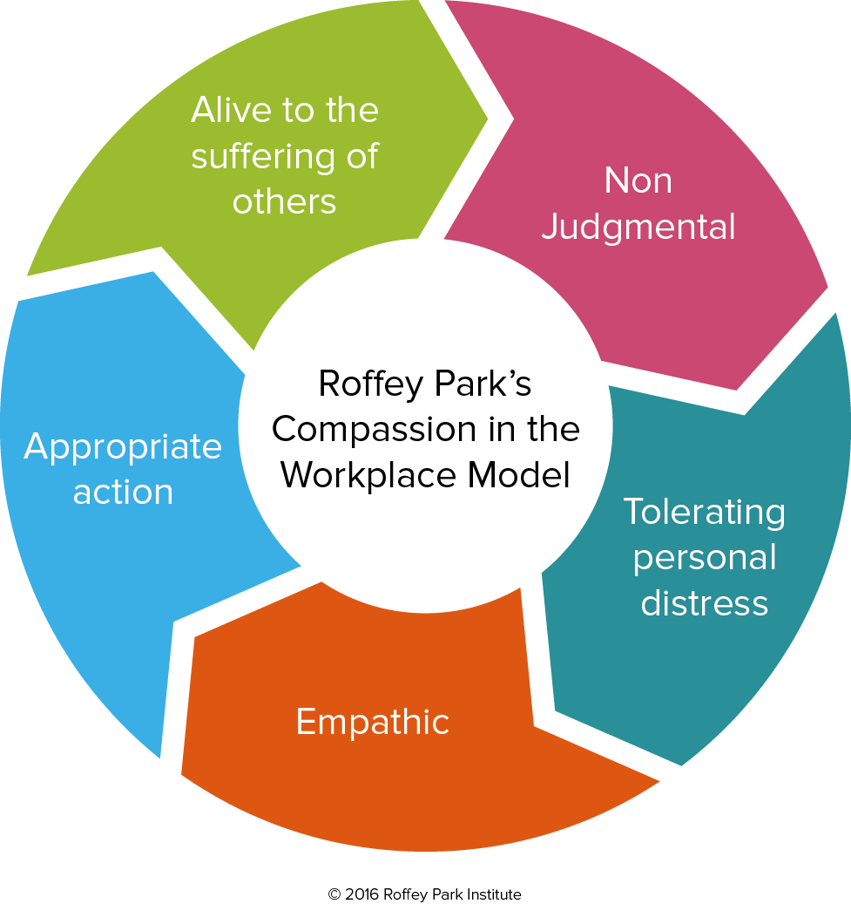

Slide 8
Reflections
Noticing – the tone of emails
Trying to role model kindness to self and others
Resist the risk of compassion becoming ‘flavour of the month’
Compassion must not be commodified!!

Slide 9
Next actions for me ….
Call for papers: Special Issue of Journal of Perspectives in Applied Academic Practice (Dec 2018)
Proposal to UoW Press for edited book (Sept 2019):
Towards the Compassionate University – chapters by ALS members and members of Darwin International Institute for the Study of Compassion (DIISC)
? Interdisciplinary Darwin Group to progress DIISC agenda in 2018/19
http://diisc.org

