Slide 1
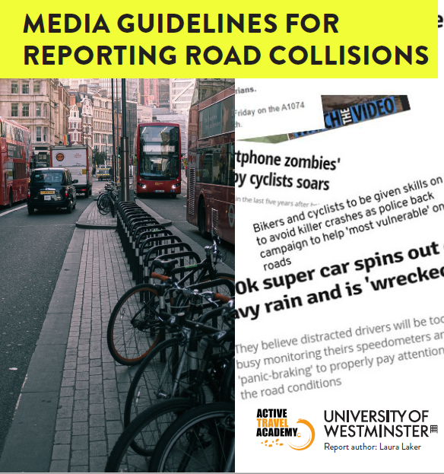
Laura Laker
Journalist
Report Author

Slide 2
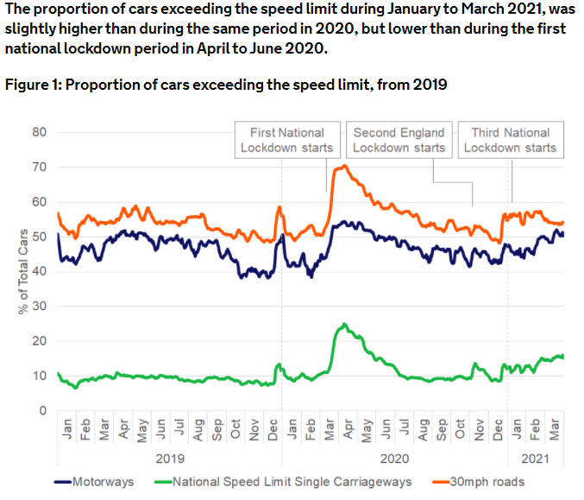
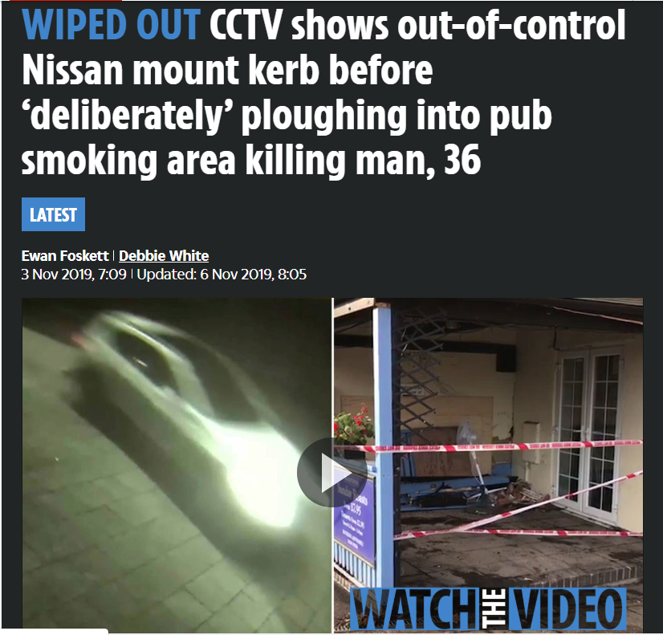
The trouble with ‘car accidents’
Sources: Vehicle speed compliance statistics for Great Britain: January to March 2021 https://www.gov.uk/government/statistics/vehicle-speed-compliance-statistics-for-great-britain-january-to-march-2021/vehicle-speed-compliance-statistics-for-great-britain-january-to-march-2021
Walking and cycling statistics 2019.

Slide 3
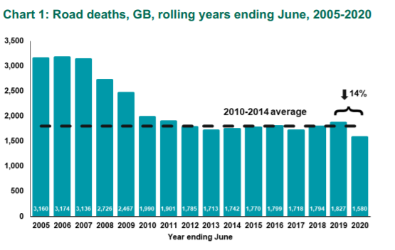
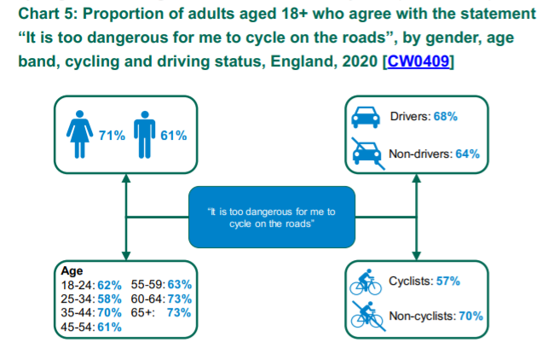
Most crashes aren’t ‘car accidents’
Road crashes kill or seriously injure someone in the UK every 20 minutes
Road deaths have remained static for a decade…
We accept road danger - but most road deaths are preventable
Speed
Distracted driving
Drug/drink driving
People want to walk and cycle more but don’t feel safe
Language is part of the solution
Sources: Reported road casualties in Great Britain: provisional estimates to year ending June 2020 https://www.gov.uk/government/statistics/vehicle-speed-compliance-statistics-for-great-britain-january-to-march-2021/vehicle-speed-compliance-statistics-for-great-britain-january-to-march-2021
https://assets.publishing.service.gov.uk/government/uploads/system/uploads/attachment_data/file/906698/walking-and-cycling-statistics-england-2019.pdf

Slide 4
What the research tells us
Subtle language changes have big impacts
Crash vs accident
Driver vs car
Context is crucial
Avoid implications of blame
Avoid coverage that normalises speeding or phones at the wheel
“I really encourage everybody to stop using the phrase ‘road accident’ which doesn’t always reflect the nature and recklessness of the driving involved and can be very offensive to bereaved families or people left seriously injured.” Detective Superintendent Andy Cox, Head of Crime at Lincolnshire Police, and the National Lead for Fatal Collision Investigation.

Slide 5
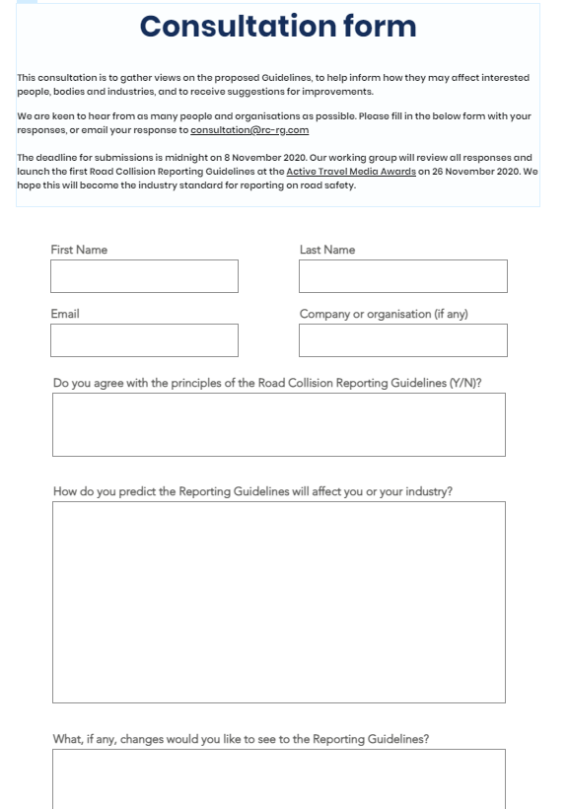
Consultation
We produced draft guidelines and held a public consultation in Autumn 2020 for six weeks on www.rc-rg.com
198 responses from our online form and email
72% (139) agreed with the principles of the Guidelines
21% (38) indirectly expressed their support for the aims
2.5% (5) did not agree
Professional rationale for support and moving anecdotes around feelings of vulnerability on the roads

Slide 6
The Guidelines
1. Be accurate: Be clear about what you know and don't know. When you learn more later, update your story to reflect that.
2. Avoid calling it an accident: unless it actually is one. Most collisions are preventable.
3. Talk about the driver, not their car: Use phrases like "the driver hit a pedestrian" over "the car hit a pedestrian”.
4. Consider the family of the victim: when publishing details of collisions.
5. Be careful with photos and images: Beware of publishing number plates, or footage or images taken behind the wheel, that might condone phone use while driving.
6. Injury is more important than delays: Loss of life or injury shouldn’t be overshadowed by traffic delays.

Slide 7
The Guidelines
7. Be wary of generalizing groups: Does your writing negatively generalise a group of people like cyclists or disabled people? This can lead to them being treated badly on the roads.
8. Give context: Large vehicles like SUVs cause more damage than small ones. Pedestrians and cyclists are at greater risk in a collision. Some junctions are notorious -- if collisions aren't isolated, don't let people believe they are.
9. Don’t OK lawbreaking: Speed cameras don't "target" drivers, they save lives. Research shows reporting that reflects that makes people more likely to support enforcement of these laws.
10. Talk to the professionals: Journalists aren’t expected to be experts in road collisions, so the guidelines document provides relevant contacts.

Slide 8
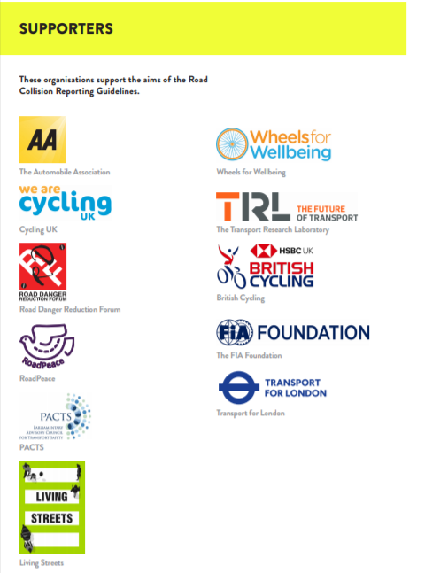
What happens next?
‘Standards by consensus’
Support from major organisations
Team effort
Publishers
Emergency services
Government
Professionals
Culture change
Politely point people to our Guidelines
Tell us how to improve them!
contact@rc-rg.com
www.rc-rg.com/guidelines

Slide 9
About the Active Travel Academy
Launched September 2019 by Professor Rachel Aldred
Expertise from within the University of Westminster, and outside
Focus on walking and cycling, micromobilities – reductions in car use
Issues: air pollution and climate change, inactivity, road danger, unequal access to transport, the loss of independent mobility in young and old
PhD studentships, international summer schools and visiting international fellowships
Open, online access journal for the field
Media awards
Media reporting guidelines
blog.westminster.ac.uk/ata/

Slide 10
Thank you!
contact@rc-rg.com
www.rc-rg.com/guidelines

