Slide 1

Course Leaders Forum
Thursday 27th February 2020
1-3pm, Fyvie Hall, Regents

Slide 2

Who is in the room???

Slide 3
Overview of the Event
1 pm Opening – Sal Jarvis, PVC
1.10 Update on Centre for Education & Teaching Innovation – Tony Burke
1.20 Update on Course Leaders Forum Steering Group Lisa Matthewman
1.30 Thoughts on ‘The Art of Course Leadership’
2pm Table discussions (World Café Style)
2.30 Plenary & capture.

Slide 4
The forum objectives include:
To promote internal networking amongst all course leaders
To build an internal network and form relationships for sharing of best practice/collaboration.
To provide a cross-faculty forum for all course leaders at the University of Westminster
To increase communication between course leaders and professional services/management at Westminster.

Slide 5
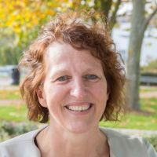
Welcome and Opening from Sal Jarvis

Slide 6
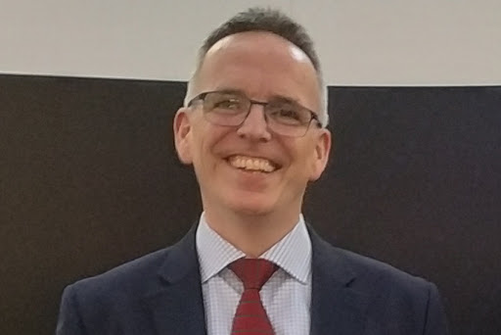
Update on the Centre for Education & Teaching Innovation – Tony Burke http://cti.westminster.ac.uk/

Slide 7
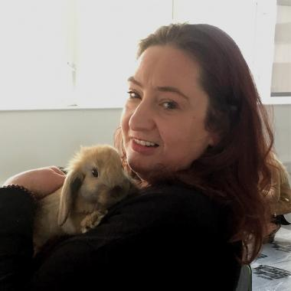
Update on the Course Leaders Forum Steering Group – Lisa Matthewman

Slide 8
The Course Leaders Forum Steering Group
The Course Leaders Forum Steering Group (CLFSG) has members from across the University
Statements of interest
It is the membership who will be organising and running learning and development events for course leaders
Hold forum events
Speaker events
Notes:
Colleagues were invited to attend the event so as to support CLs and to explore ways in which relationships between CLs and the professional services they have to deal with can be developed, so that there is collaboration.
Marketing emerged strongly as an issue in the four course leader forum meetings that Roland organised last January - mainly because there was a sense that CLs had ideas about their programmes and would like to feed them in, so we started with this. The purpose of the CLFSG is to build relationships and share perspectives,
This approach was also suggested as a positive way forward because some CLs felt that they had built a much closer personal relationship with prof services and that this was key to managing the CL role effectively and successfully.
The purpose of the CLFSG is not to develop University strategy – but to support CLs in developing their own approach or ’strategy’ for enhancing the marketability of their courses. The purpose of the CLFSG is about creating a positive forum for exchange in order to build bridges as many CLs across the Faculties (as they were in January 2018) felt that there was a need for more collaboration, connectedness and camaraderie.

Slide 9
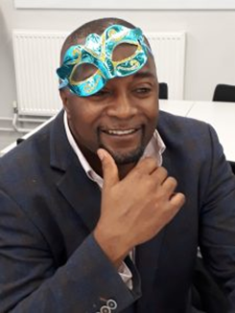

Slide 10
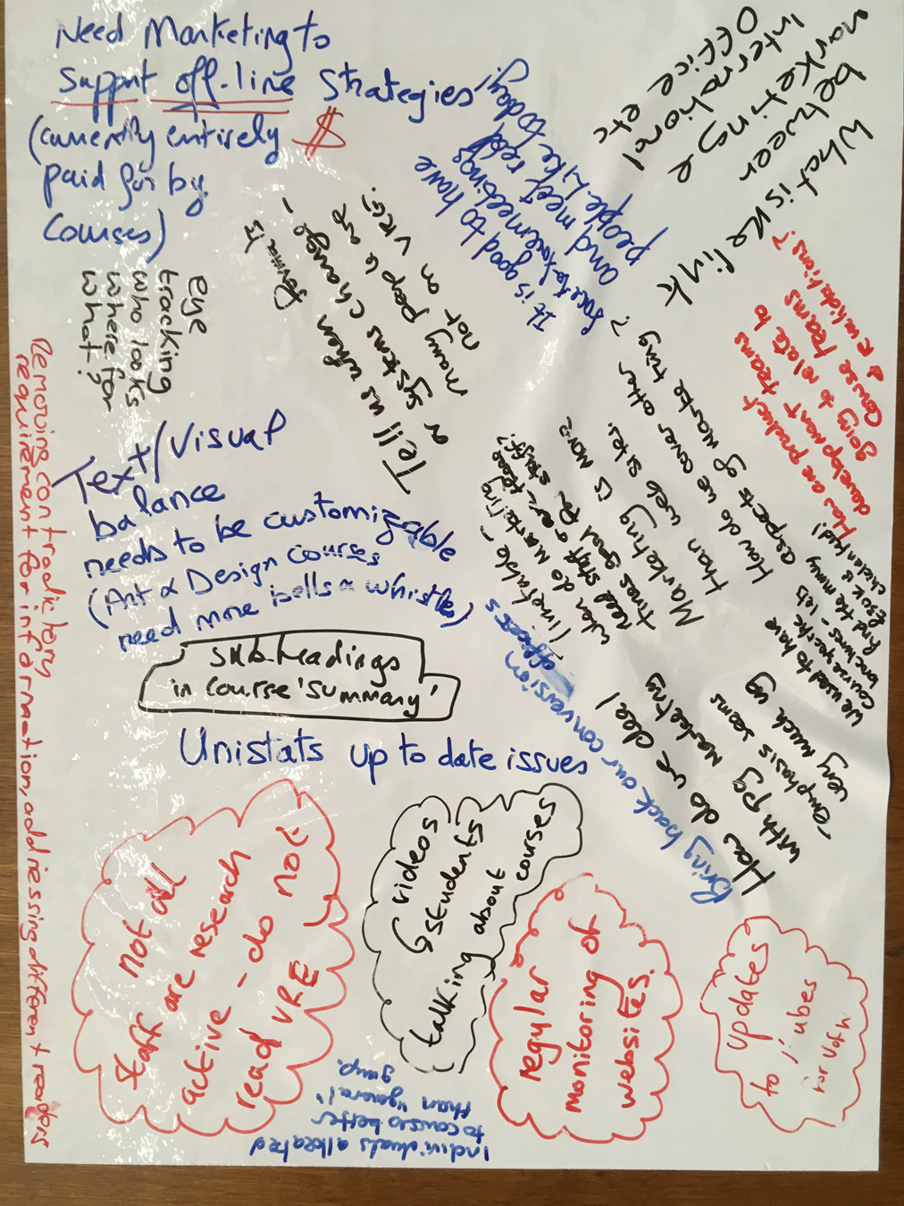

Slide 11


Slide 13


Slide 14
Themes
Responsibility versus no power or authority
Marketing
Admission
Communications
Teams and team building: Course Teams
Validation
Appreciation or Recognition Annual Event
Extraordinary Course Leader of the Year’ scheme
Mentoring & Coaching training-giving feedback to team members/empowerment

Slide 15
Academic leadership
Time management/administration
Building relationships
Student Support and Guidance
Quality Assurance/Annual monitoring
Technology
Pastoral/School Tutors
Finance & Budgets
Career Development
Sustainability in courses
Course committees?

Slide 16

The Art of Course Leadership
Apologies from Associate Heads of College (Education and Students)
Conversation in pairs
What is effective course leadership?
What do they do?

Slide 17
World Café 2-2.30pm
To walk around the tables with a discussion of issues-solution generation!
1. What are the immediate concerns for course leadership?
3. How can the CETI support CLs?
4. What are the challenges and opportunities facing CLs?
5. What are the key support needs for Course leaders?
What future resources will be needed by CLs?

Slide 18

2.30-3pm
Plenary
Key Action Points/Feed-Forward

Slide 19

Thank you for your time this afternoon!

