Slide 1
Building Compassion in Course Teams Wednesday 29th April 2pm-4pm on MS Teams
Facilitators: Kathryn Waddington, Justin Haroun and Lisa Matthewman

Slide 2
Welcome
Welcome On arriving, please have video and mic on so as to say hi to everyone, then mute both until the plenary sessions. I would advise closing your email, so as not to get interrupted by all the ‘popping champagne cork’ noises you will hear 😊 Using Chat – at the bottom of the MS Teams panel (there is a blue square with a speech bubble) this opens the chat interface. Just type whatever you wish in the box at the bottom of the chat panel and press return to send the message.
Padlet: Please share any thoughts or ideas you have on the padlet. Padlet: •https://padlet.com/l_j_matthewman/xbew9i947paic1br

Slide 3
Overview
Introductions – who is in the room
Aims of the workshop
Part One:
Intro: Ice breakers
Aims and objectives
Compassion in HE
Exercise: How compassionate are you
Plenary discussion and sharing
Part Two:
Developing self compassion
Plenary discussion and sharing
Part Three:
Leading and working with teams compassionately
Plenary discussion and sharing
Ending plenary and discussion.
Notes:
This workshop has been specifically designed to help you develop your understanding of self and team compassion and the benefits of using a compassion-based leadership approach when working with your course teams. With this workshop and accompanying toolkit, you will be able to work more compassionately and know how to structure and carry out effective team meetings from a compassionate perspective. The workshop will help you to build and strengthen your understanding of how to put team based compassion effectively into practice.
Share material from the forthcoming book: Towards the Compassionate University - Waddington, (Ed.) (2020). Routledge.
To give course leaders a greater understanding of how self-compassion can support their team’s resilience, wellbeing and engagement.
Share tools and techniques to help you develop a more compassionate approach to your personal and professional development.
Give course leaders the opportunity to experience evidence based self-compassion practices that increase well-being, resilience and can enhance team productivity.
Understand and use tools from holistic business psychological practice to enhance team-based compassion.
Motivating personnel to be more productive by being compassionate and empathetic.
Making a person become more observant and an active listener.
Rooting a highly functioning performance-culture and promoting a positive mindset.
Maximizing personal skills and building emotional resilience.
Imbibing keen awareness at work and promoting empathetic communication.
A successful workplace compassionate leadership program comes with the following outcomes:
It draws attention to compassion and its benefits at the workplace.
It destroys any conflicts that existed within the team members and leaders.
It allows people to understand the positive correlation of workplace compassion and success.
It helps participants to recover from their mental blocks and focus more on their well-being.
At the end of the program, participants become more proactive and agree with helping each other whenever required. Compassion programs restore the team spirit in the employees.
Such programs teach the participants how to use pure relaxation and breathing techniques to reduce their work stress every day.
Training programs promote gratitude among employees and leaders and motivate them to build mutual respect.

Slide 4
Aims
· Share material from the forthcoming book: Towards the Compassionate University - Waddington, (Ed.) (2020). Routledge.
· To give course leaders a greater understanding of how self-compassion can support their team’s resilience, wellbeing and engagement.
· Share tools and techniques to help you develop a more compassionate approach to your personal and professional development.
· Give course leaders the opportunity to experience evidence based self-compassion practices that increase well-being, resilience and can enhance team productivity.
· Understand and use tools from holistic business psychological practice to enhance team-based compassion.

Slide 5
Part One Compassion in HE

Slide 6
Introduction
Waddington, K. (Ed.) (forthcoming 2020)
Towards the Compassionate University: From Golden Thread to Global Impact. Routledge
Waddington, K. (2019) Understanding and creating compassionate institutional cultures and practices. Ch17 in Gibbs et al. Values of the University in a Time of Uncertainty. Springer. Available as e-book
J. of Perspectives in Applied Academic Practice (2018). Vol. 6, No. 3: SI on Compassionate Pedagogy:
https://jpaap.napier.ac.uk/index.php/JPAAP/issue/view/23
The Evidence Base for Compassion

Slide 7
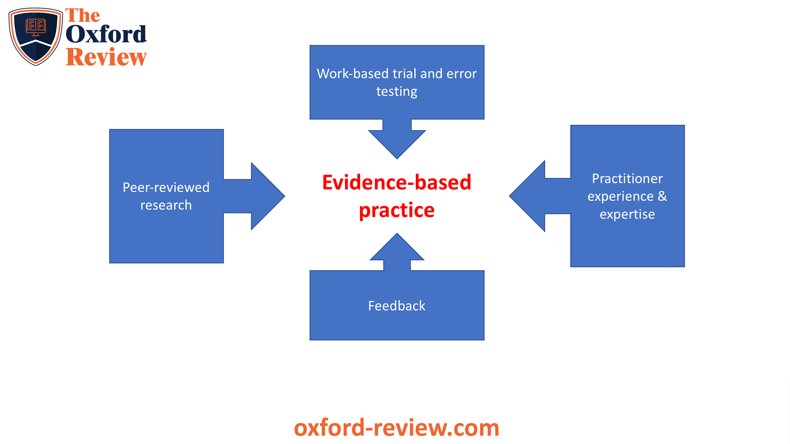
https://www.oxford-review.com/oxford-review-encyclopaedia-terms/evidence-based-practice/

Slide 8
Kolb’s Learning Cycle https://www.simplypsychology.org/learning-kolb.html

Slide 9
Definition and Scientific Approach
A discrete and evolved emotional experience
An organisational process involving:
Awareness of another person’s suffering or need
Making meaning of suffering in a way that contributes to a desire to alleviate it
Feeling empathic concern
Taking action
Seppälä et al. (2017) The Oxford Handbook of Compassion Science. Oxford University Press

Slide 10
Some Benefits of Compassion See Waddington (2019, p. 250)
Relationships based upon compassion are stronger, more positive and collaborative
Compassionate leadership results in stronger emotional commitment to the university / course
People working and learning in compassionate organisations are less likely to experience stress and burnout
Compassion also can help with growing trust between individuals and creates psychological safety
Compassionate cultures can result in improved innovation and creativity
Notes:
A Look At The Importance And Benefits
The definition of compassion clearly states the importance of the ‘action’ component in it. Unless we can express compassion through our behavior, the feelings cannot be conveyed. Organizations may have tremendously talented professionals who have uber experience in their field, but unless they greet others with respect, talk empathetically, or be able to internalize others’ pain, they cannot be as successful in their fields.
The benefits of being compassionate at work are vast. It guarantees a healthy flow of communication that has warmth and love in it and goes all the way to improve a company’s organizational health. A company indeed will succeed if it has employees and managers exhibiting these traits.
The Benefits Of Workplace Compassion
1. Employee Retention
One of the vital benefits of a compassionate workplace is employee retention. Employees who receive empathy, understanding and help from their colleagues and superiors are likely to stay in the organization for a long period of time and install all their efforts for the benefit of the organization. On the contrary, employees who are ill-treated or fail to receive any professional co-operation whatsoever will lose motivation to work productively.
2. Stress Reduction
Compassion creates space for active communication. Employees in a compassionate work atmosphere can vent out their professional troubles to each other and socialize in the office. It lets the stress get evened out and increase the likelihood of being more productive.
Working with compassionate and kind people give employees the chance to manage work stress and burnout and use their emotional resources to combat it (Figley, 1995; Lilius et al., 2011). Studies show that when people exchange positivity and bond with each other at work, their stress level significantly reduces.
3. Physical Well-being
A study on workplace health and well-being in 2008 revealed that employees who spent a few minutes interacting and mixing with their colleagues had steady blood pressure and heart rate.
Besides, their immune systems were well-functioning, making them less prone to take sick leave. Increased functioning also called for better work-life balance, and the employees had happier families and social life.
4. Interpersonal bonds
Leaders and managers who follow compassionate approaches at work, have highly reciprocating employees who work dedicatedly for the company. They tend to pay forward the goodness they receive at work by achieving the organizational targets. Besides, they also form healthy and strong professional relationships and feel comfortable to work as a part of the team.
Exchanging compassion promotes generosity and builds affective commitment of the workers towards their superiors and the institution as a whole (Eisenberger, 2006). When people perceive that they are valued and cared for by the organization, they automatically feel positive about their work commitments and voluntarily offer support and care to others they work with (Goetz et al., 2010).

Slide 11
What does compassion mean to you?
Responses to https://self-compassion.org/test-how-self-compassionate-you-are/
How compassionate are you?
Group plenary and sharing.
Padlet:
https://padlet.com/l_j_matthewman/xbew9i947paic1br

Slide 12
Looking to the Future: Implications for Learning and Teaching
The COVID-19 pandemic is set to significantly impact the way we teach, and who we teach, and a culture of self-serving individualism is wholly ill-suited to meet these challenges. A narrow focus on local issues can result in ‘inappropriate’ behaviours which can detrimentally affect the longer-term survival of the community. Collaboration, collegiality and compassion are essential to ensure the wider community’s longer-term evolution and survival.
Dermot Breslin: ‘Darwin, evolution and compassion in the 21st century university’. Ch 3 in:
Towards the Compassionate University

Slide 13
Part Two: Developing self compassion

Slide 14
As we begin this section I want to start with a reflective question What’s one thing that’s supporting you at this time?

Slide 15
Care & Compassion: An Evolutionary, Biopsychosocial Perspective
Notes:
15

Slide 16
Evolved ‘tricky’ brain and its problematic loops
New Brain
Imagination, Plan, Worry, Ruminate, Mentalisation, Self-monitor
Old Brain
Motives (food, sex, relationship seeking, caring, status)
Emotions (anger, anxiety, sadness, joy)
Behaviours (fight, flight, shut down, submission)

Slide 17
DRIVE, EXCITEMENT, VITALITY
CONTENT, SAFE, CONNECTED
Getting things done, winning, beating the rest.
Feeling safe, affiliative
Sense of wellbeing
Threat focused, protection and safety seeking
Three types of affect
regulation system.
From P. Gilbert (2009)
FEAR, ANGER, ANXIETY, DISGUST

Slide 18
Living in drive
Productivity, managing tasks, email mountain, meetings about meetings, innovation, profit margins, forecasting the future, the bottom line.

Slide 19
Living in Threat
Conflict, mistakes, uncertainty
Job loss
Bullying

Slide 20
Drive
Affiliation
Threat

Slide 24
Growing our compassion practice can help

Slide 25
The MindfuL Self Compassion Model (Neff, 2013)
Mindfulness
Common Humanity
Self Compassion
Self-Kindness
Notes:
Ask what they think each of these concepts means?
We’ve all had failures and shame
It doesn’t mean I’m a bad person at the core
Noticing the present moment experience without trying to change it - I’m feeling angry, shame (8mins) (47mins)

Slide 26
Some definitions …
Mindfulness
“paying attention in a particular way; on purpose, in the present moment, and non judgmentally."
Jon Kabat-Zinn
Self compassion
“when we notice our own suffering, imperfections, failings, difficulties, or feelings of inadequacy - caring for ourselves as we would care for someone we love”.
Kristen Neff
Compassion
“deep awareness of the suffering of oneself and other living beings, coupled with the wish and effort to alleviate it”
Paul Gilbert
Common Humanity
“We are all connected, I don’t want to over-simply things but the suffering from the loss of a loved one is not dependent on nationality, ethnicity or religion - pain is pain and joy is joy”
Desmond Tutu
Notes:
A few minutes to reflect and write down some ideas - then 2mins to capture on the board (10mins)

Slide 27
How do you speak to a friend - when something’s gone wrong?
A specific event or time or the year?
How do you talk to them?
What tone of voice do you use?
What sorts of things do you say?
Notes:
4min - reflection
Small groups of 3 - 10mins to share insights
Large group reflections - 5mins
(70mins)

Slide 28
exercise - How do I speak to myself when something’s gone wrong?
Think of times of the year/week or a specific event?
How do you talk to your self?
What tone of voice do you use?
What are the feelings? Inadequacy, shame, threat
Maybe you notice a difference in how your body feels?
Notes:
4mins (51mins)

Slide 29
The two arrows - Your not alone…
Over -identification - downward spiral…..
The inner critic/internal monologue - what are we telling ourselves?
78% of us are significantly more compassionate towards others than ourselves (Neff 2010)
Notes:
Anyone get that? Wake up late, spill something, shitty email - downward spiral…
Is that surprising?
(3mins) (73mins)

Slide 30
Exploring compassion through writing
Part One: Which imperfections make you feel inadequate or cause you distress?
Part Two: Write a letter to yourself from the perspective of an unconditionally loving imaginary friend
Part Three: Feel the compassion as it soothes and comforts you
Could you try this with your team or students in mind?

Slide 31
Calming touch
It is so natural to offer comfort to a young child through supportive touch. A hug when they are upset, the healing rub of a knee when they fall over.
Touch can activate the care system and the parasympathetic nervous system to help us calm down and feel safe.
You can try this yourself as an adult.
It may feel a bit odd at first, but you’re your body isn’t listening to your judgemental thought it just responds to the physical gesture of warmth and care.
Our skin is an incredibly sensitive organ.
Research indicates that physical touch releases oxytocin, provides a sense of security, soothes distressing emotions, and calms cardiovascular stress. So why not try it?

Slide 32
Soothing touch exercise
You might like to try putting your hand on your body during difficult periods several times a day for a period of at least a week.
Hand-on-Heart
When you notice you’re under stress, take 2-3 deep, satisfying breaths.
Gently place your hand over your heart, feeling the gentle pressure and warmth of your hand. If you wish, place both hands on your chest, noticing the difference between one and two hands.
Feel the touch of you hand on your chest. If you wish, you could make small circles with your hand on your chest.
Feel the natural rising and falling of your chest as you breathe in and as you breathe out.
Linger with the feeling for as long as you like.

Slide 33
Some people feel uneasy putting a hand over the heart. Feel free to explore where on your body a gentle touch is actually soothing. Some other possibilities are:
One hand on your cheek
Cradling your face in your hands
Gently stroking your arms
Crossing your arms and giving a gentle squeeze
Gently rubbing your chest, or using circular movements
Hand on your abdomen
One hand on your abdomen and one over heart
Cupping one hand in the other in your lap
You can watch a video guiding you through the exercise by clicking on the link below
https://youtu.be/p2eRcdUEYa4

Slide 34
Taking a compassion break
Remember I asked you to identify that one thing that is supporting you right now
Use that to build compassion by taking a compassion break
Could you do this with people
Your team
Yourself

Slide 35
“You cannot wait for an untroubled world to have an untroubled moment.
The terrible phone call, the rainstorm, the sinister knock on the door—they will all come.
Soon enough arrive the treacherous villain and the unfair trial and the smoke and the flames of the suspicious fires to burn everything away. In the meantime, it is best to grab what wonderful moments you find lying around.”
Lemony Snicket

Slide 36
Part Three: Leading and working with teams compassionately
What does the compassionate workplace look like?
What is compassionate leadership of course teams?

Slide 37
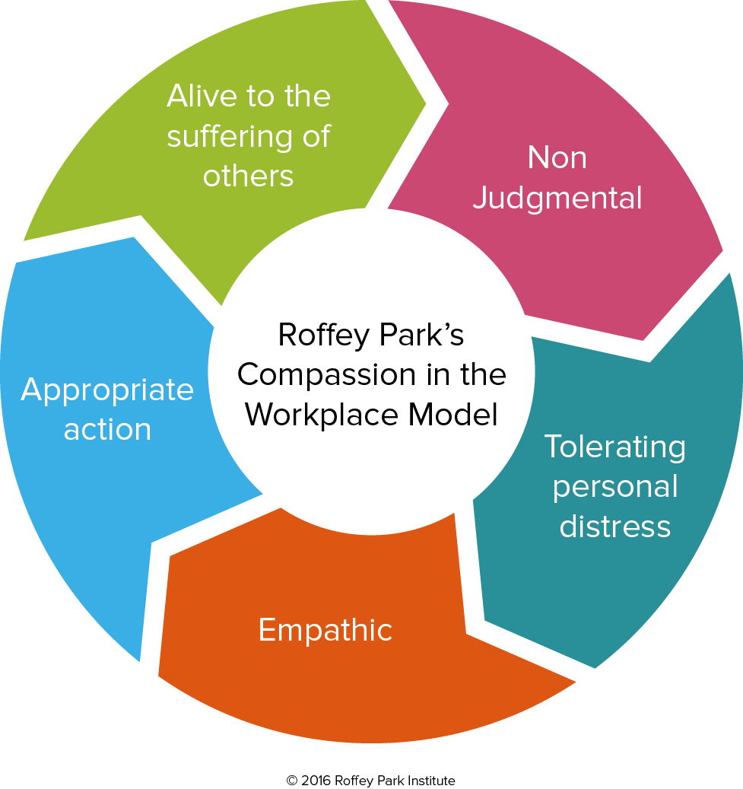
The Workplace
Compassion in the workplace
Roffey Park Institute
https://www.roffeypark.com/wp-content/uploads2/Compassionate-Leadership-Booklet.pdf

Slide 38
Thupten Jinpa – https://positivepsychology.com/compassion-at-work-leadership/
Compassion has three components:
Understanding or empathizing with others and their problems.
Loving and caring for others.
Selflessly helping others in need
Five aspects of compassionate leadership:
Awareness
Non judgmental
Resilient
Empathy
Accountable for team outcomes

Slide 39
Focus on self: Compassionate Leadership https://positivepsychology.com/compassion-at-work-leadership/
Is self-motivated and able to influence his employees positively.
Builds long-term trusting relationships and collaborations for his company.
Is morally strong and has an ethical code of conduct.
Takes responsibility for low employee productivity and aims to rebuild it.
Has the ability to make his team feel secure and comfortable at work.

Slide 40
The Team Focus
Holistic Business Psychology Approach-role modelling behaviours at course team meeting/module meetings
Mind: Build in one to one’s with each team member, use integrative/compassion focused coaching practices, be interested in team members development
Body: Team meetings/team building: regular meetings, one minute contemplation at start and end, emotional checkin…food to share, fun things
Build in explicit team building (informal or formal)
Open door-office hours for your team and walk the floor visit team members
Spirit: Self and team, What is the spiritual make up of your course team? Values and ethics of the team?
Positive psychology
Notes:
Holistic or integrative psychology is the study and practice of how to return to our natural wholeness as individuals. It is an integrated approach that addresses psychological wellbeing through connecting to and promoting the health of the body, mind and spirit. It integrates traditional and innovative psychological approaches from a systems perspective and additionally combines traditional healing paradigms from complementary therapy (The Association for Integrative Psychology, 2005). Such a systems orientated approach promotes interpersonal development, transformation and effective change in various ways by using psychological and western expertise along with the holistic and eastern philosophical influences. It brings about a theoretical and practical integration that includes all aspects of the person: physical, mental, and spiritual, within a physical and social context.
Leadership: Haskins, Thomas and Johri (2018) call for a more responsible form of leadership in business and society. They argue that the relationship between kindness and leadership is therefore a topic of fundamental importance for our well-being as individuals,
Strengths based coaching is a research based approach. ... An experienced strengths based coach helps you choose the most appropriate strengths for the situation, and helps you develop your weaker areas by applying your strengths to them. In summary, using a strengths based approach increases your motivation.
Solutions Focused Coaching Is A Powerful Approach. One really powerful approach to coaching is solutions-focused coaching. At its core is the focus on helping the coachee find solutions rather than problems, building on strengths rather than weaknesses and finding positive ways forward rather than examining barriers.
Body:
Spirit:
Ashmos and Duchon (2000) recognise the importance of spirituality at work as necessitating a recognition that people want to be involved in work that will give some meaning to their lives. It is this recognition of an inner life that nourishes and is nourished by meaningful work that takes place in the context of community”.
Karakas (2010) reports that a strong spiritual workplace can improve morale and commitment, well-being and productivity, creativity and fulfilment Karakas believes that spirituality enhances employee well-being and quality of life; b) Spirituality provides employees a sense of purpose and meaning at work; c) Spirituality provides employees a sense of interconnectedness and community.
Isles (2012, 2015, 2017, & 2017) explores ethical leadership, which she describes as leading by doing and knowing what is right. Coaching psychologists can use many techniques to help leaders and managers act and make decisions ethically and also lead ethically in their attitudes and interactions.
Positive psychology has been described in many ways and with many words, but the commonly accepted definition of the field is this:
“Positive psychology is the scientific study of what makes life most worth living” (Peterson, 2008).
To push this brief description a bit further, positive psychology is a scientific approach to studying human thoughts, feelings, and behavior, with a focus on strengths instead of weaknesses, building the good in life instead of repairing the bad, and taking the lives of average people up to “great” instead of focusing solely on moving those who are struggling up to “normal” (Peterson, 2008).
What Positive Psychology Focuses on in a Nutshell
Positive psychology focuses on the positive events and influences in life, including:
Positive experiences (like happiness, joy, inspiration, and love).
Positive states and traits (like gratitude, resilience, and compassion).
Positive institutions (applying positive principles within entire organizations and institutions).
As a field, positive psychology spends much of its time thinking about topics like character strengths, optimism, life satisfaction, happiness, well-being, gratitude, compassion (as well as self-compassion), self-esteem and self-confidence, hope, and elevation.

Slide 41
In Practice
HBR Quiz:
https://hbr.org/2018/05/assessment-are-you-a-compassionate-leader
Are you a compassionate leader?
How can develop your compassionate leadership style?
Padlet:
https://padlet.com/l_j_matthewman/xbew9i947paic1br
What can you do to cultivate a more compassionate orientated team?
Group plenary and sharing.

Slide 42
CIPD webinar series (More value on face to face)
1.Maintain a regular pulse of communication – even if there is little to say
2. Try out new channels – and be prepared to get things wrong and adapt
3. Change your behaviour – new circumstances mean new rules
4. Remember to communicate the big picture – to give progress and context 5. Conversation is key – to build connection and trust
6. Share stories – to make things human and build community
7. Make feedback a priority – what’s working and how people are getting on

Slide 43
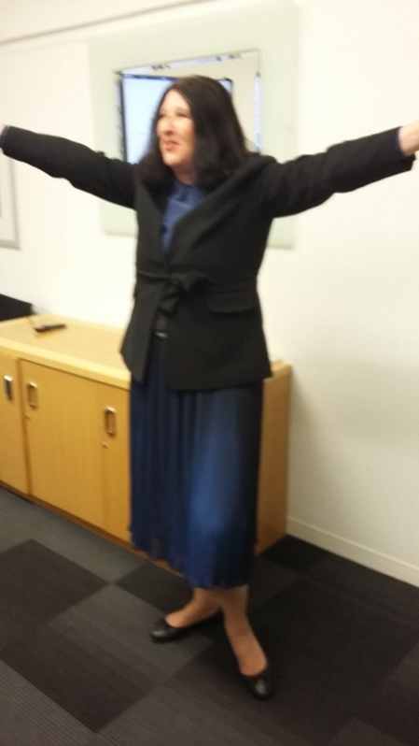
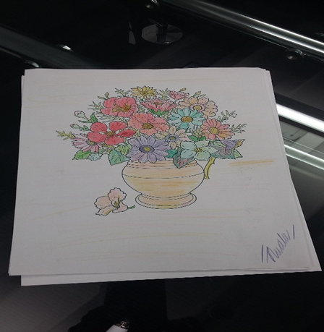
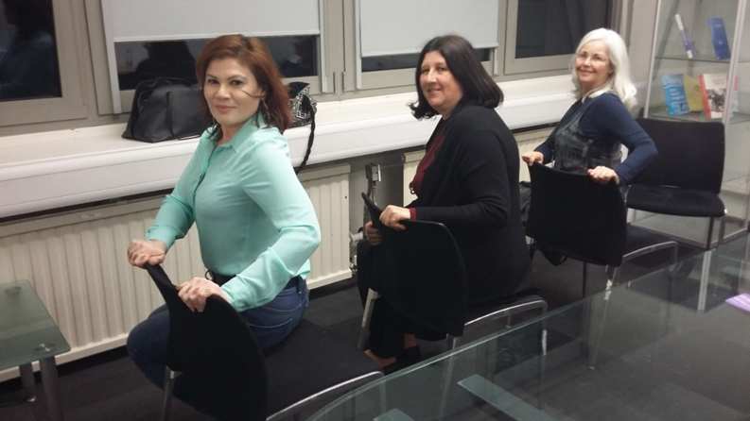
Notes:
Mindful moment ( 5 minutes) ? any ideas??
Five Senses Exercise
This exercise is called “five senses”, and provides guidelines on practicing mindfulness quickly in nearly any situation. All that is needed is to notice something you are experiencing with each of the five senses.
Follow this order to practice the five senses exercise:
Notice five things that you can see.
Look around you and bring your attention to five things that you can see. Pick something that you don’t normally notice, like a shadow or a small crack in the concrete.
Notice four things that you can feel.
Bring awareness to four things that you are currently feeling, like the texture of your pants, the feeling of the breeze on your skin, or the smooth surface of a table you are resting your hands on.
Notice three things you can hear.
Take a moment to listen, and note three things that you hear in the background. This can be the chirp of a bird, the hum of the refrigerator, or the faint sounds of traffic from a nearby road.
Notice two things you can smell.
Bring your awareness to smells that you usually filter out, whether they’re pleasant or unpleasant. Perhaps the breeze is carrying a whiff of pine trees if you’re outside, or the smell of a fast food restaurant across the street.
Notice one thing you can taste.
Focus on one thing that you can taste right now, in this moment. You can take a sip of a drink, chew a piece of gum, eat something, or just notice the current taste in your mouth or open your mouth to search the air for a taste.
This is a quick and relatively easy exercise to bring you to a mindful state quickly. If you only have a minute or two or, for whatever reason, you don’t have the time or tools to try a body scan or fill out a worksheet, the five senses exercise can help you or your clients bring awareness to the current moment in a short amount of time.
Chair Yoga
https://www.youtube.com/watch?v=GzkfOKkIteA
Mind Body Spirit Approach
a) Exercise
b)
c) https://www.youtube.com/watch?v=GzkfOKkIteA
d)
e)
f) Music for the mindfulness colouring
g)
h) https://www.youtube.com/watch?v=rftzxqY3hqM
Bijelo Dugme - Ne gledaj me tako i ne ljubi me vise
TRY TO ARRIVE ON TIME
http://www.bbc.com/capital/story/20170209-why-some-people-are-always-running-late

Slide 45
Reading
Waddington, K. (Ed.) (forthcoming 2020)
Towards the Compassionate University: From Golden Thread to Global Impact. Routledge
Waddington, K. (2019) Understanding and creating compassionate institutional cultures and practices. Ch17 in Gibbs et al. Values of the University in a Time of Uncertainty. Springer. Available as e-book
J. of Perspectives in Applied Academic Practice (2018). Vol. 6, No. 3: SI on Compassionate Pedagogy:

Slide 46
Kathryn
'Compassion Gap in UK Universities' paper which I mentioned at the beginning, it also mentions leadership development: https://www.fons.org/Resources/Documents/Journal/Vol6No1/IPDJ_0601_10.pdf

Slide 47
Developing Self Compassion Exercises Neffs self compassion practices online https://self-compassion.org/# https://self-compassion.org/category/exercises/
Learn about what compassion is, what it isn’t, and its benefits to yourself and others.
Practice self-compassion. Recognise the inevitability of suffering, notice your own, and treat yourself with the same kindness, care and understanding you might treat another.
Listen with more empathy. Imagine things from the other person’s perspective and communicate this attempt at understanding.
Spend time during your day – perhaps during any mindfulness practice, or when travelling or working – silently wishing other people well, wishing them happiness and freedom from suffering.
In seated practice, cultivate feelings of compassion for things which are easy, for example, people you love, close friends and relatives, loved pets, etc. Then extend this ‘circle of compassion’ towards mere acquaintances and strangers. And then, perhaps, to people you actively dislike.
Increase your acts of kindness to others. Help people to do things that they cannot or might struggle to do for themselves. Try to be helpful, rather than harmful.
Try and shift from a self-focus to a systems focus, recognising yourself as part of a much larger connected biological system in which cooperation commonly results in better outcomes.
Continuously hone your skills and abilities around noticing, approaching, alleviating and preventing suffering in yourself and others – such as non-judgement, empathy, distress tolerance, courage and technical helping skills.
Notes:
For those who are wondering how to start, here are some simple hacks on how to show more compassion at work:
1. Self-compassion
All positive feelings should start with yourself. Unless you can show love and kindness to you as a person, you cannot prove it to anyone else. Start with regular activities such as giving a few compliments to yourself, forgiving yourself for any past mistakes, or focusing on your strengths and capabilities more than your shortcomings.
2. Communication
The key to being compassionate work is a sound communication pattern. Whether it is a team member, a supervisor, or a client, communicate openly and express yourself clearly to others. At the same time, lend your ears to anyone who wants to confide in you and listen with patience and neutrality at all times.
3. Contact
Only if it is appropriate to do so, you can rely on expressing your compassion by establishing a gentle physical contact with the sufferer. A gentle pat on the back, eye-contact, or holding the hands while listening to his sorrows are powerful NVCs (nonverbal cues) that express compassion and empathy.
4. Encouragement
Compassion gets reflected by verbal encouragement and motivation. You can practice compassion at the workplace by continuously supporting and cheering others for their hard work and achievements. You may never know when your words will start reinforcing them positively and bring about favorable changes, but keep on encouraging them.
5. Initiation
Whether it is by providing personal support, exchanging feedbacks, or expressing your opinions, if you are a compassionate worker, be prepared to take the first move. Compassionate leaders and workers set an example to the entire work fraternity by their sense of responsibility and openness to others.
6. Thoughtfulness
Be aware of the emotions and thoughts of others. How your words might affect your colleagues, subordinates or your clients should be your prime concern. You can work on building general awareness by careful observation at the workplace, organizing meetings and feedback sessions at regular intervals, or one on one conversations that can help in gauging the mental state and level of engagement in the person.

Slide 48
Online/e readings
https://www.roffeypark.com/wp-content/uploads2/Compassionate-Leadership-Booklet.pdf
Https://positivepsychology.com/compassion-at-work-leadership/
https://jpaap.napier.ac.uk/index.php/JPAAP/issue/view/23
https://hbr.org/2016/12/the-most-and-least-empathetic-companies-2016
https://thepsychologist.bps.org.uk/volume-33/may-2020/compassion-essential-orientation
https://jpaap.napier.ac.uk/index.php/JPAAP/issue/view/23
https://hbr.org/2016/12/the-most-and-least-empathetic-companies-2016

Slide 49
TEAMS TOOLKIT
https://www.uxbooth.com/articles/three-exercises-to-teach-your-team-empathy/
https://oscarkilo.org.uk/wp-content/uploads/2017/12/Compassion-at-Work-Toolkit-FINAL-5-December-2017.pdf

