Slide 1
Students as Co-Creators’ spring seminar series
Introduction to the Pedagogies for Social Justice project
Kyra Araneta
University of Westminster

Slide 2
The ‘Pedagogies for Social Justice’ project
Why this project?
Brought to you by a student-staff partnership; a part of the Centre of Education and Teaching Innovation (CETI) at the University of Westminster.
Our current tools: reading lists, podcast, glossary and study group
Other elements: multidisciplinary steering group
Our aims
To centre student voices and the values, beliefs and experiences that accompany them in order to dismantle contemporary forms of coloniality in curricula, relationships and research
To unravel assumptions about curricula, critically examine its contents and imagine new ways of learning together​
To create spaces that facilitate horizontal learning, ideation and dreaming

Slide 3
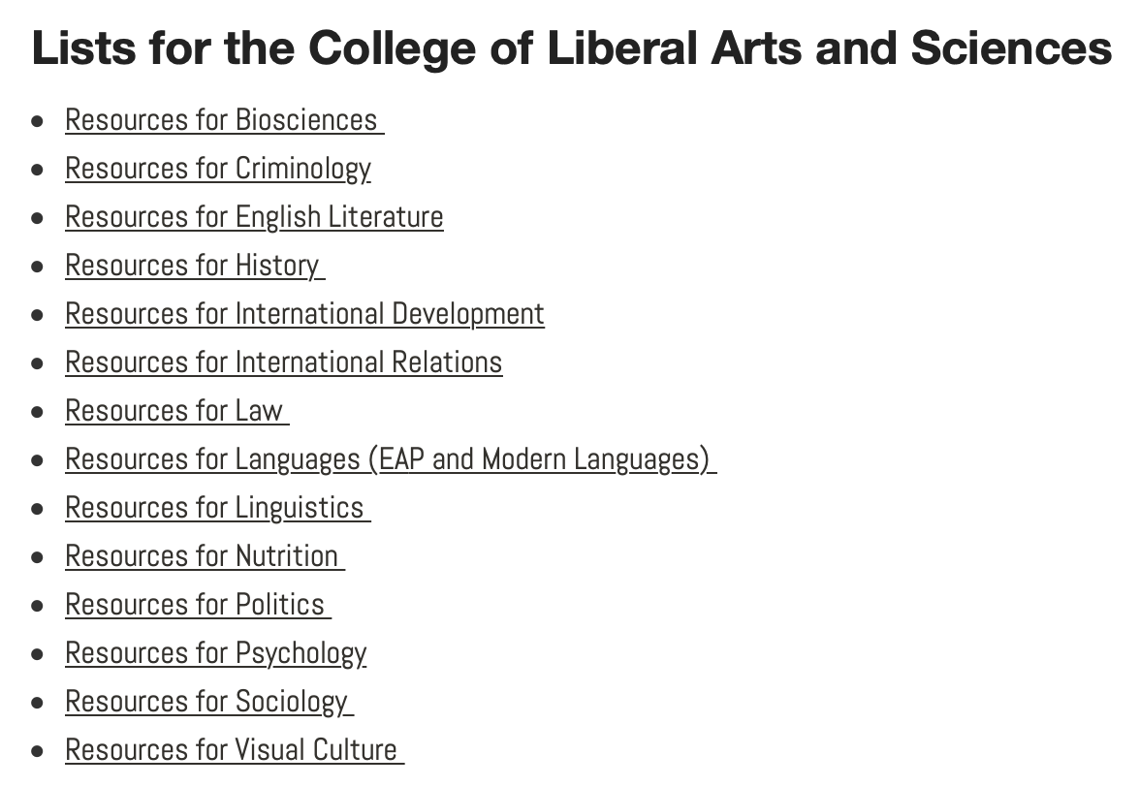
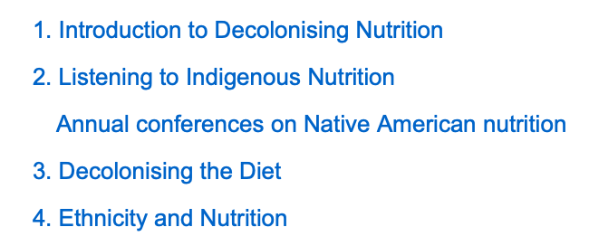
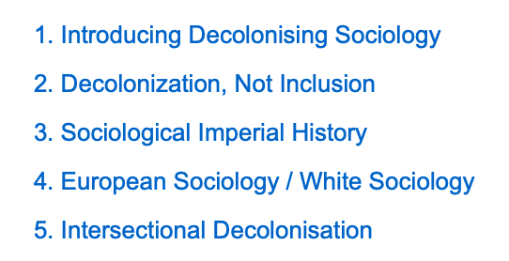
Reading lists
Categorised by discipline, subject area or area within the institution.
i.e. Decolonising Law – Differentiation and Discrimination; Feminism and Law; Restorative Justice and Reparations; ﻿Self-determination.
Aims to provide students and staff with resources to begin thinking about and engaging in decolonising learning and teaching.
Compiled by both students and staff at the university.

Slide 4
Glossary
Podcast
Aims to centre discussions on topics such as anti-racism and decolonisation as a means of exchanging and generating pedagogical practices and remedies.
Invites students, lecturers and external speakers from the educational community to discuss and reflect on their work, activism and knowledge.
Structured as an A-Z list of terminology that offers definitions, historical context, further reading, and guidance for using some of the terms.
Dedicated to students and staff interested in further developing their knowledge and pedagogy by recognising how terms impact their own and other’s lives in the context of academia.
A student-led project

Slide 5
Decolonisation and Anti-racism (DAR) study group
Facilitates the analysis and discussion of certain texts and media to help members develop their understanding of race, coloniality and oppressive educational systems.
Invites both students and staff from all levels of understanding of decolonial and anti-racist work.
Learning
Home
Decolonial and anti-racist research

Slide 6
‘A decolonial space, however, becomes a rebellion against the white, colonial university. It is a place of disrupting power, hierarchy and authority, through the “healing” of staff and the growing consciousness of students together and not in separation. This allows for a decolonial space to then be a space of continuing resistance through re-existence rather than only struggling against colonial university logics ranging from silencing to co-optation’
Raza Memon, A., & Jivraj, S. (2020). Trust, courage and silence: carving out decolonial spaces in higher education through student–staff partnerships. The Law Teacher, 54 (4), 475-488.

Slide 7
Are you seeking transformation and long term engagement or short term changes and one-off transactional relationships?
How do you usually respond to having your assumptions or practices challenged?
How many of your relationships in the university are balanced, reciprocal and non-extractive?
What brings you here today? Why is this work important to you?
How can you share responsibility and leadership with your students?
What kinds of colonial assumptions and attachments might be blocking you from engaging in decolonisation?
What kind of learning/unlearning are you willing to do?
What perspectives are present in your curricula? Which are absent?
Some questions to think about...

Slide 8
Links and contact information
To see our website and ways to follow the project:
http://blog.westminster.ac.uk/psj/
To watch our seminars about ethical and decolonial partnerships:
http://cti.westminster.ac.uk/student-partnership-resources/
To listen to conversations about decolonising the curriculum with both students and lecturers:
https://anchor.fm/student-partnership
To read discipline-specific and general reading lists about decolonising higher education:
http://blog.westminster.ac.uk/psj/tools/reading-lists/
If you have any questions about the project, email Dr Jennifer Fraser (University Director of Student Partnership, Centre for Education and Teaching Innovation and Principal Lecturer, School of Social Sciences) at j.fraser@westminster.ac.uk
Follow and interact with us via Twitter: @PSJproject

