Slide 1
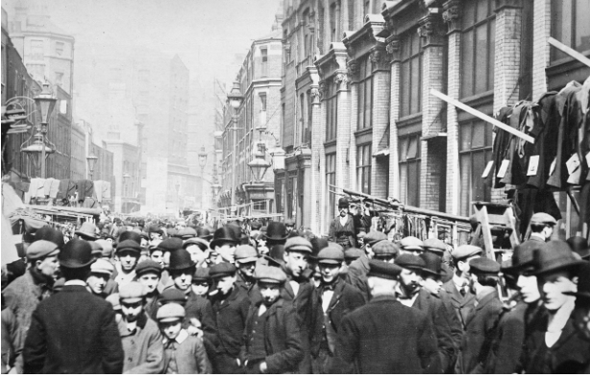
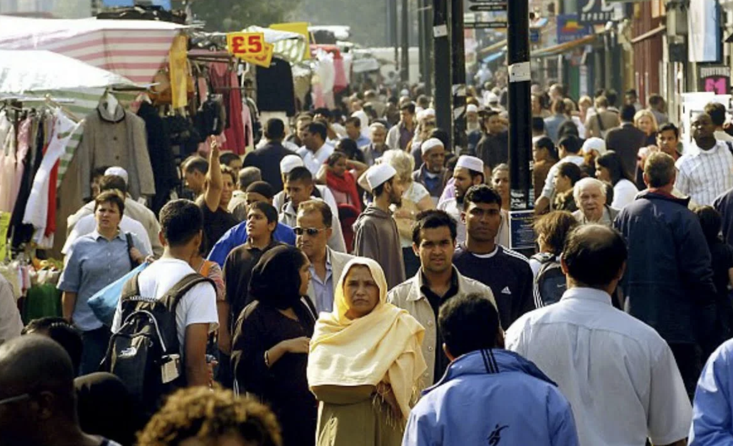
London’s East End: Immigration and Development

Slide 2
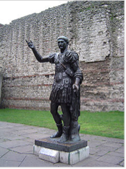
London: East End
Covers the districts to the east and outside the medieval (5th-15th centuries) walled City of London; north of the Thames
Grew out of villages clustered around City walls, marshes and Thames
Defensive wall: built by Romans around London; retained until 18th century.
East End includes Whitechapel, Stepney, Shoreditch, Tower Hamlets and Hackney
Roman Wall in Tower Hill

Slide 3
East End: brief history
Immigrants since 17th century have included: French Protestants (Huguenots); Irish weavers; Ashkenazi Jews; Bangladeshis; Somalis
Immigrants worked in: clothing industry; traded; money lending.
Low wages and poor conditions led to protest
Social reformers and revolutionaries active in East End from mid-18th century
An important place for formation of Unions and workers associations
Area developed rapidly in the 19th century
Inhabitants provided services for the Royal Navy
Construction of docks of 1799—1815
Rural population came looking for employment
East End political radicalism contributed to the formation of the Labour Party.

Slide 4
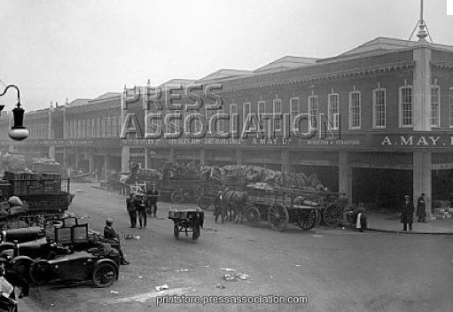
Spitalfields: the beginning
‘Spitalfields’: name derives from that of a medieval hospital on this site, ‘The priory of St. Mary of the Spittle’.
Relatively rural area until the Great Fire of London (1666)
Late 17th century: slowly becoming a suburb of London

Slide 5
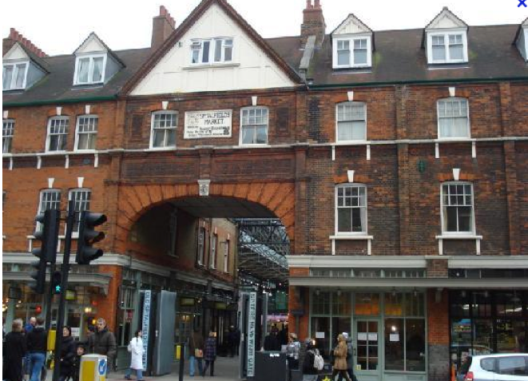
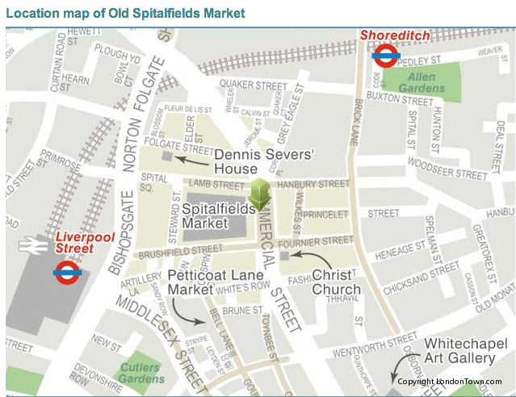
Old Spitalfields Market

Slide 6
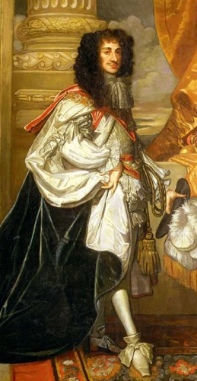
Old Spitalfields Market
1682 – King Charles II grants John Balch a Royal Charter to hold a market on Thursdays and Saturdays in Spital Square
This encourages more people to move to and settle in the area
Today’s building constructed in 1880s

Slide 7
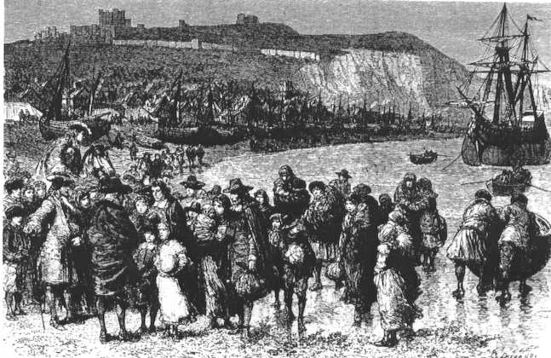
Huguenots: ‘asylum seekers’ and labour migrants
1670--1710: Huguenots – members of the Protestant Reformed Church of France – arrive in England
Fleeing religious persecution in France: ‘asylum seekers’
Some 25,000 came to London; many of these to Spitalfields
Also fled to Wales, Ireland, Denmark, Switzerland,etc
Brought with them silk-weaving skills;
Silk industry thrived: Spitalfields became known as ‘weaver town’

Slide 8
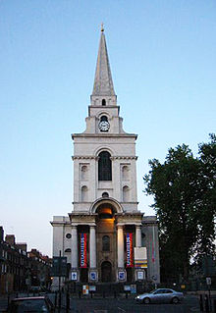
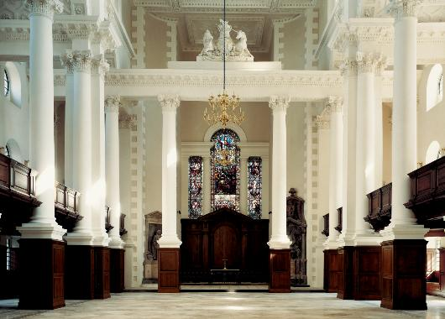
Christ Church Spitalfields
By 1700: nine Huguenot churches in Spitalfields
Fears about the large numbers of religious ‘non-conformists’, including Huguenots in the area
12 new Church of England churches built to combat non-conformism
Stipulated that they must have tall spires – to rise above non-conformist chapels!
Christ Church Spitalfields one of these: built by Nicholas Hawksmoor

Slide 9
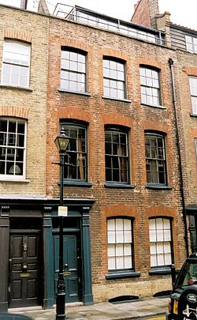
Fournier Street
Houses built mainly in 1720s
Built for Huguenot master silk-weavers and mercers (textile merchants)
One of the best preserved collections of early Georgian town-houses in Britain

Slide 10
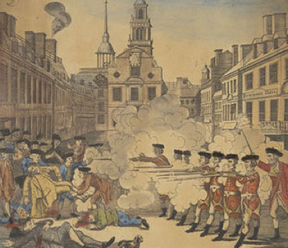
Irish labour migration
From 1730: Irish weavers arrive to work in silk trade
Long working hours for little money forced them to organize illegal trade unions
Frequent riots and other protests against wages and working conditions
1769: Spitalfields Riots: soldiers try to arrest an entire meeting of weavers; meet resistance; fire on weavers
Two men hanged, one Irish; one Huguenot

Slide 11
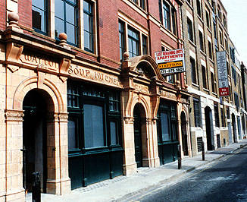
Jewish immigration: seeking work and asylum
1881—1914: over 2 million Jews flee economic hardship and brutal persecution in Russia and Eastern Europe.
120,000 come to England; many to Spitalfields
By 1900 Jews are 95% of the population in the Wentworth Street district of Spitalfields
As they grew wealthier, Jews moved to suburbs like Golders Green and Hendon
Jewish community now almost entirely gone

Slide 12
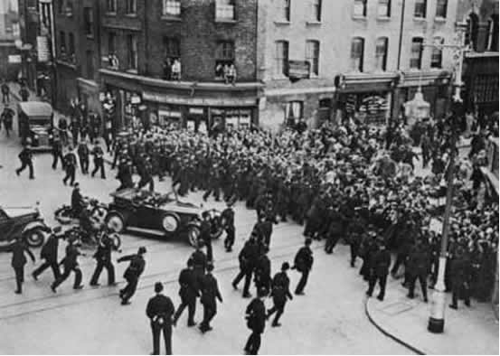
Jewish immigration: seeking work and asylum
Jews – unlike Huguenots – not warmly welcomed
Jewish immigration prompted first UK law designed to limit immigration: the Aliens Act (1905)
In 1930s: British Union of Fascists (led by Oswald Moseley) stoked anti-semitic prejudice
1936: Battle of Cable Street:
Anti-fascists fought the Metropolitan Police
The police wanted to ensure that British Union of Fascists could march through the East End
The protests led to the march being called off

Slide 13
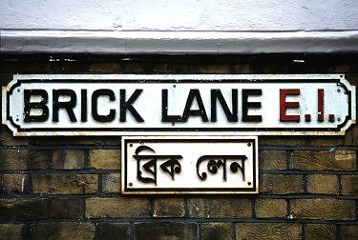
Bangladeshi immigration
Immigrants from what is now Bangladesh came to East London as early as late 1600s
Sailors (lascars) on East India Company merchant ships
Significant Bengali migration to England from 1960s
Migration driven by search for work
And for security: upheavals of Partition in 1947 – creation of Pakistan and India – and of 1971 war, which created Bangladesh
Pakistan, and Bangladesh, part of Commonwealth: British Nationality Act 1947 gave Commonwealth citizens right of entry to UK
Later acts restricted entry

Slide 14
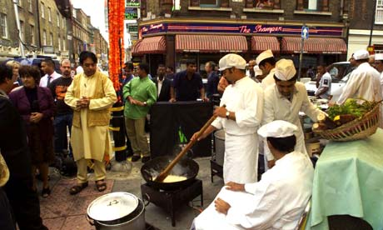
Bangladeshi community
Early arrivals mainly single working men
Joined later by families
Many Bangladeshi immigrants settled in and around Brick Lane; as well as to the east of the area
Most originate from the Sylhet region in north-east Bangladesh

Slide 15
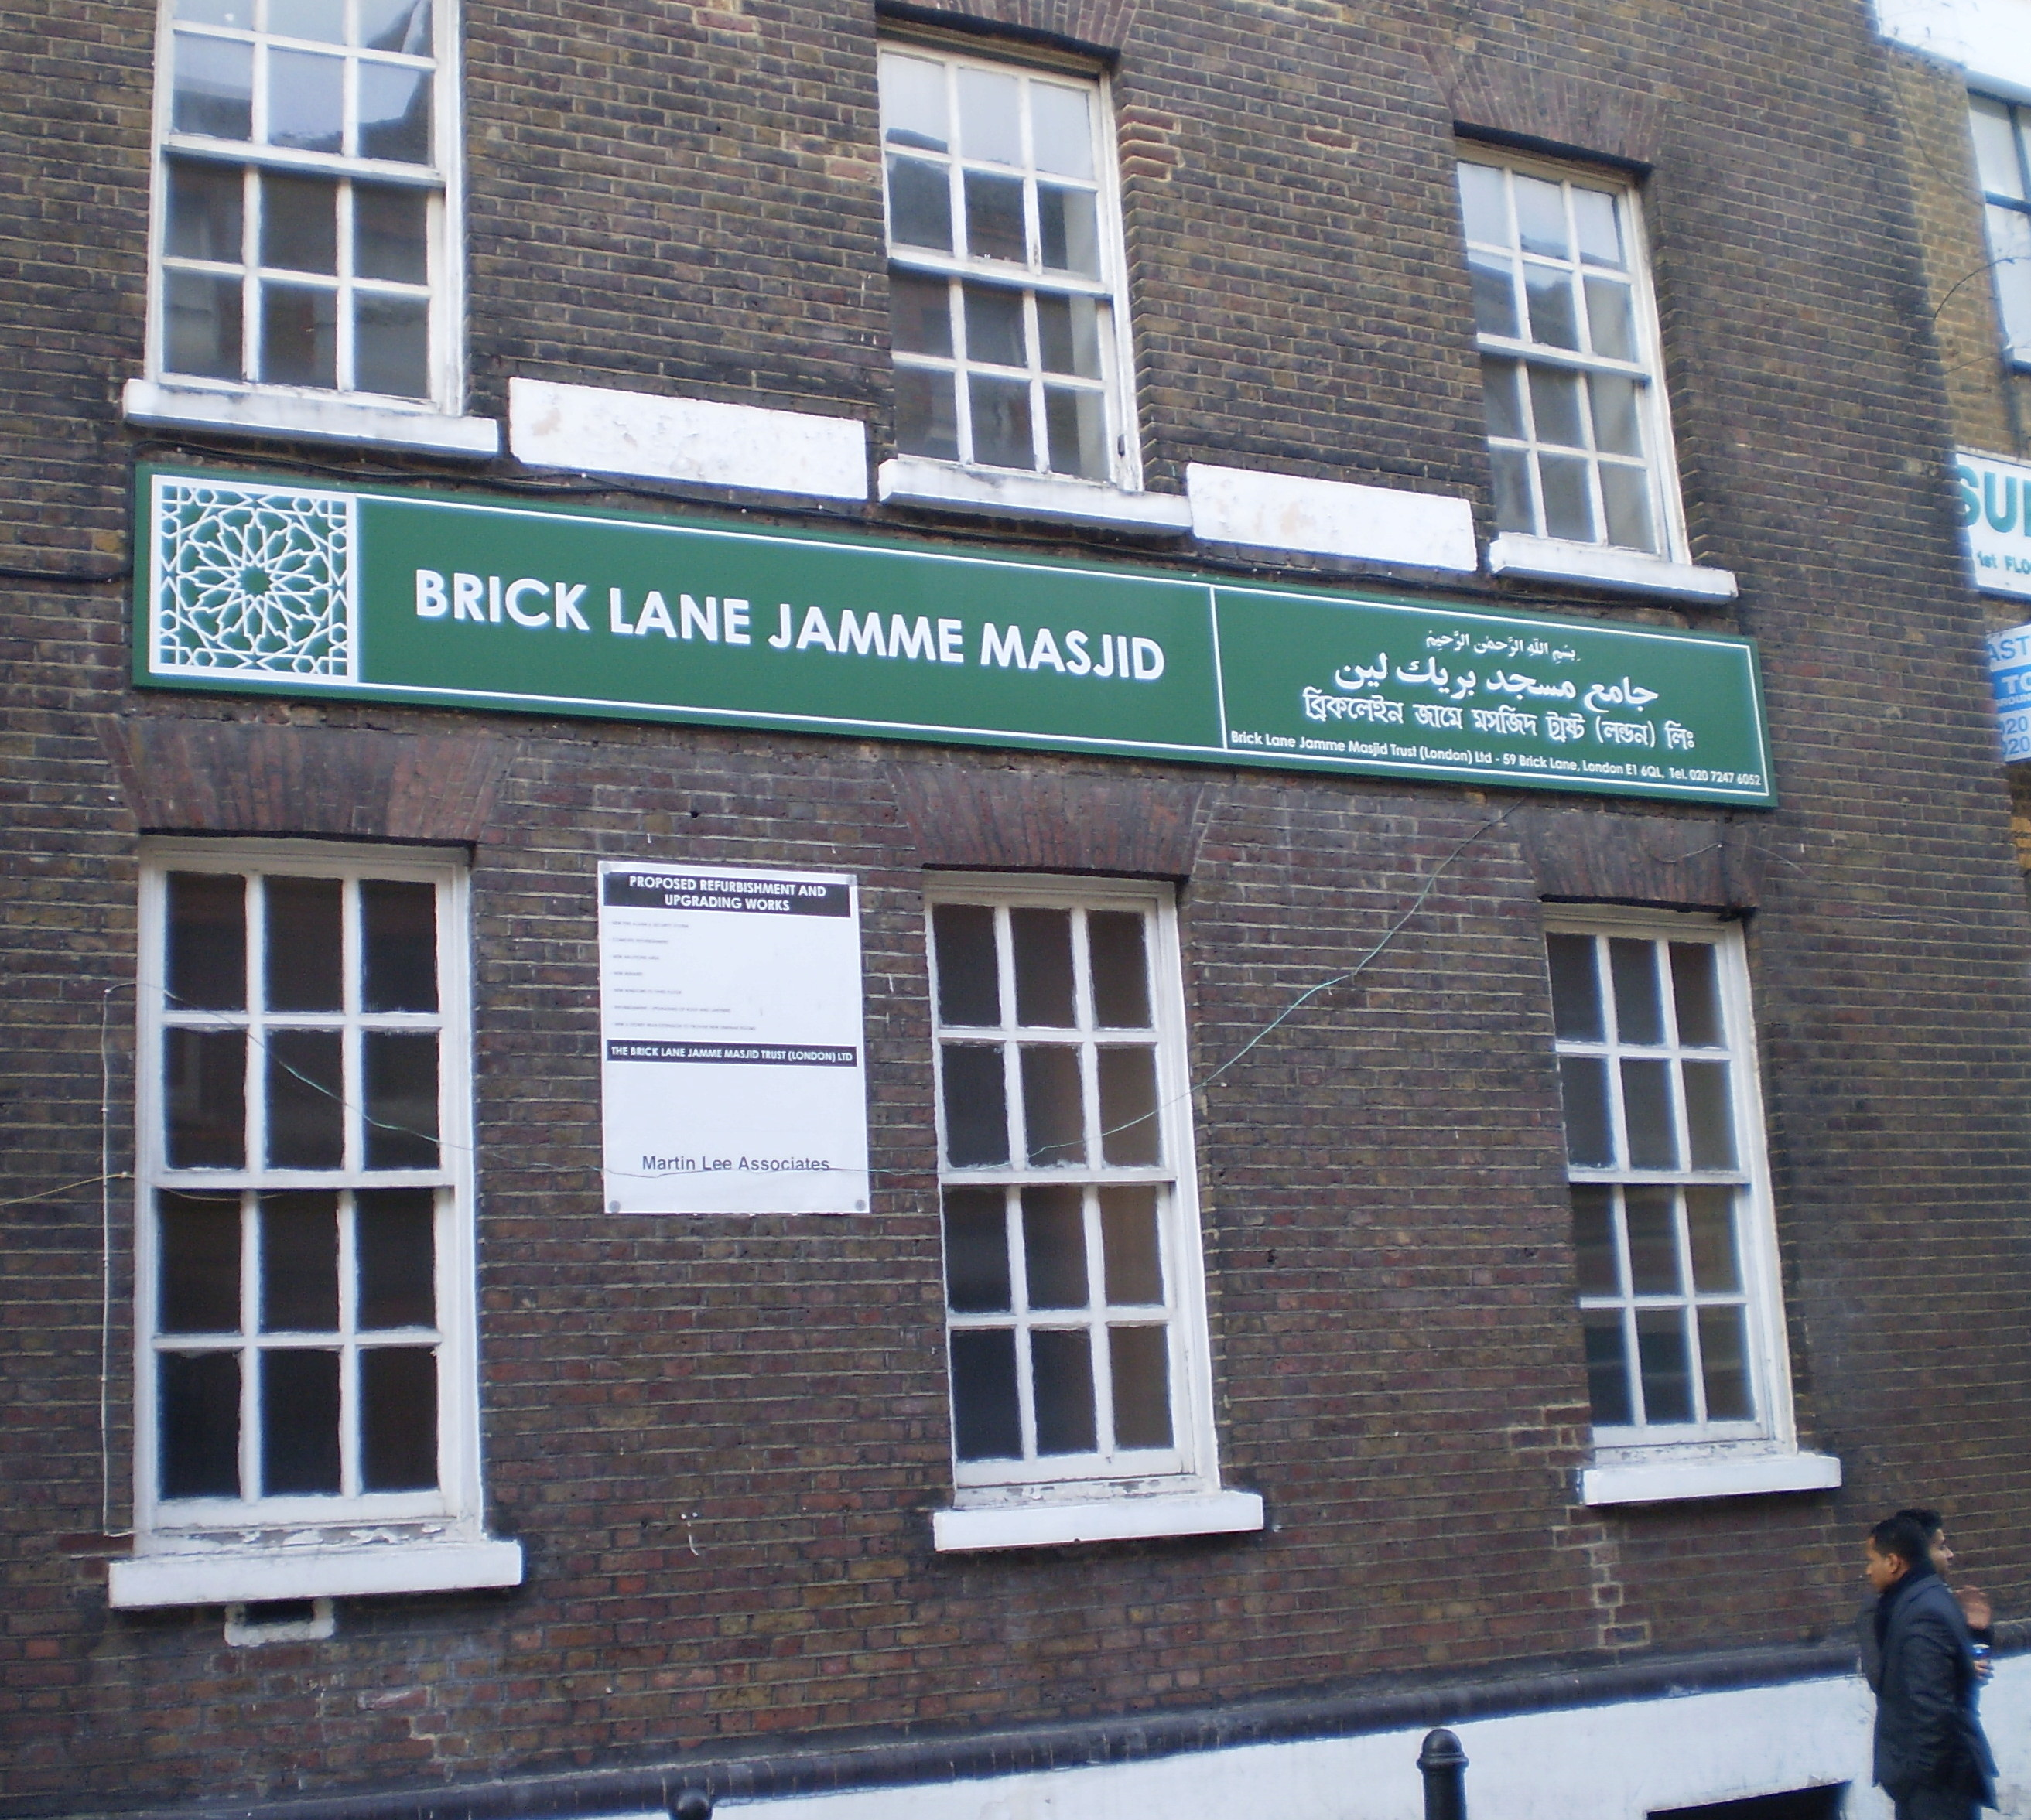
Bangladeshi community
Size of Bangldeshi community led to area being named ‘Banglatown’
2001, 68 per cent of the population of the Spitalfields and Banglatown ward was of Bangladeshi origin

Slide 16
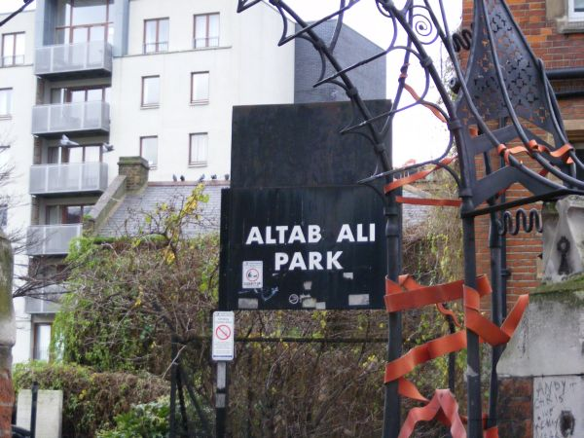
Bangladeshi community
Migration from ‘New Commonwealth’ countries (eg, India, Bangladesh, Jamaica) helped prompt restrictive legislation:
Eg, Immigration Act 1971
Bangladeshi, and many other ‘New Commonwealth’ immigrants, in London and elsewhere, have been the target of racial prejudice and hostility
The 1970s saw increasing attacks by the far right National Front
One such attack resulted in the murder of Altab Ali in 1978

Slide 17
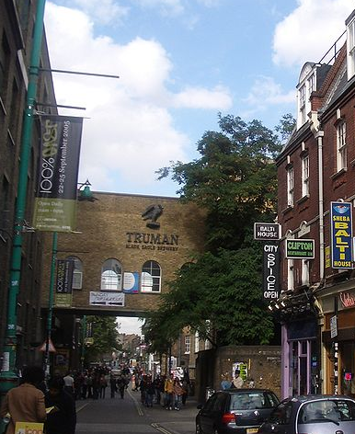
The Truman Brewery
Formerly the Black Eagle brewery
Brewing on this site began in 1666
Huguenot immigrants made a significant contribution to the brewery:
Helped create a popular dark beer called porter

Slide 18
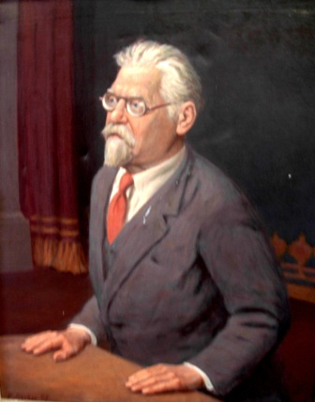
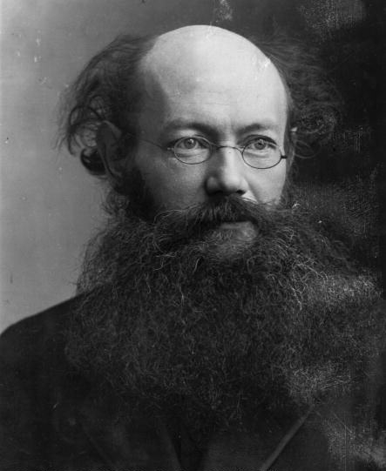
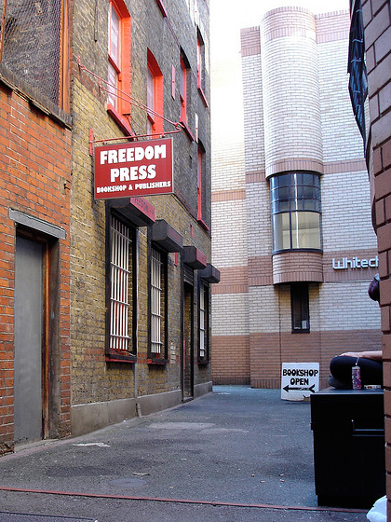
Anarchist immigrants to the East End
In 1898, Rudolf Rocker, a German non-Jewish anarchist who settled in the East End, became editor of the radical Yiddish paper, Arbeter Fraynd (Worker's Friend)
In 1886, the Russian anarchist Peter Kropotkin, living in exile in Britain, helped found the anarchist publisher and bookshop, Freedom Press, just off Whitechapel High St. It still operates today.

Slide 19
Reflect on these questions:
What have been the drivers of migration to the Spitalfields area?
What can the history of this area tell us about how immigrants have ‘integrated’?
How should development be understood now?
In what way migration enhance development?
Does East London represent a globalised world: culture, economics and politics? If so, what are the symbols or indicators of this globalised world?

