Slide 1
Library and Archive Services
Introduction for Doctoral Researchers
Ka-Ming Pang
Academic Engagement Librarian

Slide 2
How we support Doctoral Researchers
Signposting you to online guides for information on:
Access to collections and resources
Search tools
Training and advice
Specialist staff

Slide 3
Getting Started

Slide 4
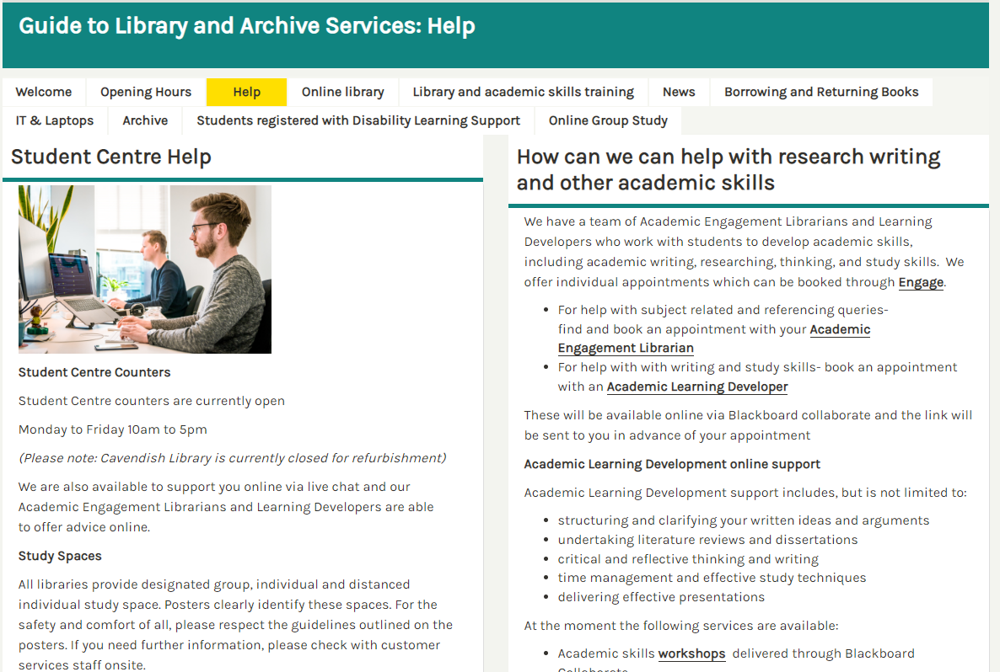
Guide to Library and Archive Services
https://libguides.westminster.ac.uk/libraryisonline
More comprehensive guide
Opening hours
Links to online resources for research and academics skills
Access workshop recordings

Slide 5
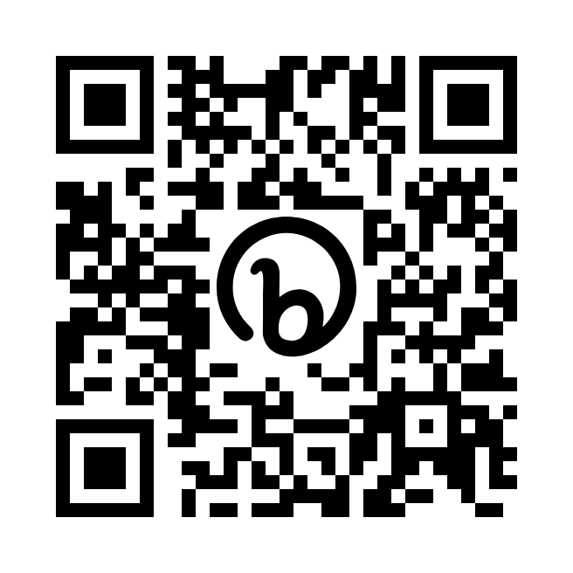
Library Guide for DRDP
bit.ly/uowdrdp
Find out how to keep track of current research
Know where to get help for your Research Data Management Plan
Learn more about how writing Literature Reviews
Get started with Literature Search and Research Methods

Slide 6
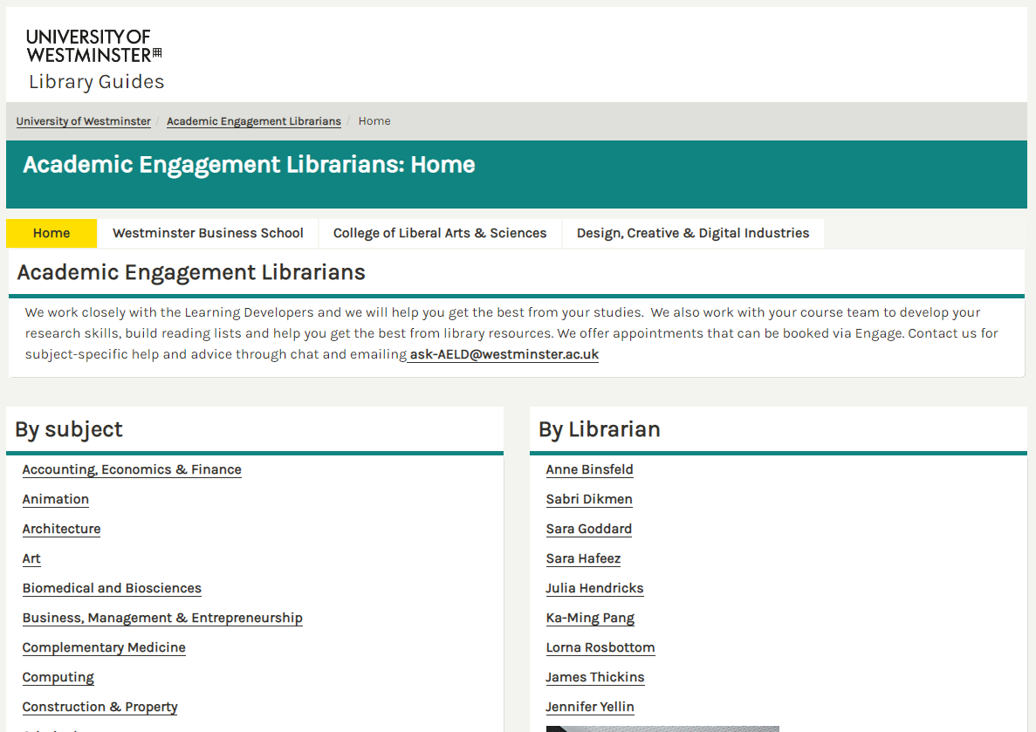
The Academic Engagement Librarians
https://libguides.westminster.ac.uk/academicliaison
1-2-1 appointments
Workshops
Subject support – Literature Searching
Reference Management
Top Tip!
The subject guides contain information about resources relevant to your subject area and points you to the most relevant databases.
Notes:
Subject specialist
Available for 121s
As well as the DRDP workshops we can provide ongoing help and support
Workshops will give you a firm basis for your research BUT general
For subject support, make sure you contact you Liaison Librarian for an individual consultation
Academic Liaison Librarians – Key contacts

Slide 7
WHAT CAN YOUR LIBRARIAN DO FOR YOU?

Slide 8
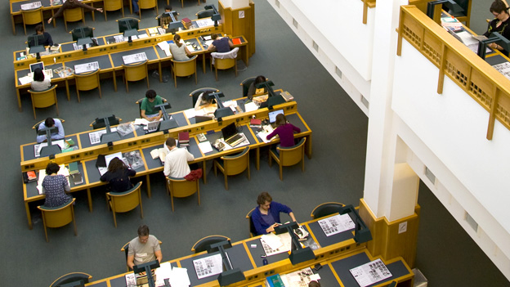
Accessing Other Collections
SCONUL Access scheme
The SCONUL Access scheme allows you to visit a range of other academic libraries for reference and, in some cases, to borrow items too.
Inter Library Loans
Use to request an item that we don’t have in our own collections
British Library
Contact your Academic Engagement Librarian for help and advice on accessing other collections
Notes:
The SCONUL scheme is a reciprocal scheme where Higher Education libraries offer access to

Slide 9
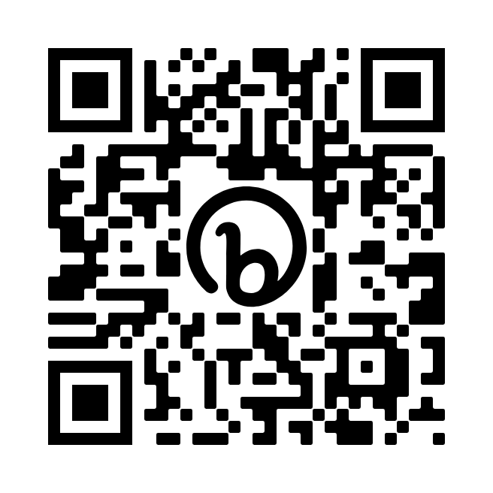
Values 101
Deepen your understanding of the research and teaching cultures in which we work.
Join this online programme of 5 two-hour interactive workshops to:
Explore the relationship between our values and the research and learning culture in which we work
Have an opportunity to network and engage with your colleagues, and spark ideas on how to bring personal values and institutional/research values into closer alignment
Date and Time – 5 weekly sessions starting:
Tuesday 31st October 2023
Time: 10-12pm
More details on Eventbrite page:
bit.ly/101values

Slide 10
Thank You
LIBRARY DRDP GUIDE
Contact Us: studentcentre@westminster.ac.uk

