Slide 1

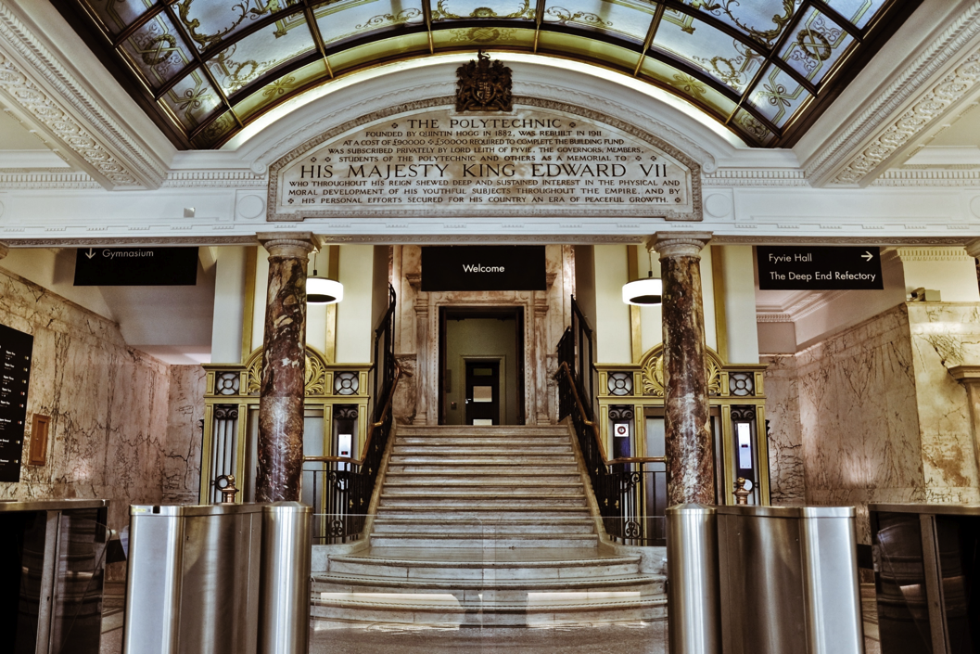
Welcome to the University of Westminster

Slide 2
Professor Leigh Wilson, Head of the Graduate School
l.wilson@westminster.ac.uk, Room 309, 309 Regent Street
https://www.westminster.ac.uk/about-us/our-people/directory/wilson-leigh
Office hours/doctoral tutor hours: Tuesdays 10-12, online
Dr Kristina Vasileva, Acting Deputy Head of the Graduate School
k.vasileva@westminster.ac.uk
https://www.westminster.ac.uk/about-us/our-people/directory/vasileva-kristina

Slide 3


Notes:
The new building opened by the King and Queen, 1911. Education and entertainment mission continues in 20thc
QHT

Slide 4
‘an institution where the Public, at little expense, may acquire practical knowledge of the various arts and branches of science connected with manufacturers, mining operations and rural economy.’
Prospectus, Royal Polytechnic Institution, 1838

Slide 5

Our Founders’ Mission
Open to all, open to the new
Education for the whole person
Grounded in life
‘Instruction and delight’
Notes:
Founded 1838, Sir George Cayley. Original building (site of 309 Regent St)

Slide 6
This is still our mission!

Slide 7
Being Westminster, 2022-29
‘Our excellence in research and knowledge exchange will infuse our education endeavour, inspiring and equipping our students as agents of change, locally as well as globally. We will continue to grow our community of PhD researchers, ensuring that the Westminster postgraduate research experience remains sector-leading and the foundation for great careers.’

Slide 8
REF 2021
More than 70% of outputs ranked as 3* or 4*
Over half our units of assessment have 100% of their outputs ranked as 4*, 3* and 2*
82.6% of our impact case studies ranked as 4* or 3*
Impact case studies submitted by Art and Design were ranked first nationally
Impact case studies submitted in Business and Management gained the 2nd highest score nationally
Politics and International Studies impact case studies scored 4th highest nationally
All our submitted units are now ranked at 100% 4*, 3* and 2* for research environment
100% of our Art & Design and English submissions were judged to enjoy a world-leading and internationally excellent research environment (ie 3* and 4*)

Slide 9
PRES 2023
18th out of 100 universities for overall satisfaction (83%)
In top 10 of those 100 universities for experience of progression and responsibilities
Number 10 of 100 universities for satisfaction with supervision
For more on the PRES results, see here.

Slide 10


