Slide 1
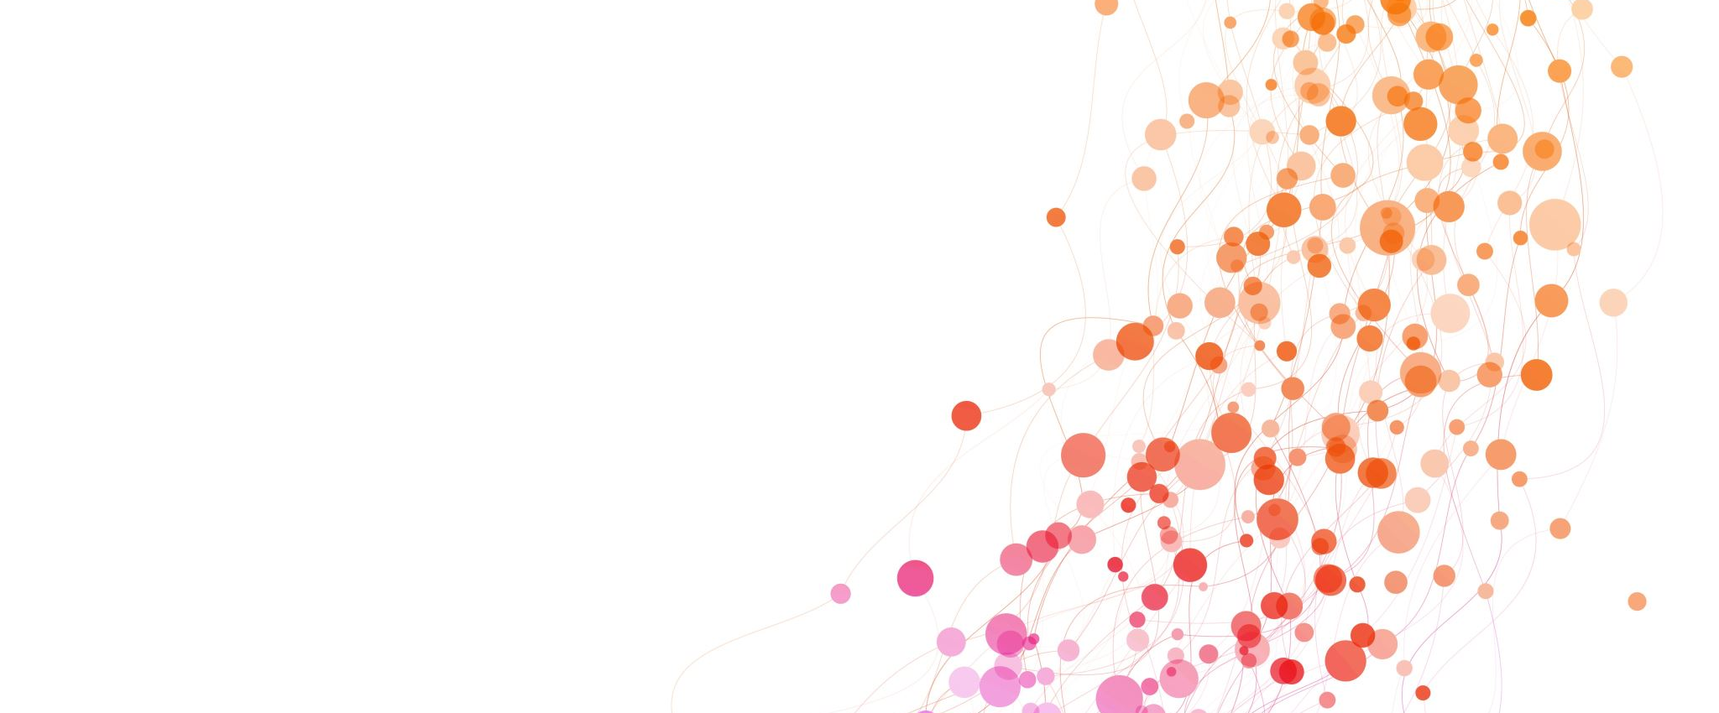
What’s involved in a PhD

Slide 2
The process
Propose
Research
Write the thesis

Slide 3
The actual process
Propose
Research
Write the thesis
Collaborate
Written communication
Budget
Grant writing
Social media
Network
Develop technical skills
Public speaking
Design
Plan
Teach
Manuscript preparations
Conferences
Problem solving

Slide 4
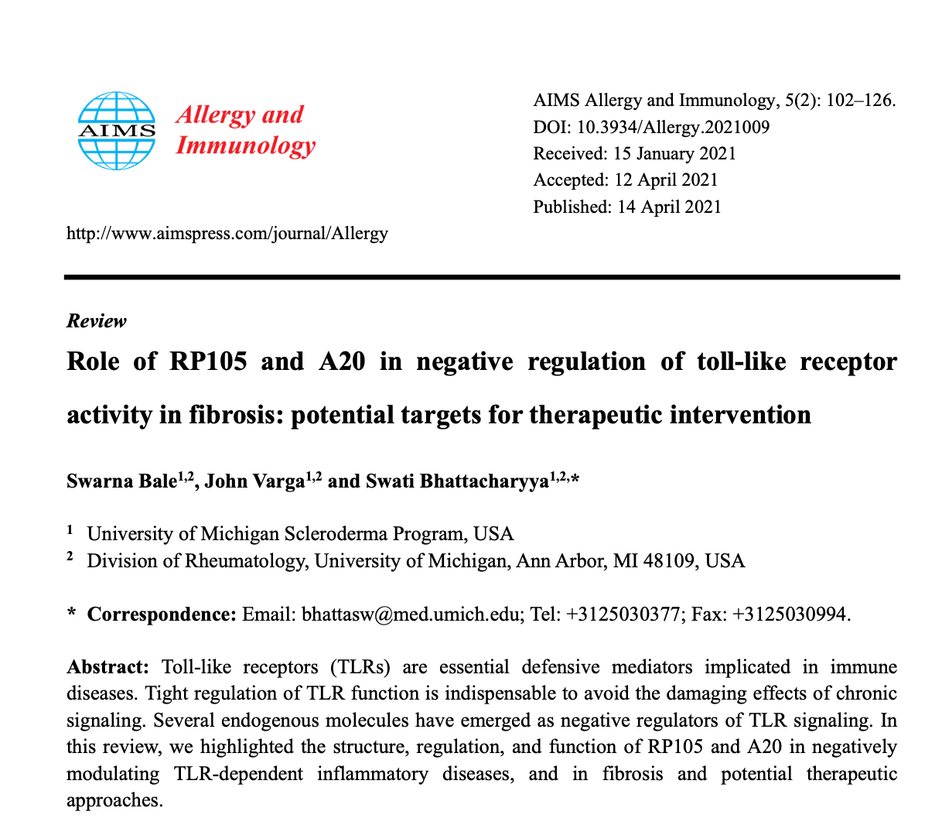
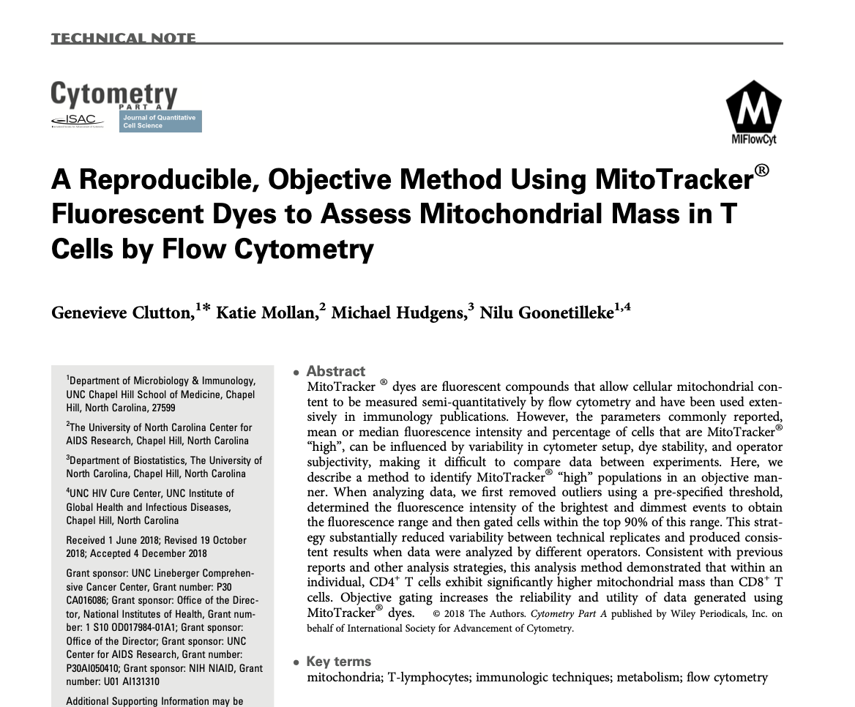
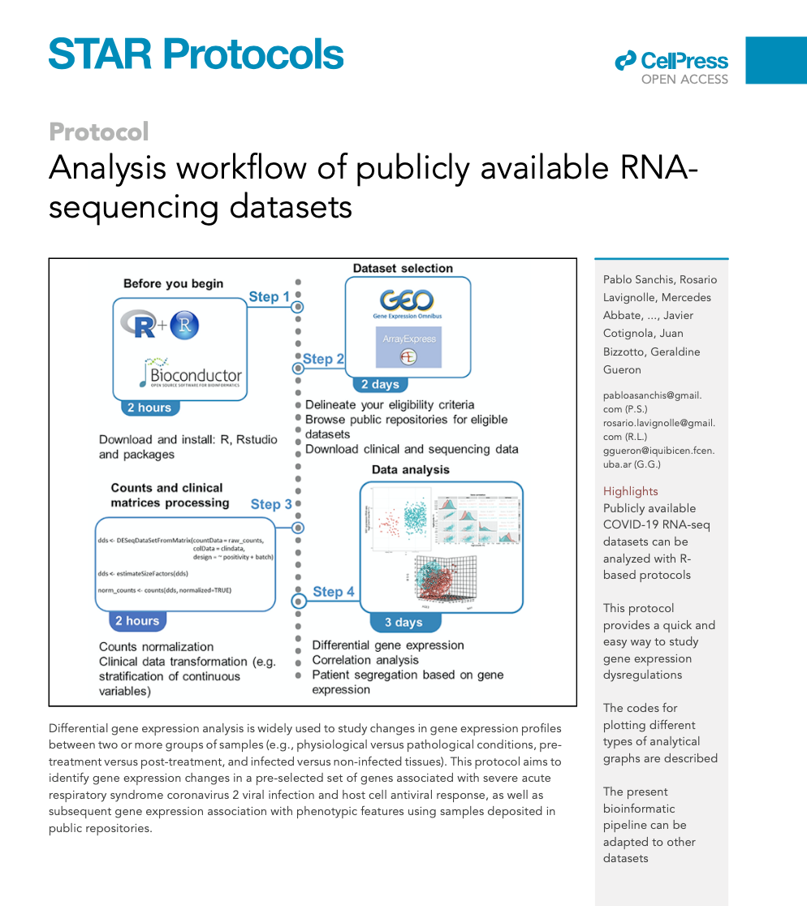
Constant learning

Slide 5
Constant learning
Other people
Supervisors
Staff
Other PhD Students
External collaborators
Making mistakes (lots)

Slide 6
Writing the thesis
Leave enough time
Write as you research
It will be rewritten and rewritten…

Slide 7
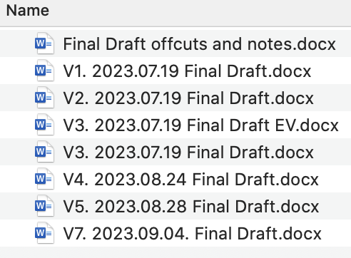
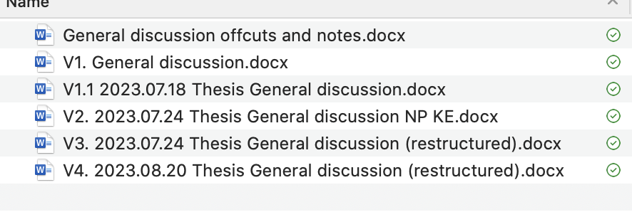
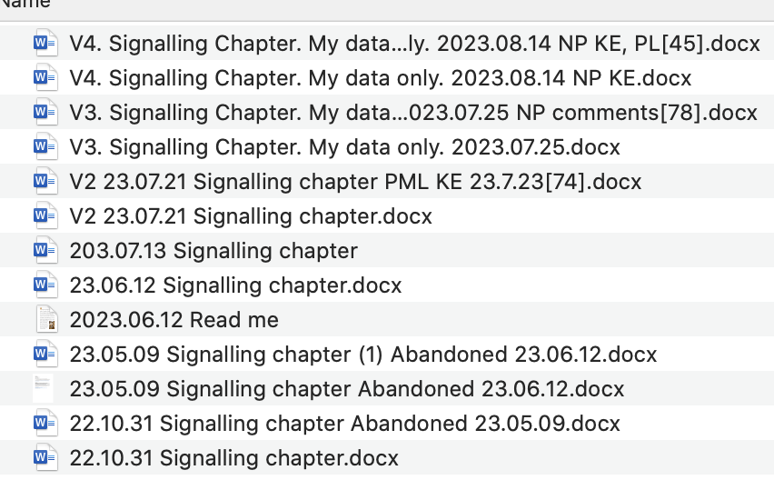
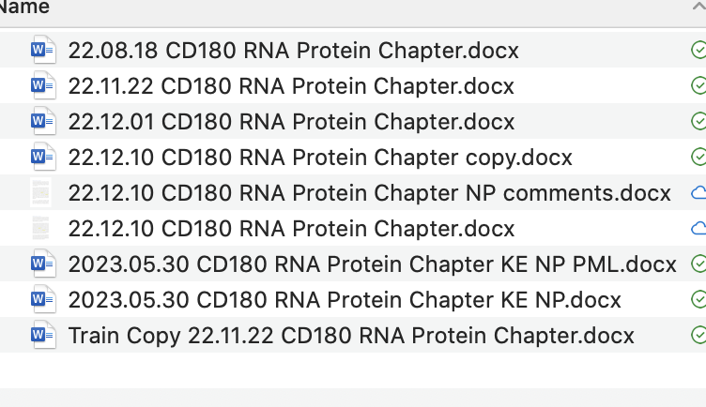

Slide 8
Writing the thesis
Leave enough time
It will be rewritten and rewritten…
Write a story & go to the DRDP
Write to help you think
Link

Slide 9
Do extra “stuff”
Take part in research outside PhD
Fund it with university & external grants!
Join committees & societies
Organise talks
Journal clubs
Work with others – there is freedom in a PhD

Slide 10
I’m an expert
This is easy
Actually never mind
I feel like I can do this
Progress
Learning
Setback
Kind of getting it now
Setback
Actually, never mind
I have no idea what I’m doing

Slide 11
Other tips
Pick a font/format & stick with it.
If you think it will take you 1 hour, it’ll probably take you two.
Leave headspace to think (Prof Dwek’s tip).
Be agile & adapt. Things will change!
Enjoy your first year – it gets progressively more intense.

Slide 12
