Slide 1
Library and Archive Services
Introduction for Doctoral Researchers
2024
Ka-Ming Pang
Academic Engagement Librarian

Slide 2
How we support Doctoral Researcher
Signposting you to online guides for information on:
Access to collections and resources
Search tools
Training and advice
Specialist staff

Slide 3
Getting Started

Slide 4
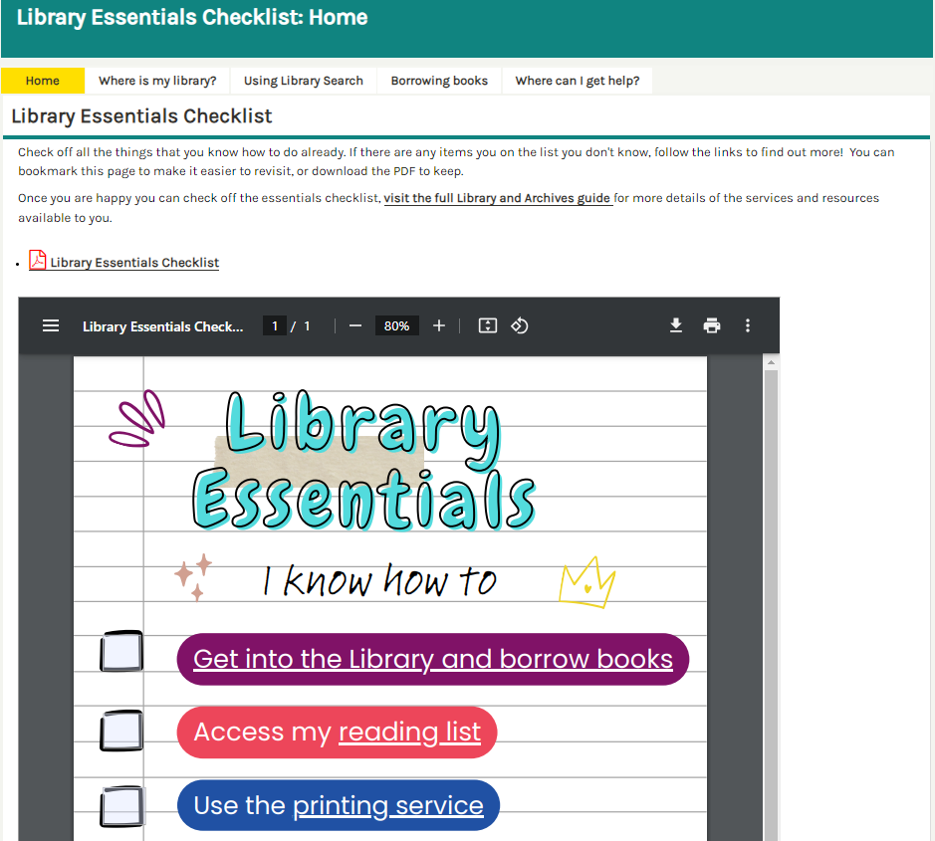
Library Essentials Checklist
https://libguides.westminster.ac.uk/orientation
Checklist that is useful if you are new to the Library.
Learn how to use the printers.
Map of Campus Libraries.

Slide 5
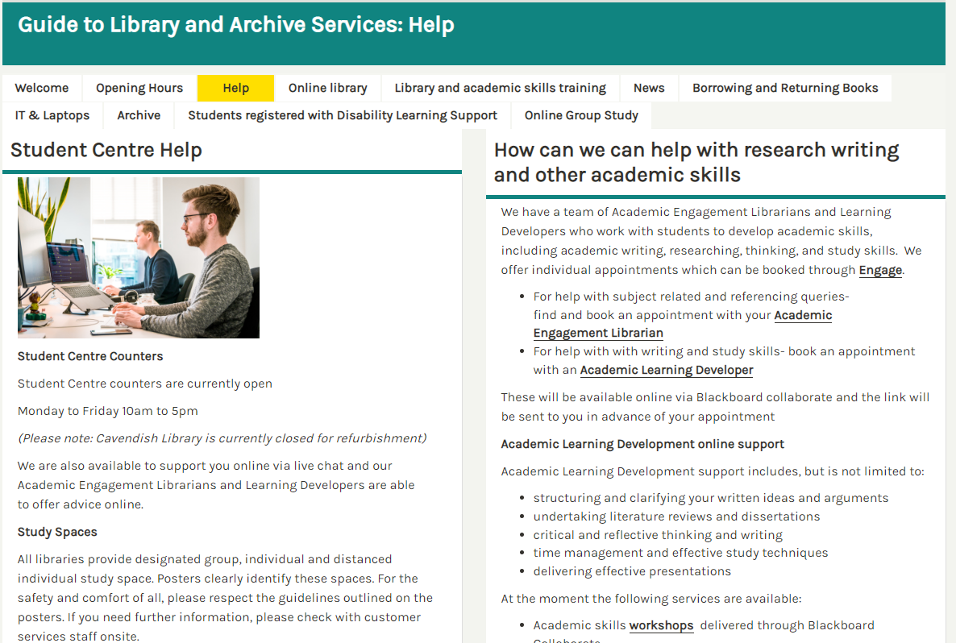
Guide to Library and Archive Services
https://libguides.westminster.ac.uk/libraryisonline
More comprehensive guide
Opening hours
Links to online resources for research and academics skills
Access workshop recordings

Slide 6
The Academic Engagement & Learning Development Team
(AELD)

Slide 7


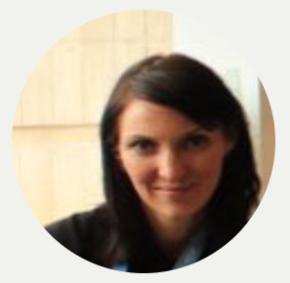




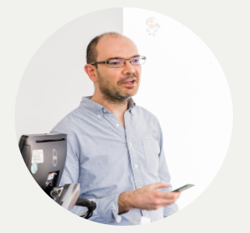


Get more efficient with your searches by talking to
your librarian
AELD Team
We provide:
1-2-1 appointments
Workshops
Subject support – Literature Searching
Reference Management help
Top Tip!
The subject guides contain information about resources relevant to your subject area and points you to the most relevant databases.

Slide 8



Upskill yourself with help from Learning Developers
AELD Team
Find out how to improve your:
- Academic writing
- Time management
- Dissertations
- Critical thinking
- Reading and note taking
- Revision skills
- Presentations
Learning Developers Libguide

Slide 9
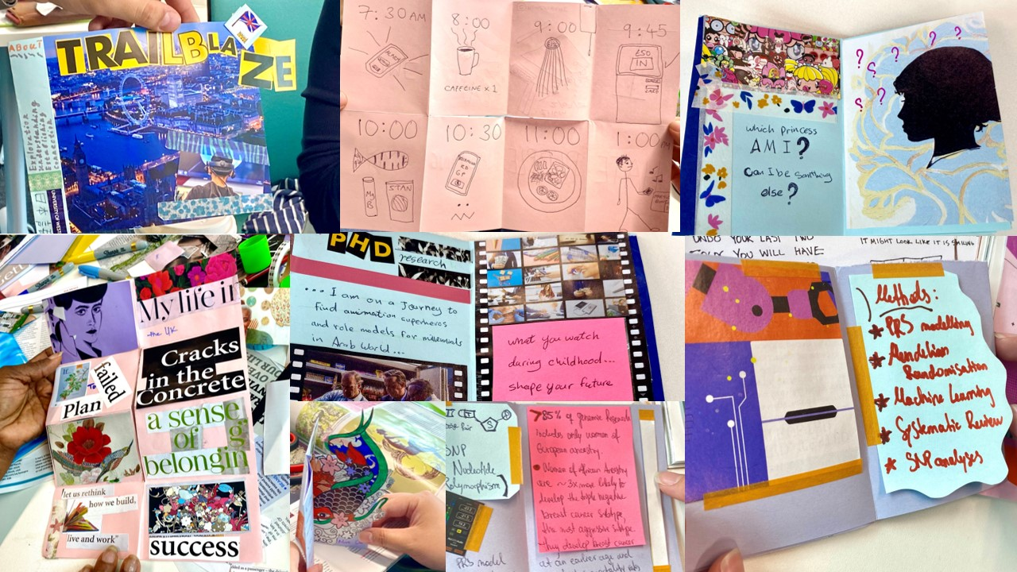
We offer a range of workshops
Critical Thinking
RefWorks
Literature Search
Defying Writer’s
Block
Zotero

Slide 10
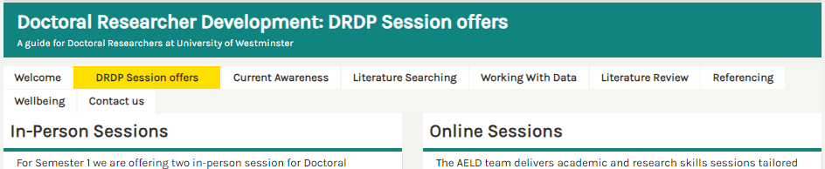
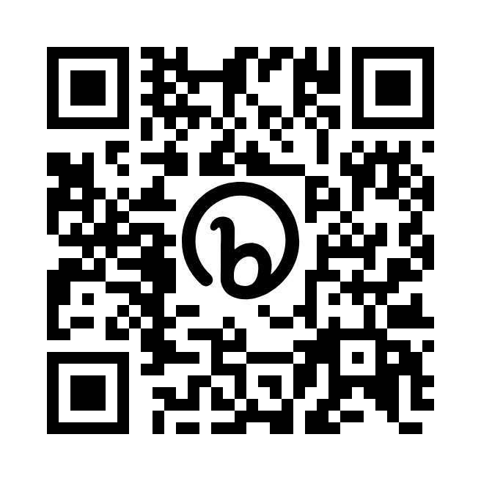
Library Guide for Doctoral Researchers
bit.ly/uowdrdp
Find out how to keep track of current research
Know where to get help for your Research Data Management Plan
Learn more about how writing Literature Reviews
Get started with Literature Search and Research Methods
*NEW* List of AELD workshops

Slide 11


Accessing Other Collections
SCONUL Access scheme
The SCONUL Access scheme allows you to visit a range of other academic libraries for reference and, in some cases, to borrow items too.
Can’t Find What You Need?
Combination of ‘Suggest a Book’ and ‘Inter-Library Loans’ Use to request an item that we don’t have in our own collections
British Library
Contact your Academic Engagement Librarian for help and advice on accessing other collections
Notes:
The SCONUL scheme is a reciprocal scheme where Higher Education libraries offer access to

Slide 12
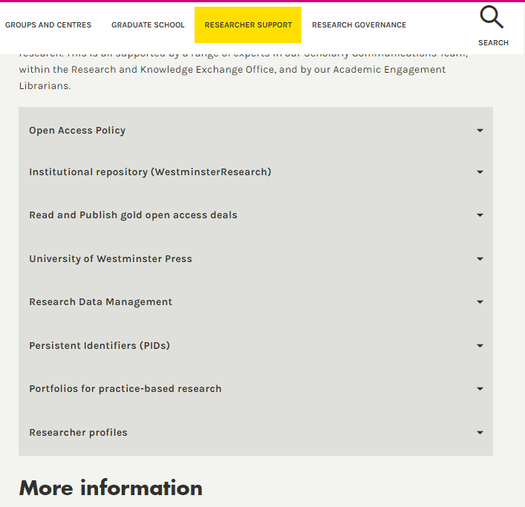
Open Research
https://www.westminster.ac.uk/research/researcher-support/open-research
Open Research (or, Open Science) looks different for each discipline, but it extends the principle of open access to research publications and research data to all aspects, methods, and products of the research lifecycle. Open Research improves the transparency, integrity, robustness, reproducibility, and reach of scholarly research.
Go to the Open Research Pages to find out more
Find open access research in:
WestminsterResearch – Institutional Respository
University of Westminster Press
See our Open Access Guide

Slide 13
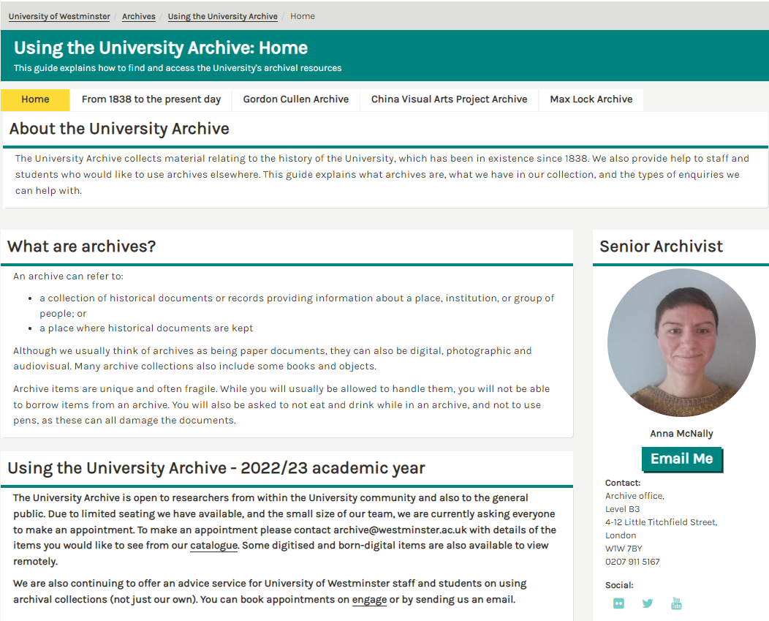
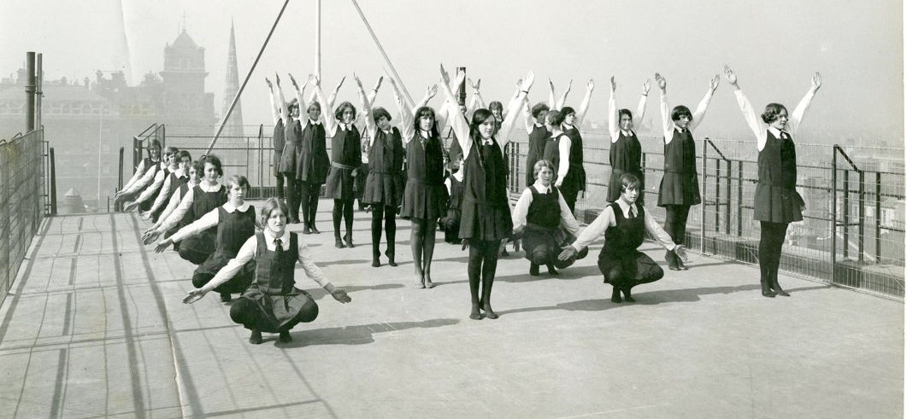
The University Archive is open to researchers. To make an appointment please contact archive@westminster.ac.uk with details of the items you would like to see. They also offer an advice service for University of Westminster staff and students on using archival collections. You can book appointments on Engage or by send them an email.
https://libguides.westminster.ac.uk/using-the-university-archive
University Archives
University Records and Archives can help with all queries relating to archival research, whether you are using our collections, need helping identifying collections elsewhere, or are struggling with online catalogues.
The team are on level B3 of 4-12 Little Titchfield Street (look for this photo on the wall!)

Slide 14
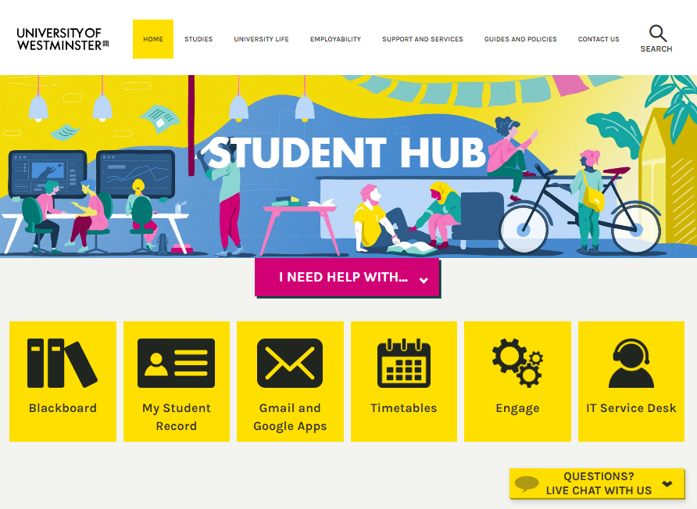


Student Centre
https://www.westminster.ac.uk/current-students
The Student Centre is the University’s Customer Service Team and they can provide you with support on a whole host of student life and wellbeing enquiries. They can answer a large number of queries and provide information about a diverse range of services and support.
If they can’t resolve your query straight away they will find you the team or colleague who can.
Come and see the friendly and approachable teams based across Harrow, Marylebone and Cavendish, see our opening hours page.
For help online, look out for the Live Chat Boxes in the bottom right corner of the pages to start a chat!

Slide 15

IT Services
They provide you with your account which you use to log into most things including:
Your email
WiFi through Eduroam
Survey tools and specialist software like NVIVO
Getting Help from IT Services
Check their FAQs
Log a ticket on Service Desk
Call 020 7915 5488
Notes:
Open access and desktop PCs with range of software

Slide 16
Thank You
LIBRARY DRDP GUIDE
Contact Us: studentcentre@westminster.ac.uk
bit.ly/uowdrdp

