Slide 1


Graduate School Induction
The Virtual Research Environment
(VRE)

Slide 2
How the VRE is used
Web interface to help manage your doctoral journey:
Annual Progression Management (APR)
Research Supervisory Meetings
Project Information
Personal Information (studentships, RAFs)
Thesis Submission
Examination Arrangements
Examination Outcomes and Completion
Research Ethics Applications

Slide 3
Benefits of the system
Clarity for students (and supervisors) during the doctoral journey – what & when reports are required
Audit trail of all decisions, repository of all documentation
Single online space to maintain supervisory meeting records
Faster approval of change requests, APR progress and outcomes
Operates on tablets and mobiles - allows your doctoral researcher record to be managed from anywhere in the world

Slide 4
How to use the VRE

Slide 5
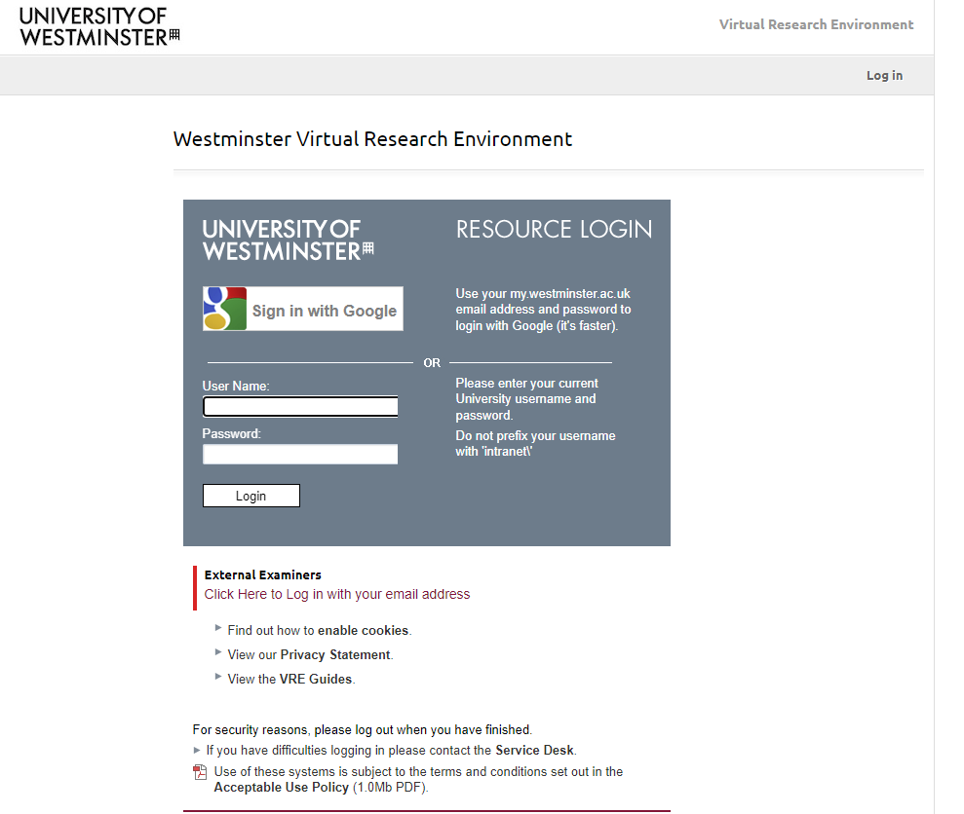
Logging in
research.westminter.ac.uk
- Use your username and password

Slide 6
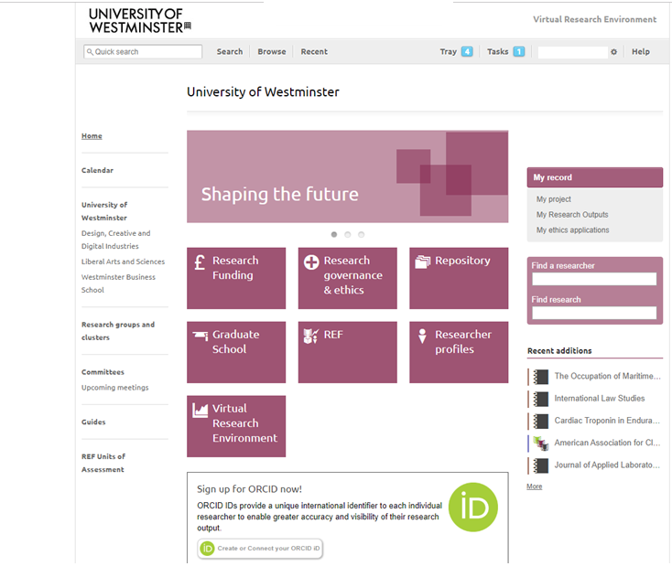
The Front Page

Slide 7
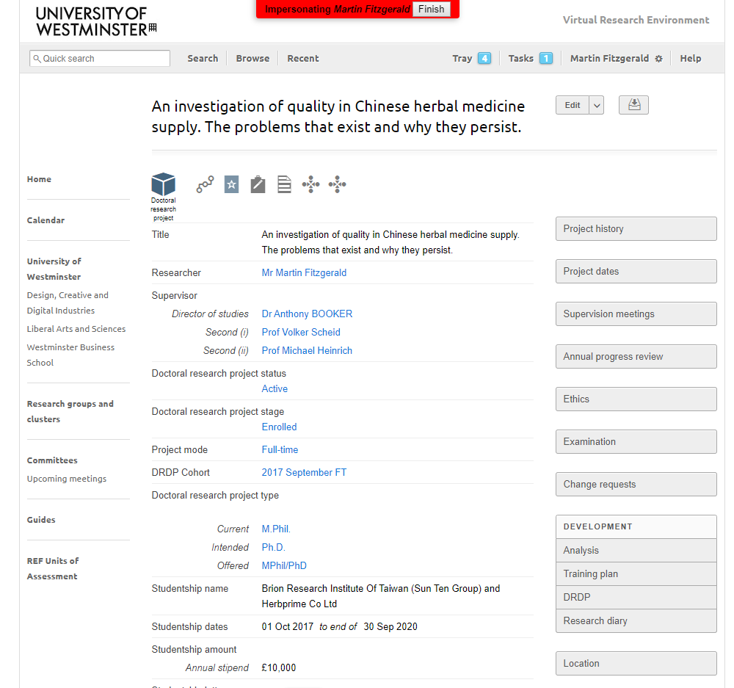
Doctoral Research Project Page

Slide 8
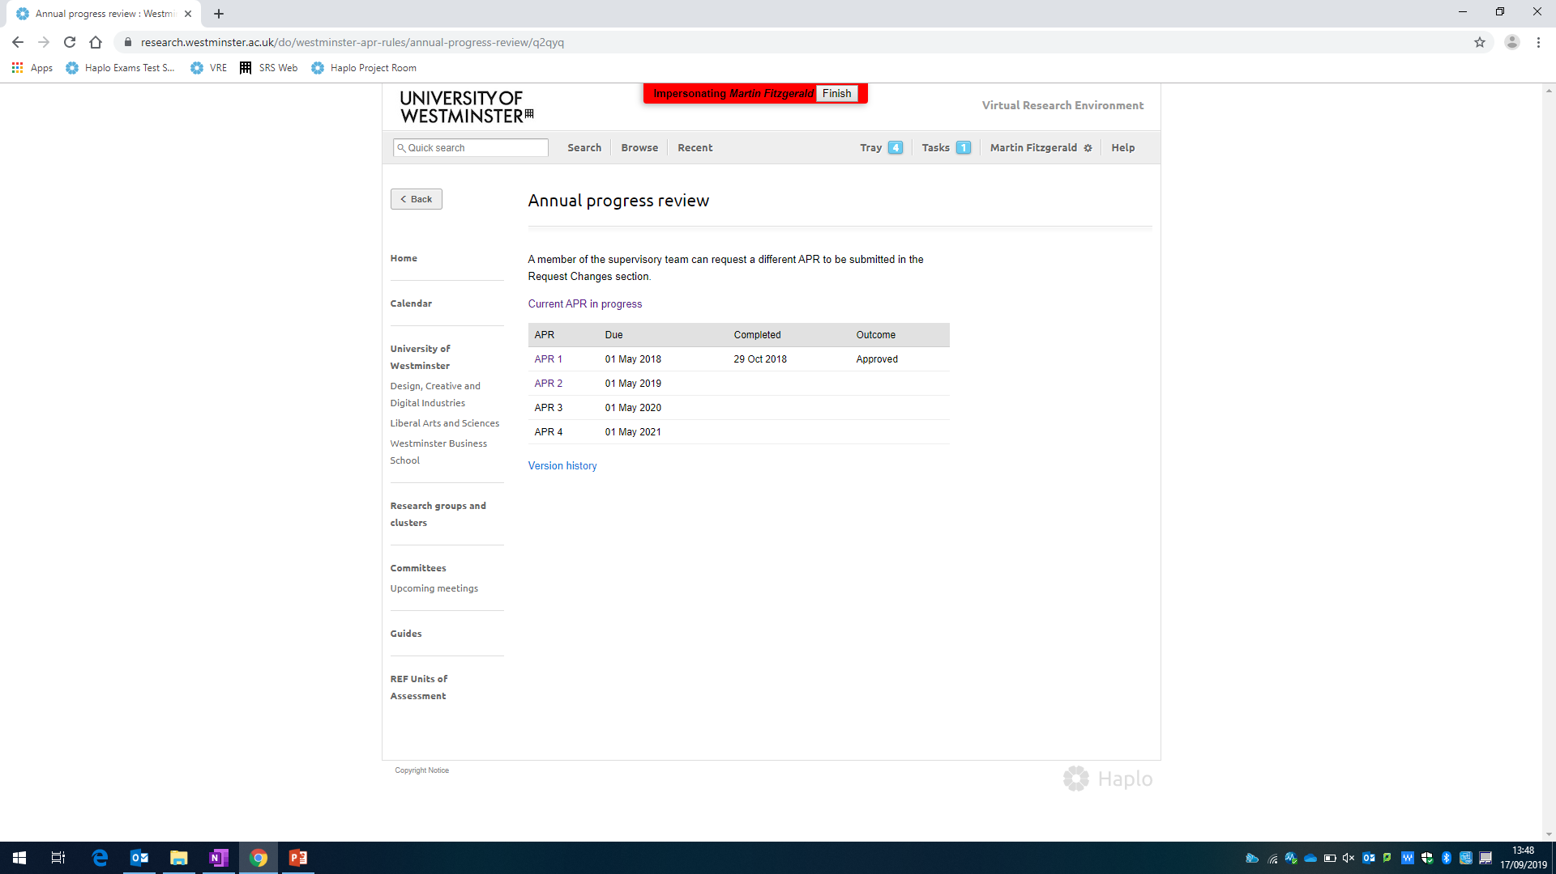
Annual Progression Review (APR) Management

Slide 9
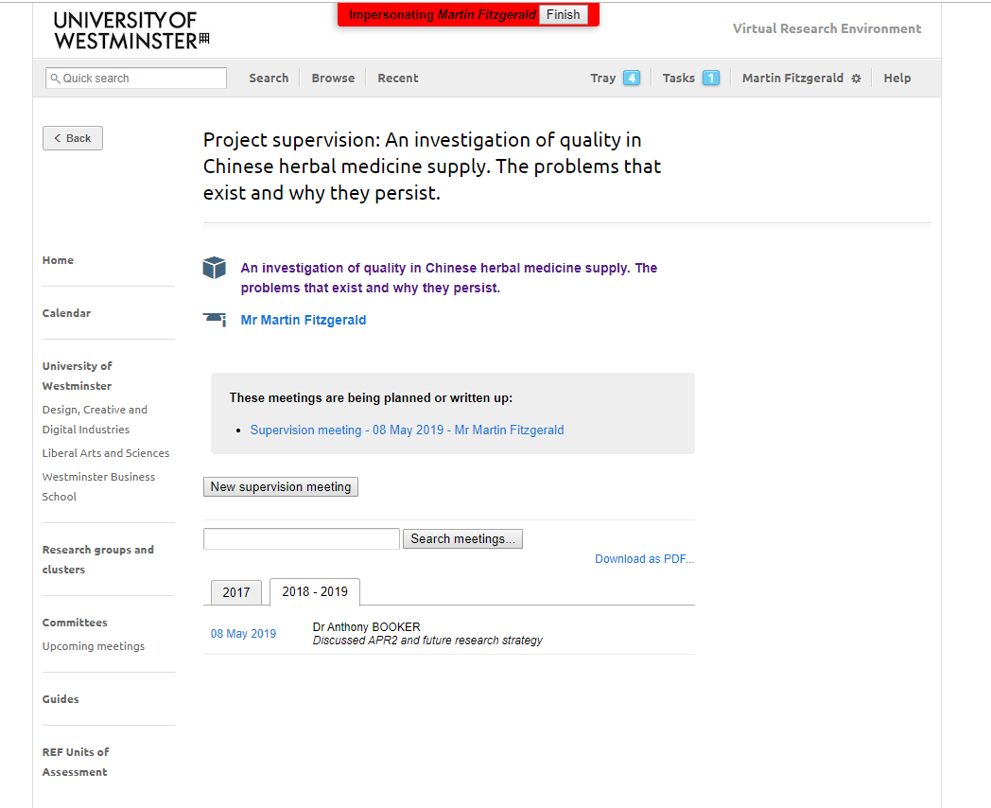
Supervisory Meetings

Slide 10

Tasks

Slide 11
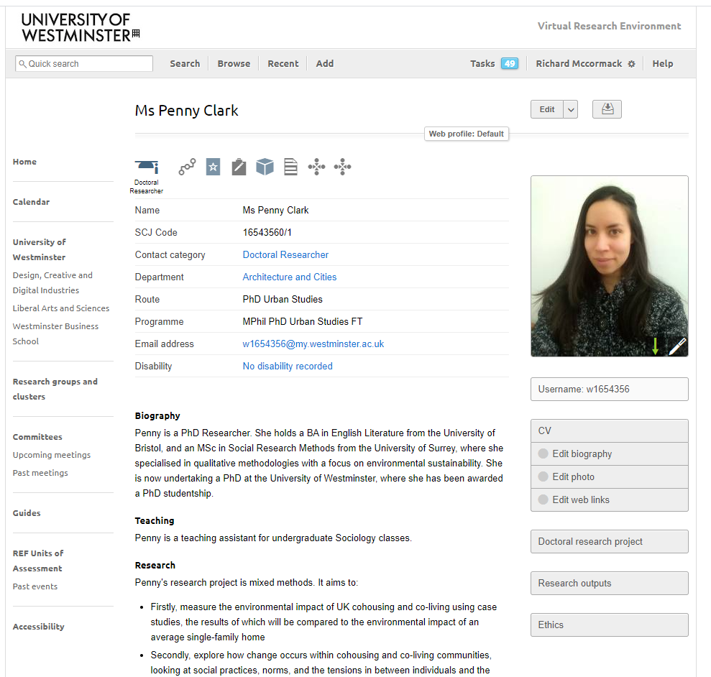
Doctoral Researcher Profiles

Slide 12
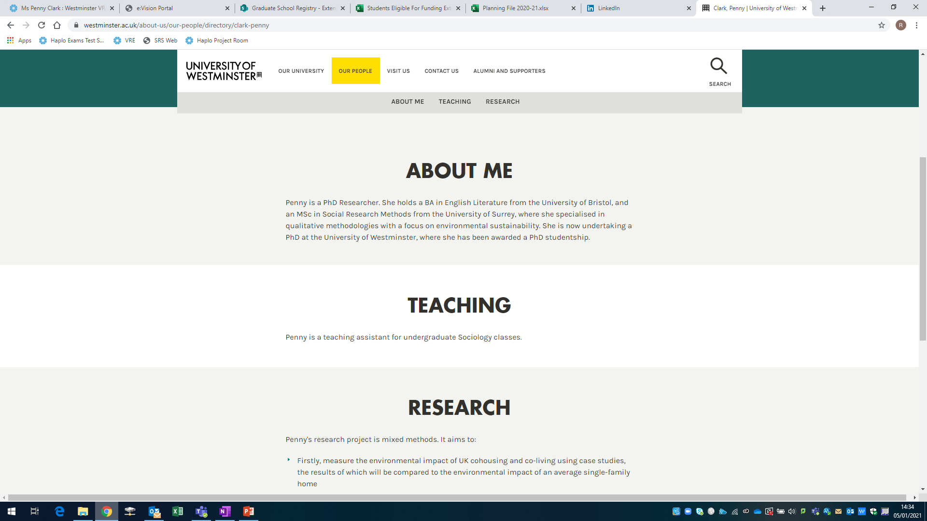
Doctoral Researcher Profiles

