Slide 1
Doctoral
Researcher
Development
Programme
(DRDP)

Slide 2
“a suite of tailor-made workshops, specialist skills sessions, and personal development planning activities to help you excel in your doctoral studies and advance your future career”

Slide 3
What skills and attributes might a doctoral researcher need to develop?

Slide 4
Researcher Development
Our programme is based on the Vitae Researcher Development Framework (Vitae RDF)
Helping you explore and develop the wide range of skills, qualities and attributes of successful researchers

Slide 5
Where to find information about the DRDP
DRDP Webpage
Inkpath
Provides overview of the DRDP and information about:
DRDP workshops, events and writing retreat
Professor Geoffrey Petts Memorial Fund and GER Scholarship Fund application information
Resources for your first year
https://blog.westminster.ac.uk/doctoralresearcherdevelopmentprogramme/
This is the platform used to book all DRDP activities
https://webapp.inkpath.co.uk/

Slide 6
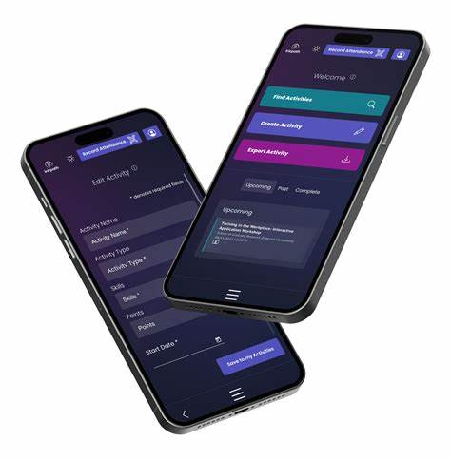
Inkpath – Your platform for the DRDP
Book DRDP training and activities
Create goals and track progress
Build a portfolio of your development activities
(you can add conferences, external training, curated exhibitions, and more)
Download from mobile app stores (Android & iOS) or visit https://webapp.inkpath.co.uk/
Inkpath, 2024

Slide 7
https://webapp.inkpath.co.uk/
Inkpath log-in – Select University of Westminster

Slide 8
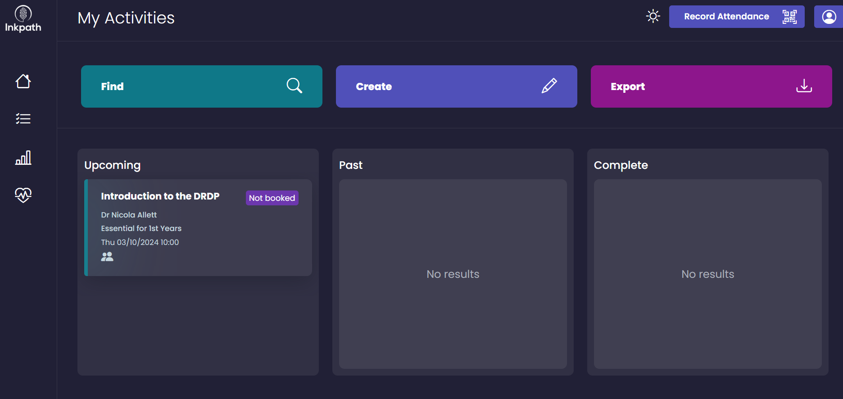
Click on ‘Create’ to add an external activity to your portfolio (e.g. conference, exhibition)
Click on ‘Export’ to download a copy of your activities
Click on ‘Find’ to start browsing

Slide 9
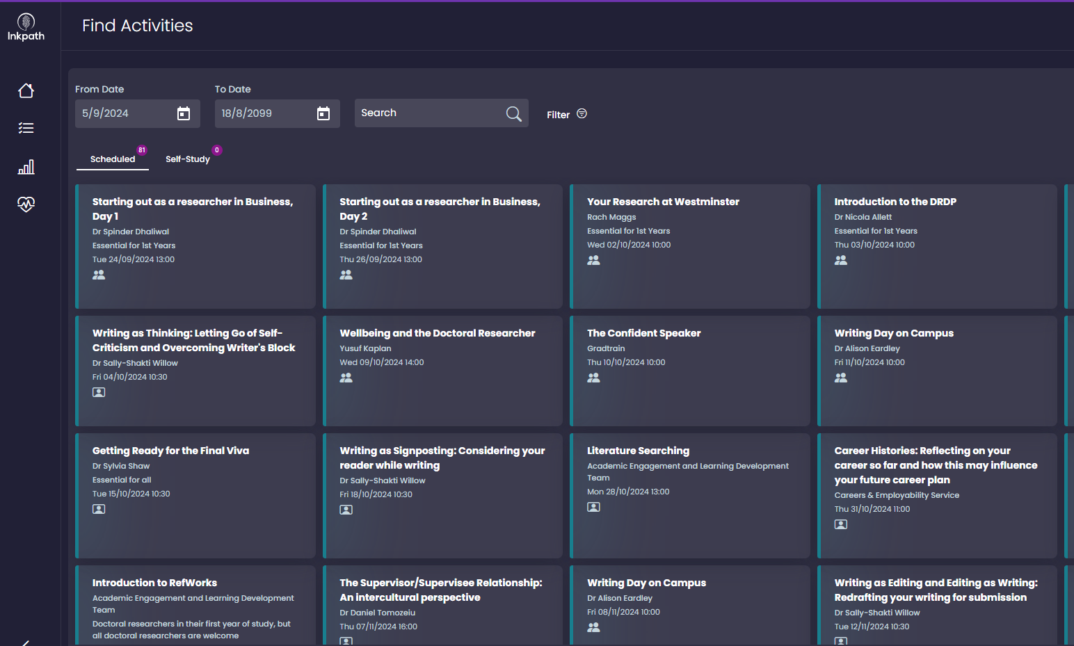
You can search or use the filter to select the skills you are interested in
Click on an activity to find out more details

Slide 10
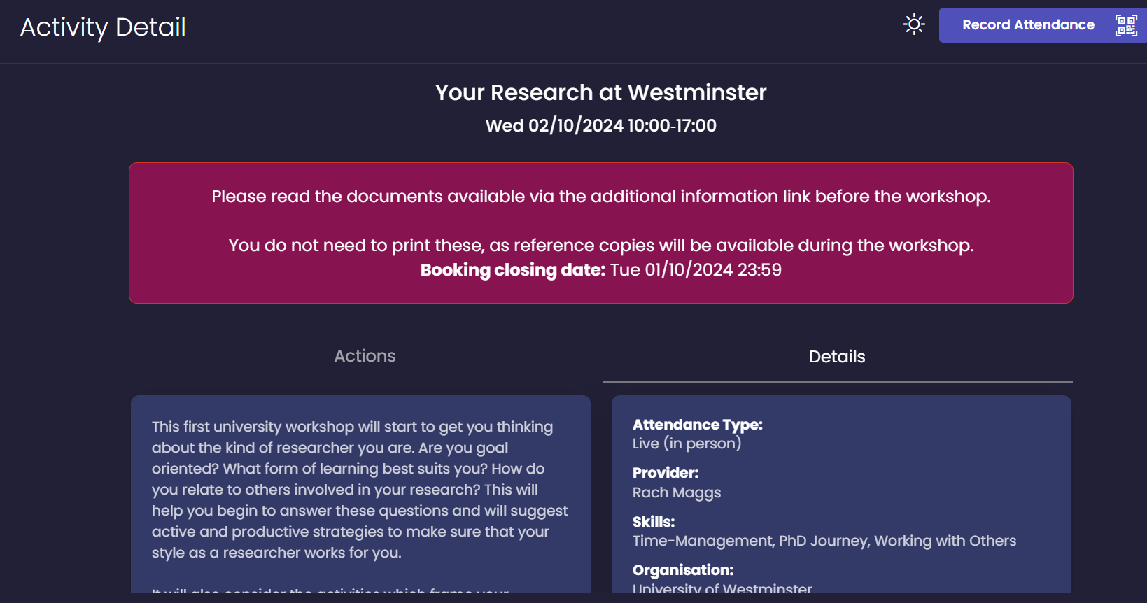
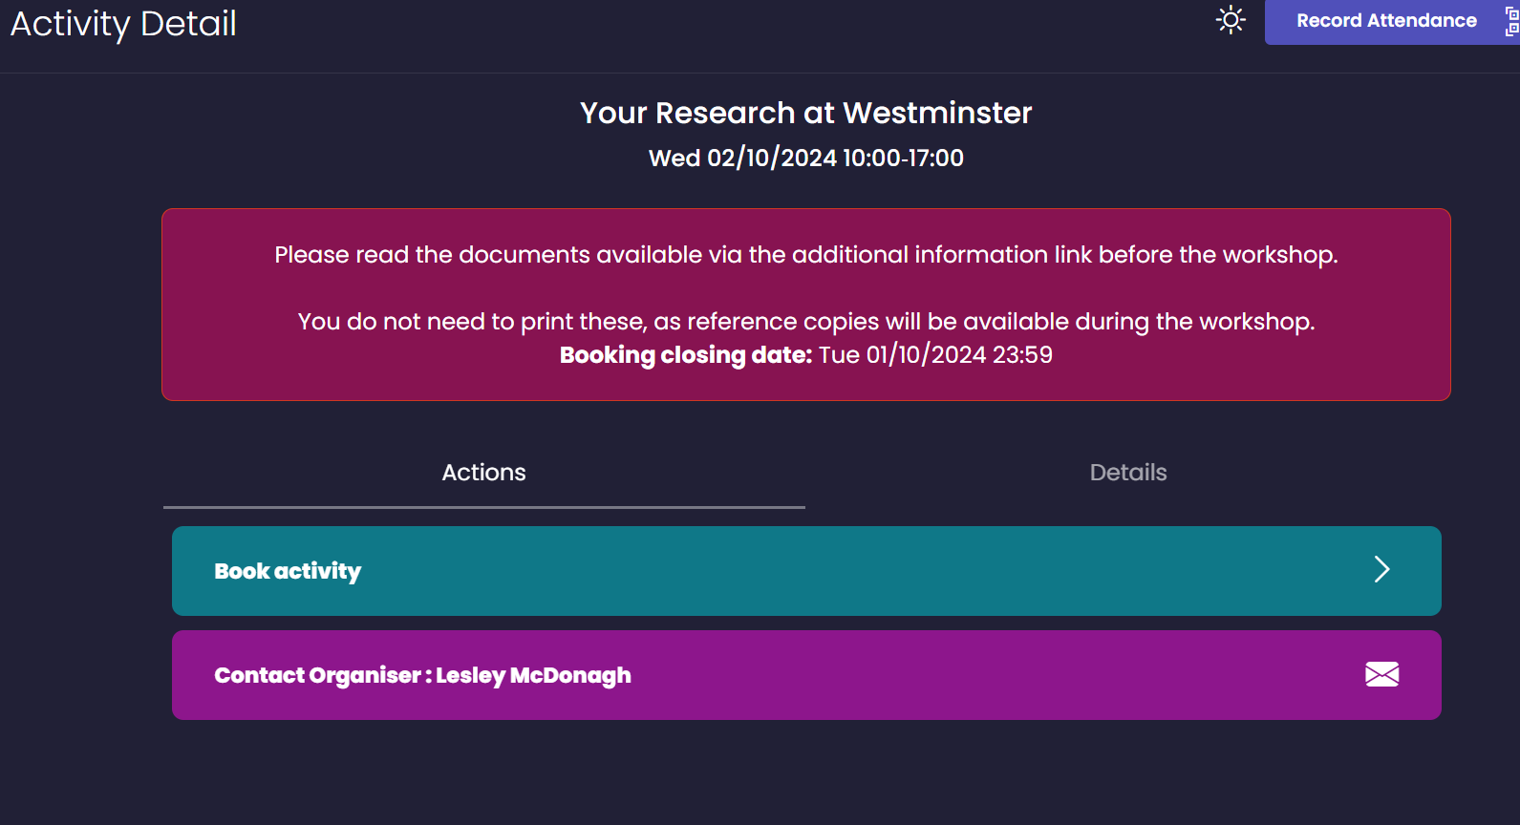
Once an activity is selected…
Under ‘details’ you will find a description of the workshop
Under ‘Actions’ you will be able to book the activity

Slide 11
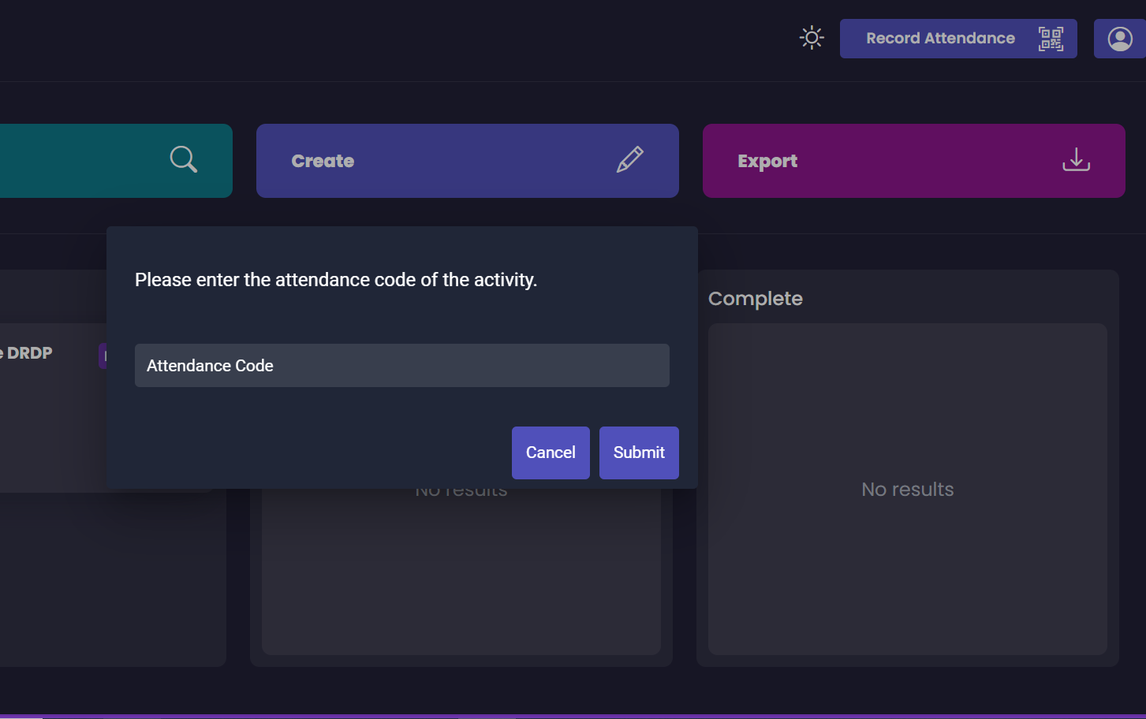
Record your attendance using Inkpath
The workshop facilitator will share a QR Code
If you have a question about recording attendance, please contact the Graduate School

Slide 12
School Induction and Workshop Dates
Starting Out as a Researcher in Media and Communication
24th September, 12pm-5pm,
12pm-5pm, Venue: J Building, J1.03, in Harrow campus
Starting Out as a Researcher in STEMM (Computer Science and Engineering
and Life Sciences)
Day 1, 25th September, 2pm-5pm, Room C2.05, 115 New Cavendish St
Day 2 26th September, 2pm-5pm, Room CLG.06, 115 New Cavendish St
Starting Out as a Researcher in SHAPE (Humanities, Social Sciences, Law and
Architecture and Cities)
Day 1: 25th September, 10am-2pm, Room 4.33, Little Titchfield Street
Day 2: 26th September, 1pm – 4pm, Room 4.33, Little Titchfield Street
Starting Out as a Researcher in Business
24th September, 1pm-5pm, Room M206, Marylebone Campus
Starting Out as Researcher in Arts
2nd October TBC

