Slide 1
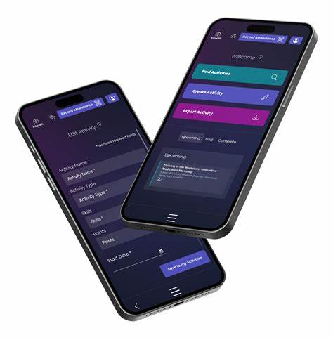
Inkpath – Your platform for the DRDP
Book DRDP training and activities
Create goals and track progress
Build a portfolio of your development activities
(you can add conferences, external training, curated exhibitions, and more)
Download from mobile app stores (Android & iOS) or visit https://webapp.inkpath.co.uk/
Inkpath, 2024

Slide 2
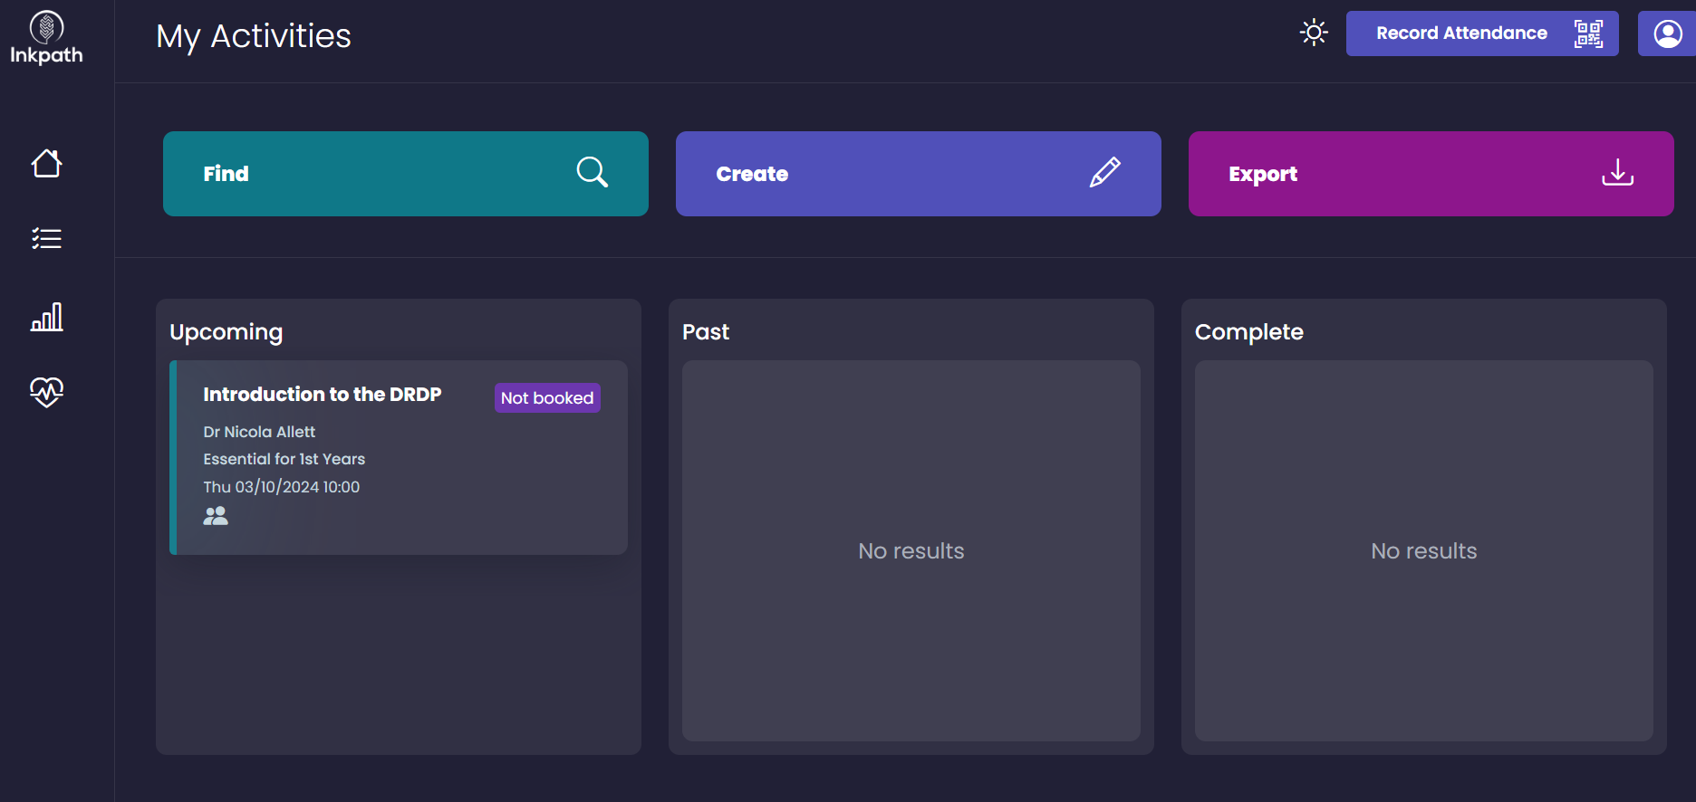
Click on ‘Create’ to add an external activity to your portfolio (e.g. conference, exhibition)
Click on ‘Find’ to start browsing

Slide 3
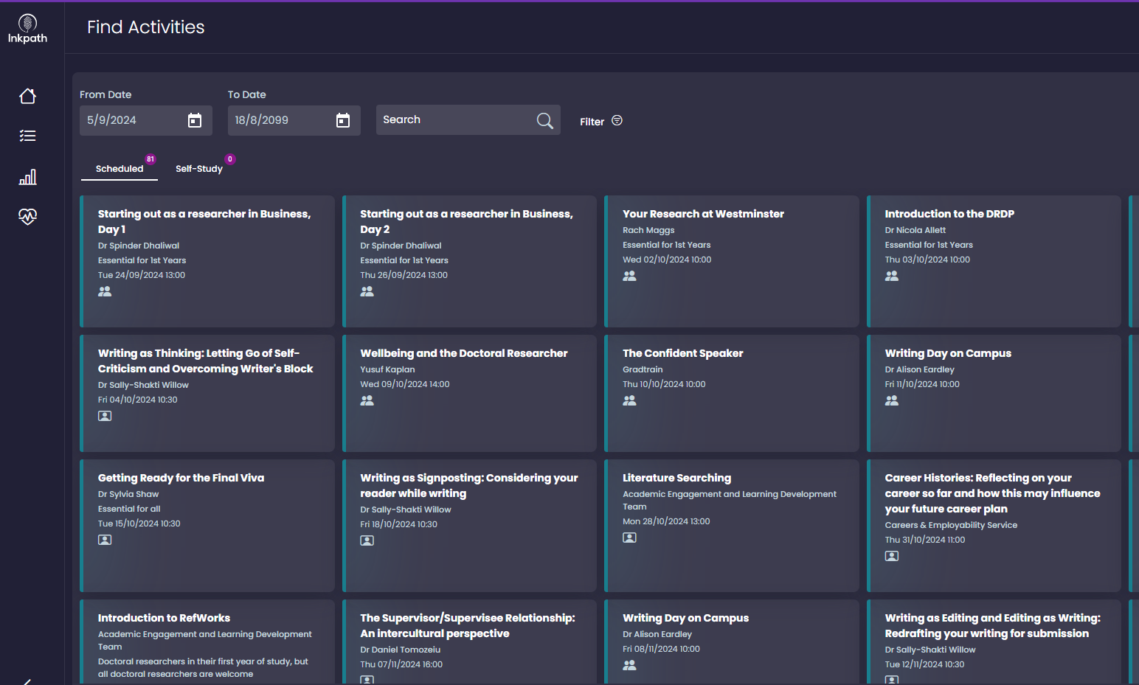
You can search or use the filter to select the skills you are interested in
Click on an activity to find out more details

Slide 4
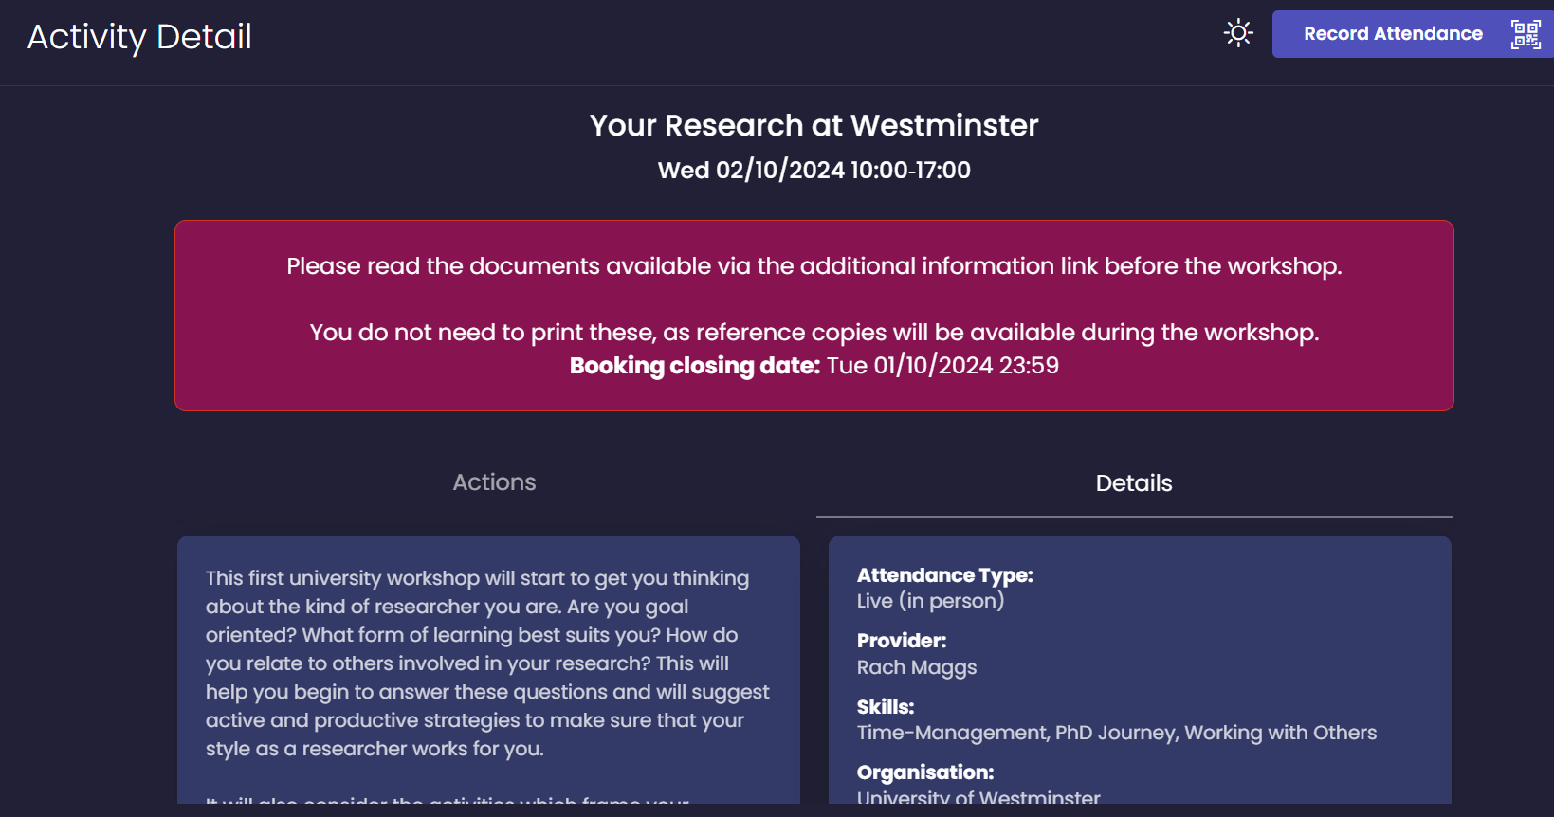
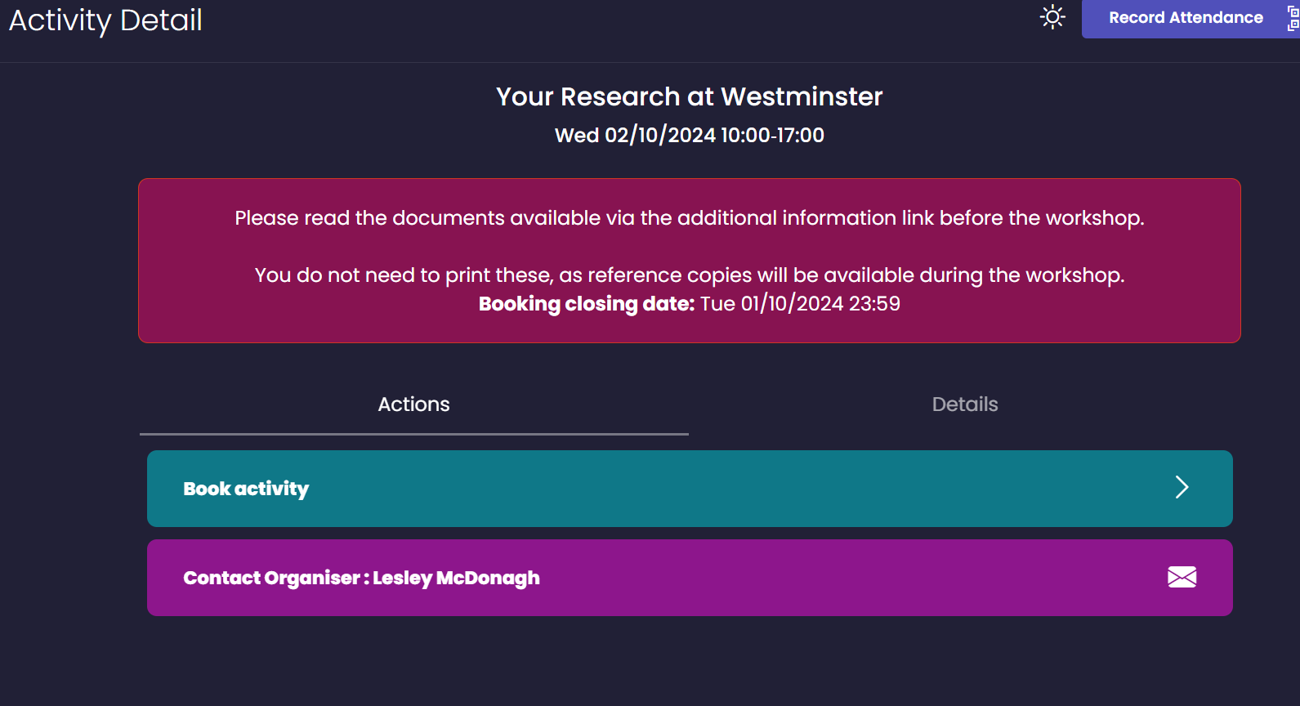
Once an activity is selected…
Under ‘details’ you will find a description of the workshop
Under ‘Actions’ you will be able to book the activity

Slide 5
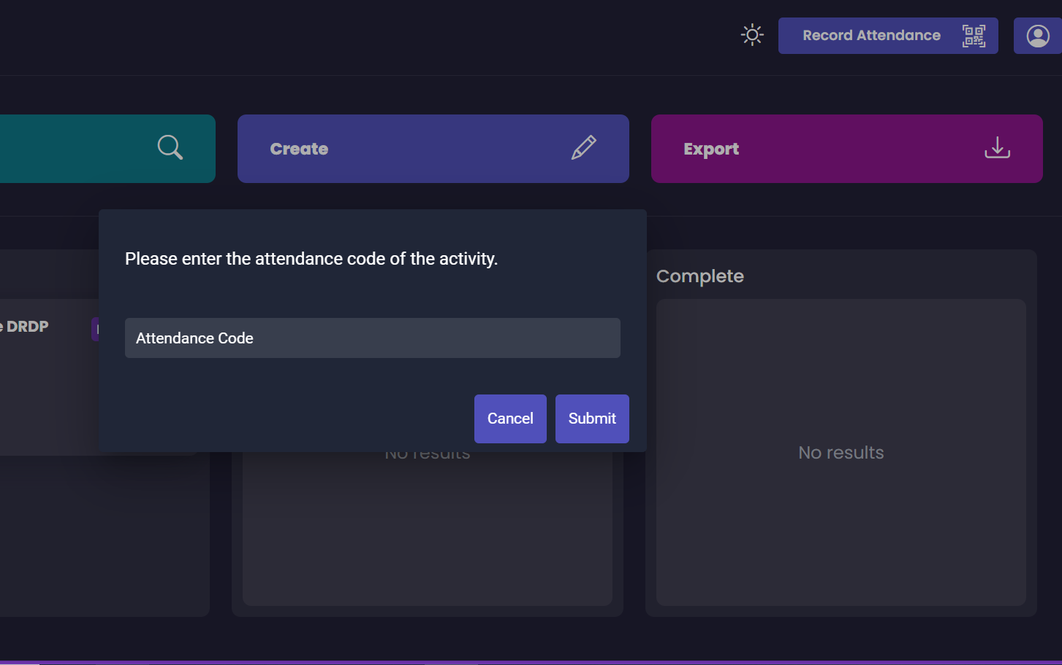
Record your attendance using Inkpath:
The workshop facilitator will share a QR Code to scan.
If you have a question regarding recording attendance, please contact the Graduate School.

