Slide 1
Welcome to the GS Induction Event and University of Westminster

Slide 2
Importance of Our Society
Why Join Our Society?
Networking and connecting with peers
Professional development opportunities
Emotional support and community

Slide 3
Networking and Connecting
Meet fellow students and professionals
Build lasting relationships
Collaborate on research and projects
Let us hear your suggestions
Workshops and seminars for skill development
Keep connected with Coffee meetings

Slide 4
Thank you and good luck !

Slide 5
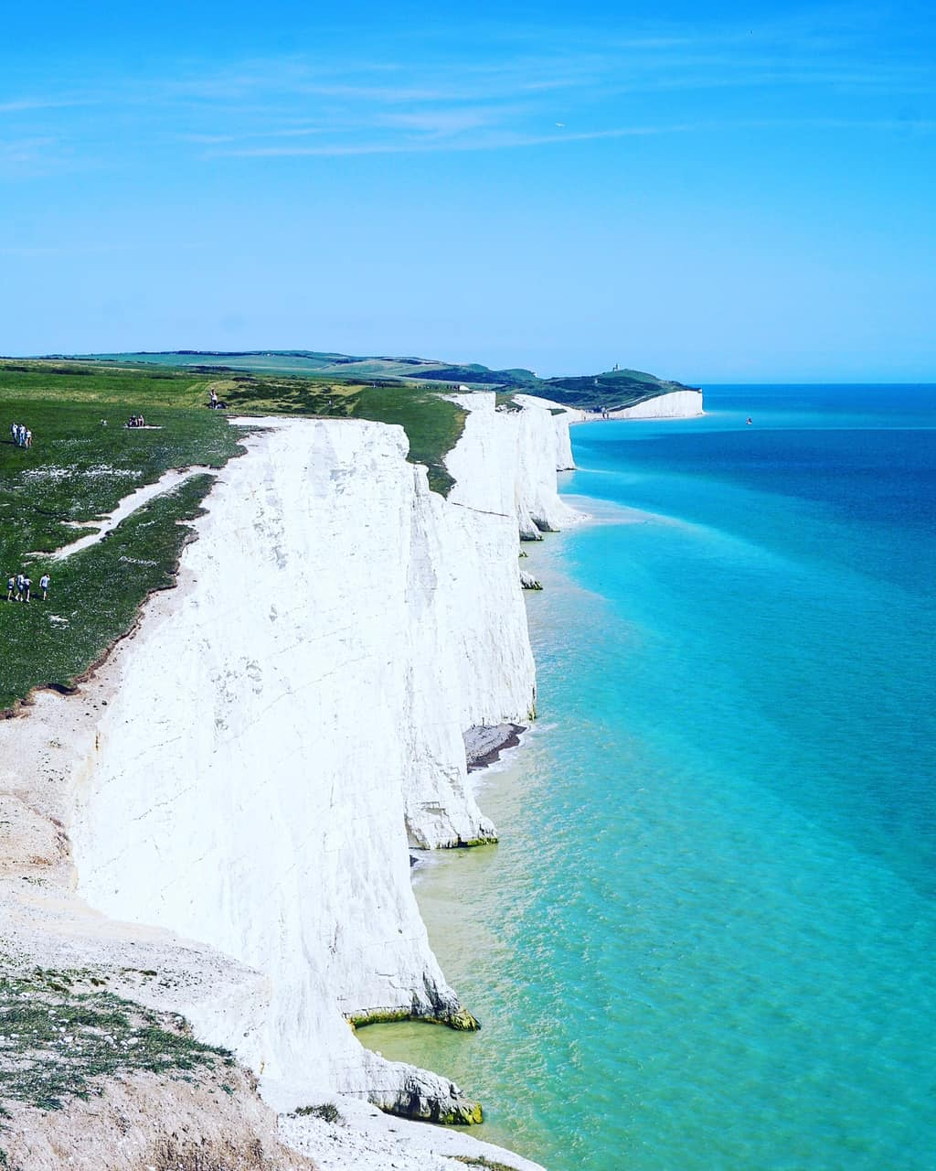
Upcoming Activities for Autumn
Exciting Activities This Year
Trip to Seven Sisters
Pub social meetings
Monthly coffee meetings
Peer review symposium
Supportive meetings and chats in PhD rooms

Slide 6
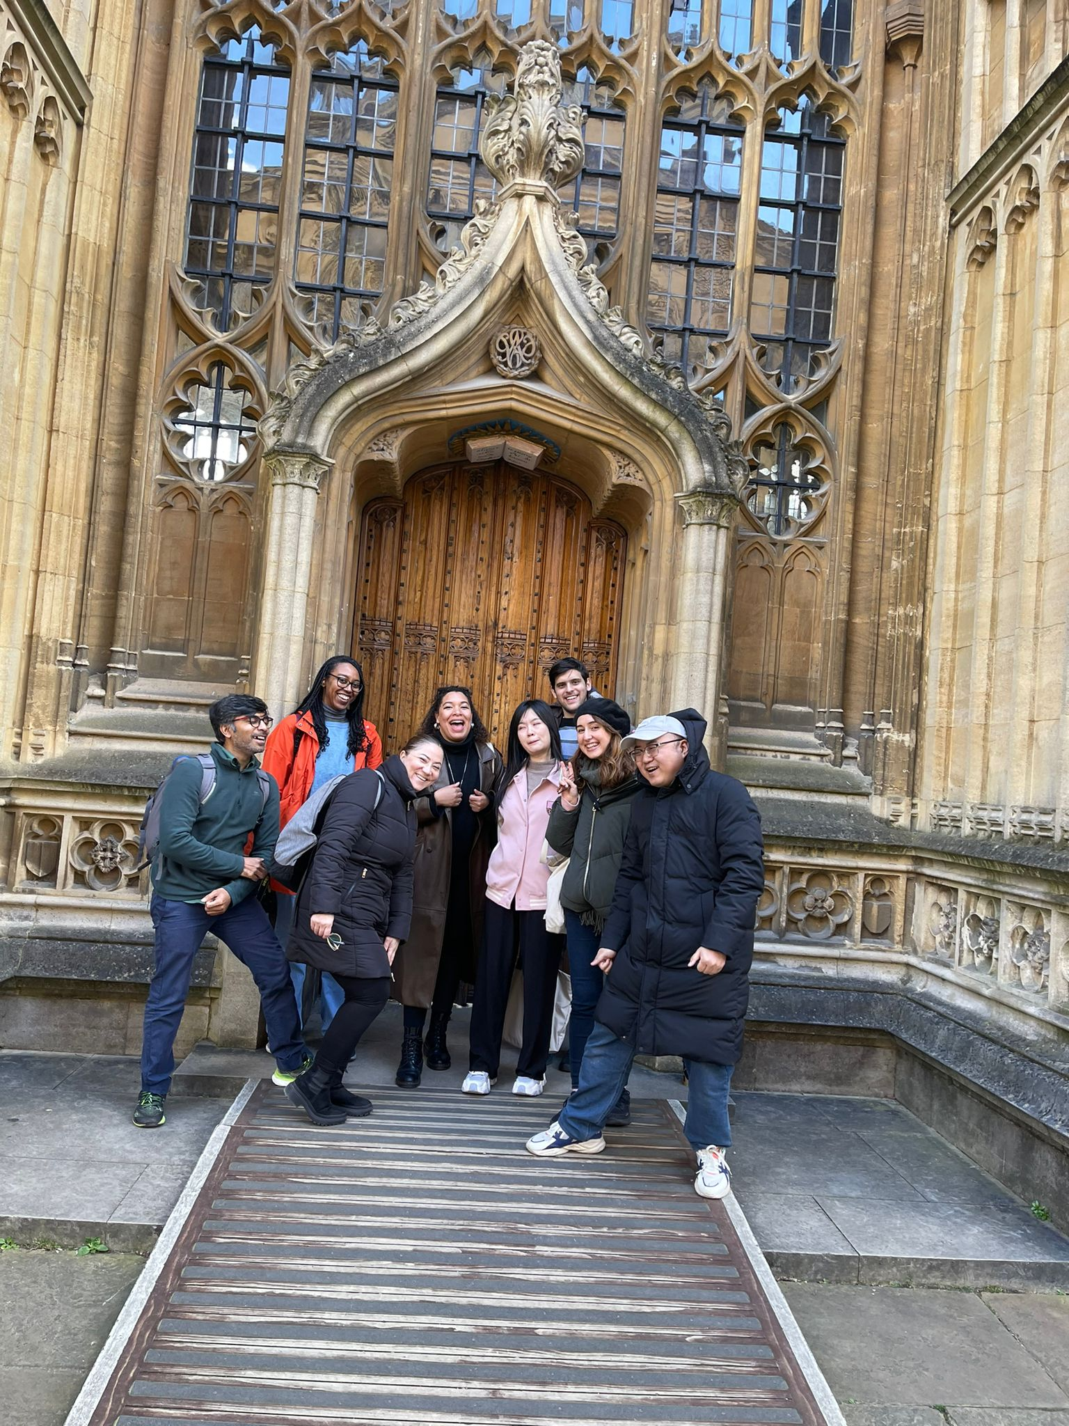
Join Us!
Become a part of our vibrant community
Enhance your academic and personal growth
Make lasting memories and connections

