Slide 1


The Graduate School
How we support you

Slide 2
Graduate School (all PGRS)
College of Design, Creative and Digital Industries
College of Liberal Arts and Sciences
Westminster Business School
School of Architecture and Cities
School of Computer Science and Engineering
School of Media and Communication
School of Arts
School of Social Sciences
School of Humanities
School of Life Sciences
Westminster Law School
School of Management and Marketing
School of Organisations, Economy and Society
School of Finance and Accounting
School of Applied Management

Slide 3
Graduate School Academic Structure
Head of the Graduate School
Deputy Head of the Graduate School
School PhD Co-Ordinator
School DRDP Co-Ordinator
Doctoral Tutor
Supervisory Teams

Slide 4

Graduate School Governance
The work of the Graduate School falls under the remit of the Pro Vice-Chancellor (Research) *soon to be Deputy Vice-Chancellor (Research & Knowledge Exchange)
Overseen by the Graduate School Board (GSB) - which GS Director Chairs (2 PGR Student Reps)
GSB reports to the Research & Knowledge Exchange Steering Committee
GSB has 2 subcommittees:
  Research Degree Progression Committee (RDPC)
  Doctoral Researcher Development Programme (DRDP) Committee (1 PGR Student Rep)
  GS Assembly (twice a year) (PGR student led)

Slide 5
Graduate School Office
Research Degree Programme Management (from enrolment to graduation)
Doctoral Researcher Development Programme (DRDP) Co-ordination
Graduate School Event Co-ordination (including annual GS Festival)
Committee Support
Doctoral Researcher Support, Guidance & Signposting
Administration (studentship payments, letters, queries, etc).

Slide 6

Research Degree Programme Management
Enrolment/Re-enrolment
Annual Progress Reviews (APRs)
Change in personal circumstances (suspensions, extensions, mode of study change, Mitigating Circumstances)
Examinations:
  Thesis Submission
  Exam Arrangements (including Viva and Panel)
  Examination Outcomes
  Conferment and Graduation

Slide 7
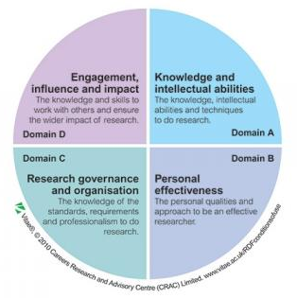

Doctoral Researcher Development Programme (DRDP)
Management of Programme
Programme Review, Development and Quality Assurance (dedicated DRDP website, flexible creation of own development and training)

Slide 8
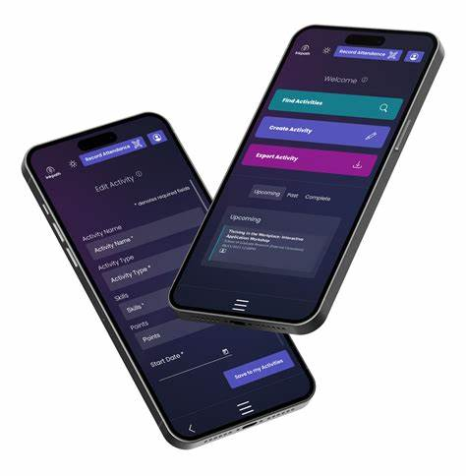
Inkpath
Book DRDP training and activities
Follow suggested goals or create their own, tracking progress
Build a portfolio of their development activities
  (in addition to DRDP they can add conferences, external training, curated exhibitions, and more)
Inkpath, 2024

Slide 9
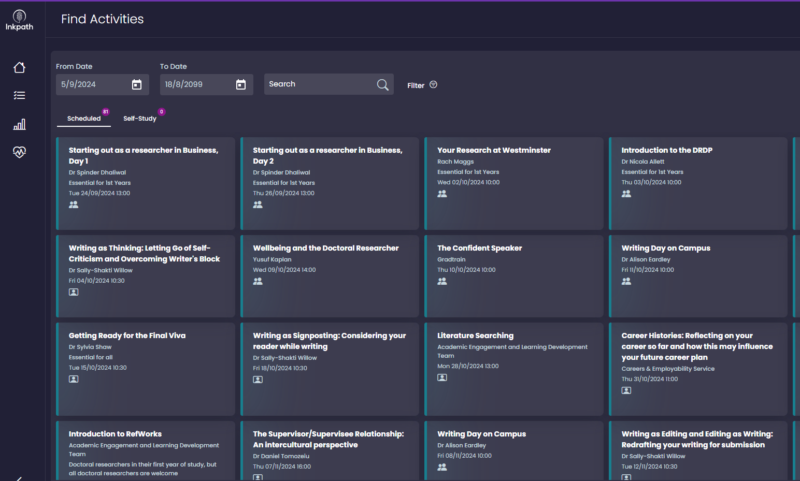
Inkpath
The user can browse all sessions, conduct a keyword search, or search specific skills or goals
On booking, the user receives email and calendar invite. They will also receive a reminder.
After attending, feedback submitted via Inkpath

Slide 10

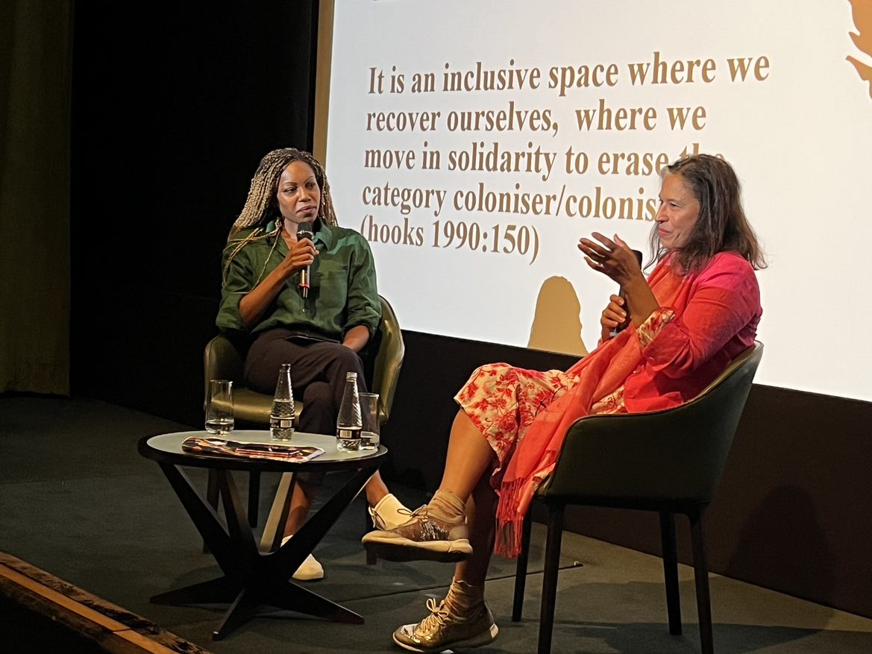
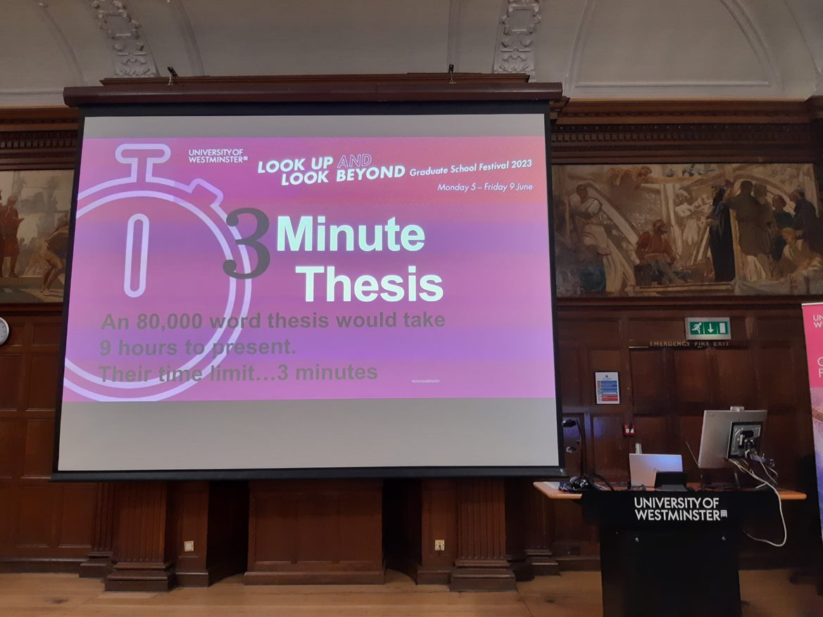
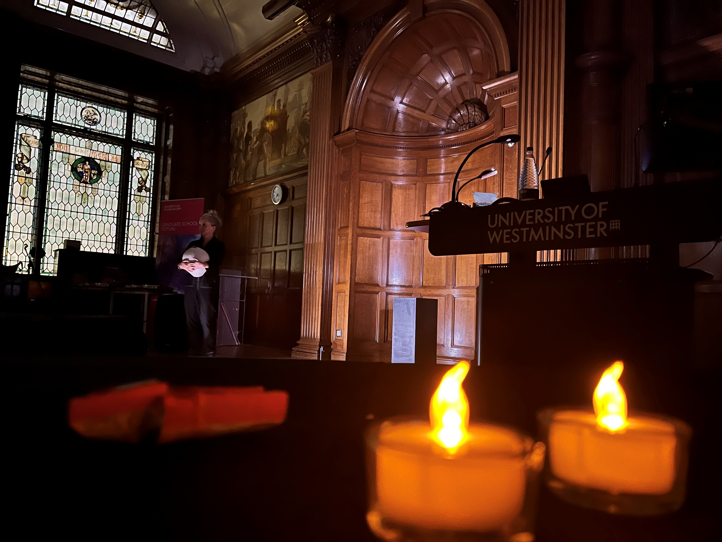
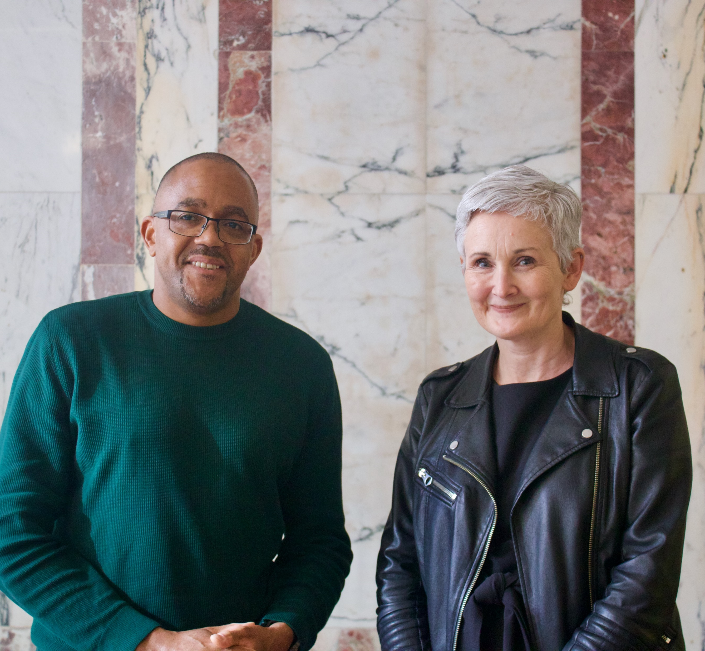
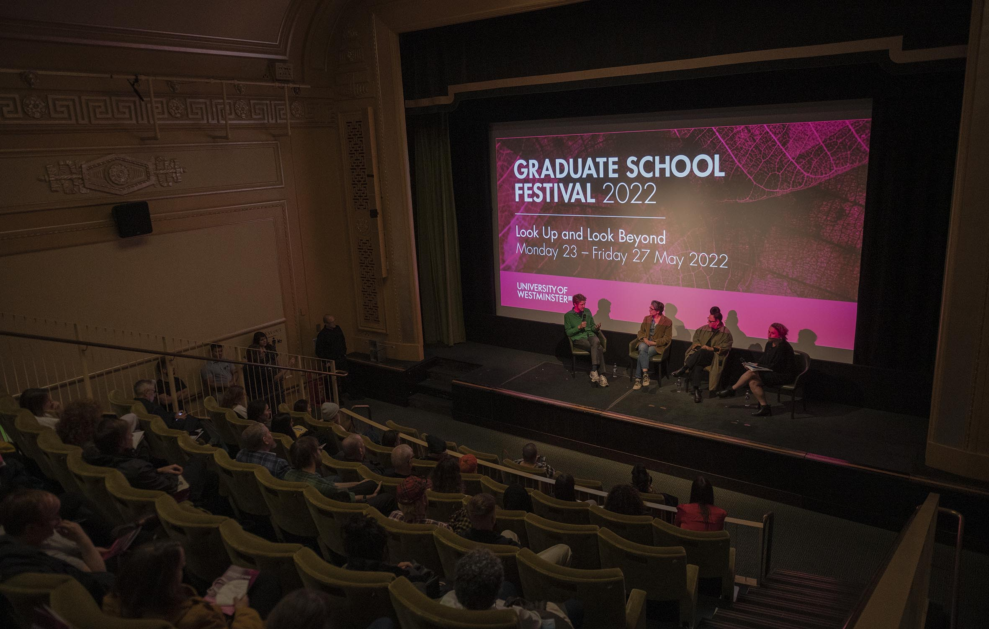
Graduate School Events
Graduate School Festival:
  Keynote Speakers, In-Conversation with…..
  ShowOff, Wellbeing Sessions
  3-Minute Thesis Competition
Plus:
  University Mental Health Day
  Lunchtime Sessions
  Coffee Mornings
  Weekly GS Updates, X,
  Facebook

Slide 11
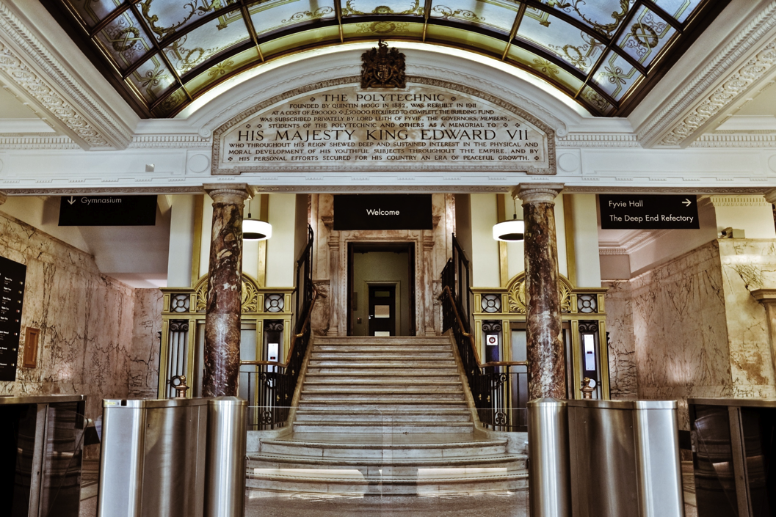

Where we are
Graduate School Office
UG.01
309 Regent Street
London W1B 2HW
www.westminster.ac.uk/research/graduate-school

Slide 12

Contacting Graduate School Office
Student Appointments
By Request - online (MS Teams) or in-person (Regent Street)
Appointment slots must be booked in advance via submission of a booking form
Email
Any queries contact: graduateschool@westminster.ac.uk
In an emergency
Dial 020 7911 5000 ext. 5555
Dial 5555 from a campus landline
Visit the reception desk
If urgent, email the above and we will contact you.

Slide 13
Doctoral Tutor
There are three Doctoral Tutors and you can contact any one of them. Their contact details and online availability are detailed below:
Dr Sylvia Shaw
Email: S.Shaw@westminster.ac.uk
Hours: 10am-12pm Wednesdays
Teams Meeting Link

Slide 14

..and finally!
Read the Research Degree Handbook https://www.westminster.ac.uk/research/graduate-school/academic-programme
Refer to the DRDP Website
http://blog.westminster.ac.uk/doctoralresearcherdevelopmentprogramme
Liaise closely with your supervisory team
Read the GS Weekly Update (and see useful links each week)
Contact us if any issues
Enjoy Westminster and your research!

