Slide 1

Survey, semi-structured interviews & software feedback
18 July 2022

Slide 2

Practice researchersurvey data analysis
Notes:
Jenny introduce and Helen talk through

Slide 3
Practitioner Researcher Engagement
59 responses to the survey
International (Germany, Greece, Canada) – 3 responses
England – 49 responses
Scotland – 7 responses
Independent practitioners – 5 responses (1 Canada and 1 Greece)
Researcher within an organisation – 1 responses
Other – 2 responses
Researcher within a University – 0 responses

Slide 4
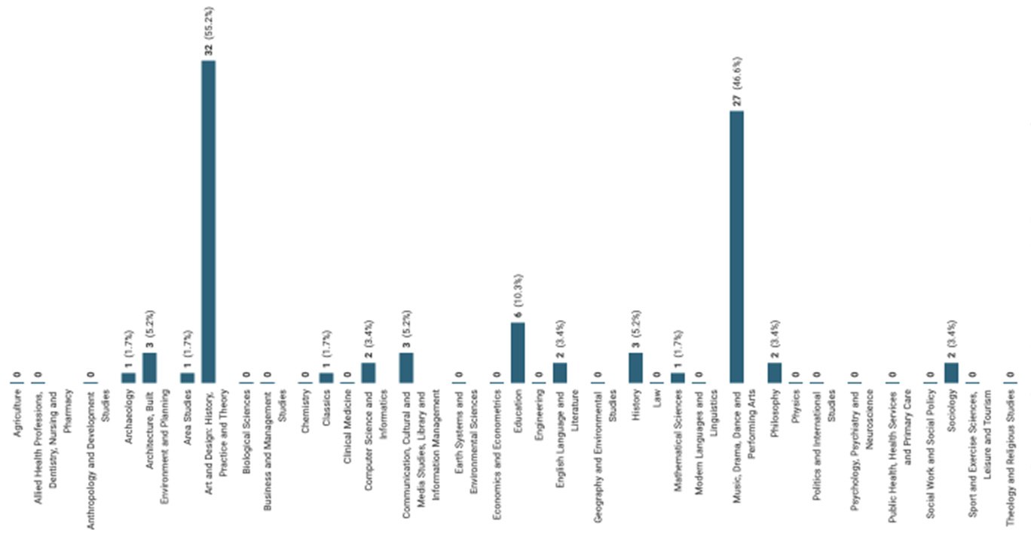
Participant subject alignment

Slide 5
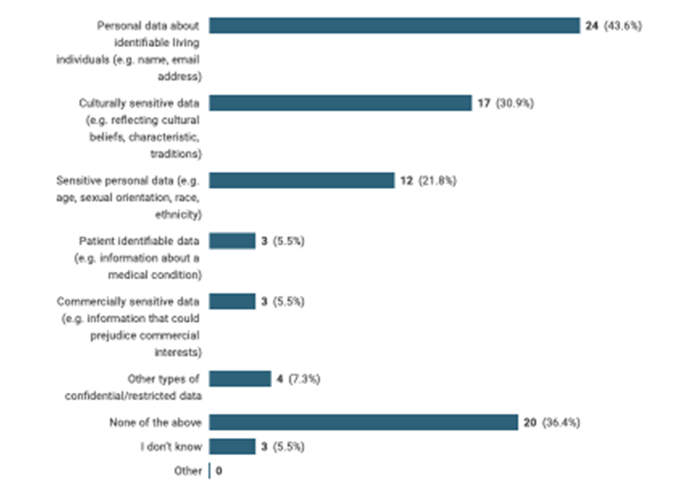
Identifying types of DATa

Slide 6
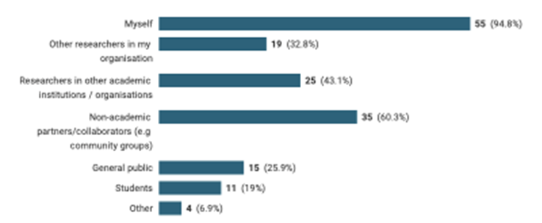
Who creates or contributes?

Slide 7
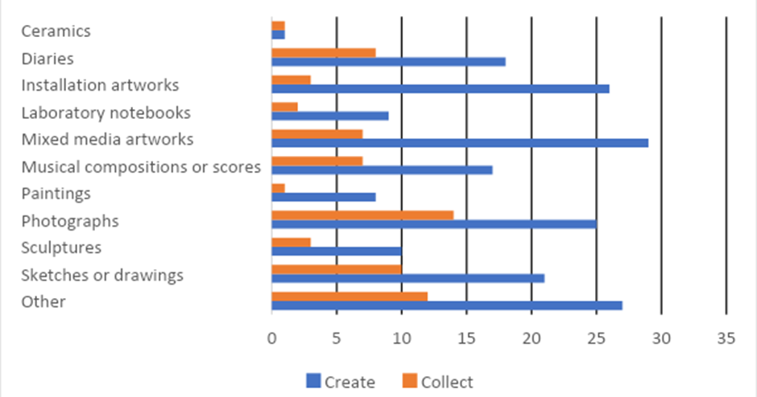
Tangible research outputs

Slide 8
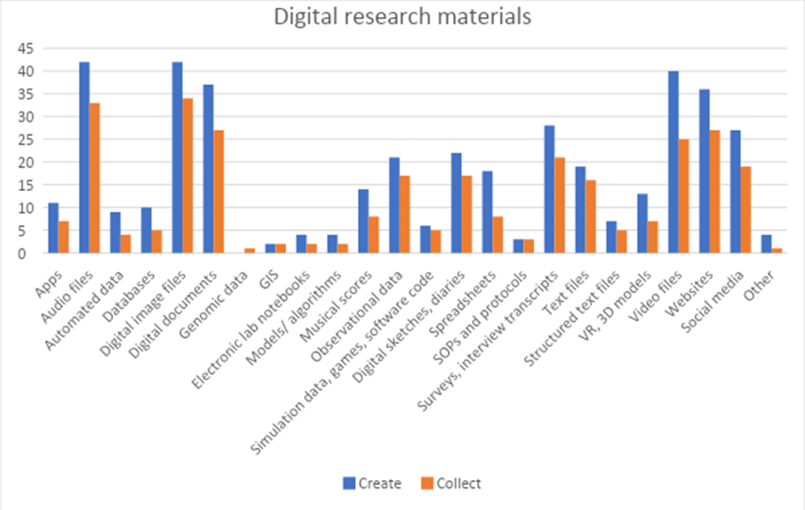
Digital research materials

Slide 9
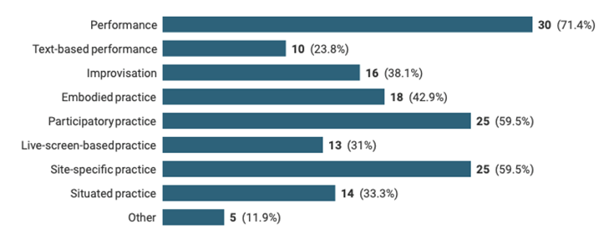
Non-TANGIBLE research events

Slide 10
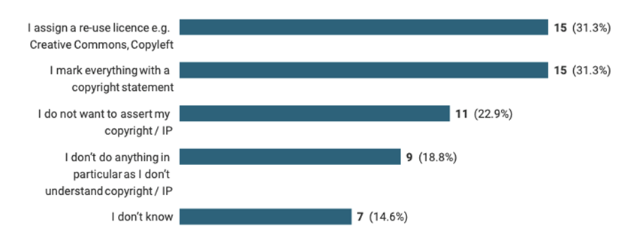
Copyright and intellectual property
Notes:
Jenny to lead

Slide 11
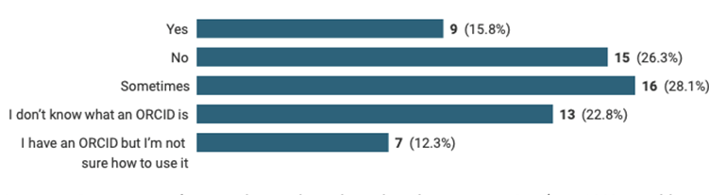
ORCid iD and metadata

Slide 12
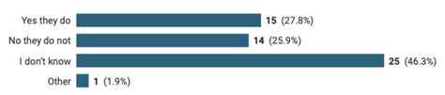
Persistent identifiers

Slide 13

InstitutionAL support TEAMS survey
Notes:
Jenny to lead

Slide 14
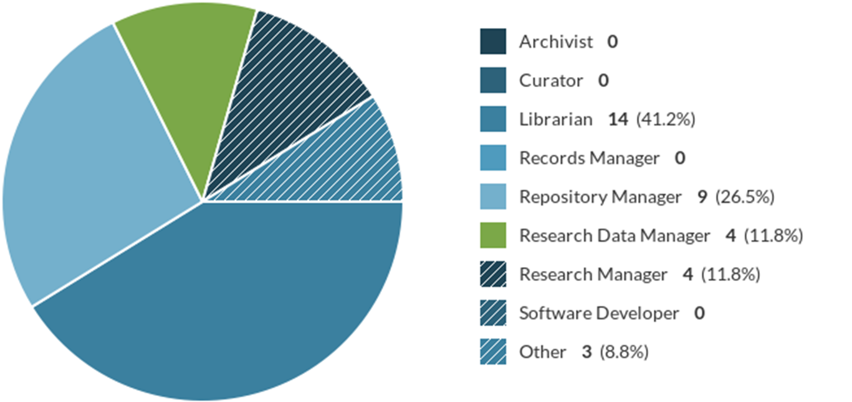
Institutional support teamS survey: participants

Slide 15
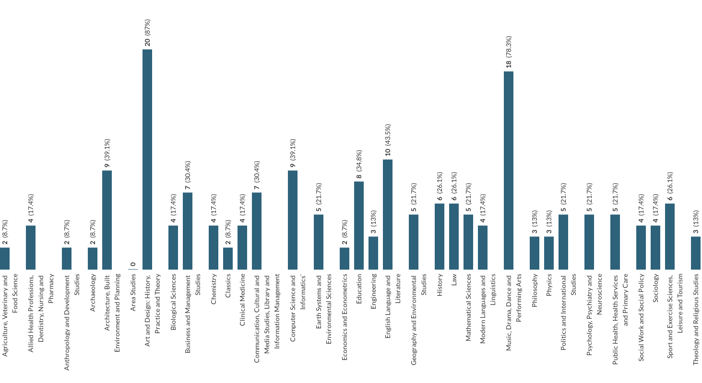
practice research FIELDS at your institution

Slide 16
Barriers to capturing practice research
Culture
Infrastructure/
technology
Expertise/skills
Complexity/time
Intellectual Property

Slide 17
Semi-structured interview themes
Participatory research and recognition of the participant role / contribution
Different collaborator roles
Difference between ‘collection’ and ’research process and outputs’
Methods – material experimentation
Outputs – video/film of objects,
Recognition of public engagement
Non-tangible

Slide 18
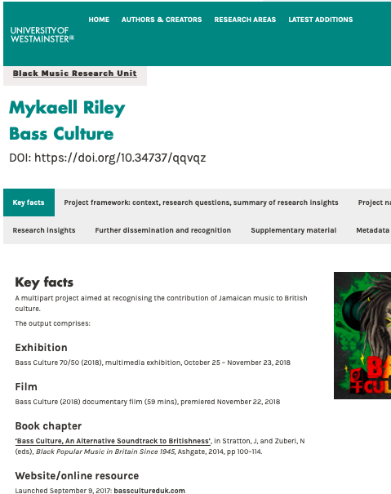
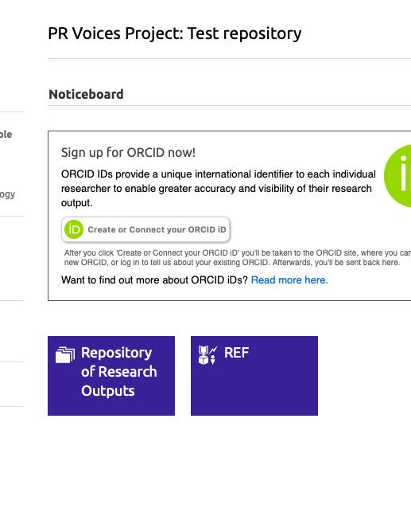
Demo of WestminsterResearch PoRTFOLIO and PRVoices test system user interface

Slide 19
Next steps
Equality Diversity & Inclusion
Sustainability
Business model

