Slide 1
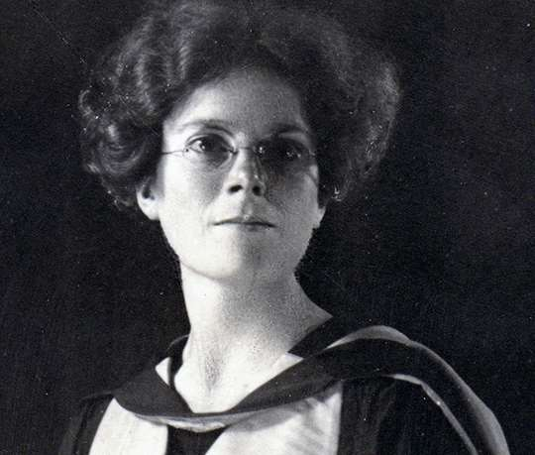
Academic perceptions of a socially responsible STEM graduate
David Van Reyk*
Education-focused Senior Lecturer, School of Life Sciences
MA (Research) student, Faculty of Arts and Social Sciences
@ University of Technology Sydney (UTS)
Keith Heggart
Faculty of Arts and Social Sciences, UTS
Willa Huston
Faculty of Science, UTS
Dame Kathleen Lonsdale, pacifist, women’s rights activist, Quaker and crystallographic chemist
Pronounced “van rike”
he/him/his
david.vanreyk@uts.edu.au
https://www.english-heritage.org.uk/visit/blue-plaques/kathleen-lonsdale/
Notes:
Hello!! Firstly cheers to Jennifer Fraser for allowing me to preview some our work as a prelude to my time in the UK in the last quarter of this year. We are investigating how universities go about teaching for socially responsible STEM graduates.

Slide 2
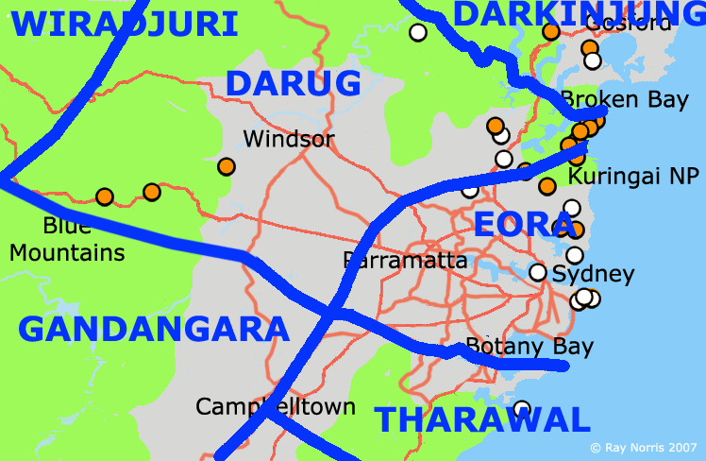
https://www.innerwest.nsw.gov.au/live/community-wellbeing/aboriginal-community/tradition-custodians
Notes:
Before starting, this is a practice those of you who have seen presentations from Australia will be familiar with. I would like to acknowledge that I am giving this presentation on the lands of the Gadigal and Wangal peoples of the Eora Nation. They remain the owners of these never ceded lands, and as such they are custodians of all knowledge that was, is being and will be created on these lands. I also pay my respects to the Gadigal and Wangal elders. And a shout-out to any Indigenous or First Nations attendees. Finally, I would invite any attendees to make an acknowledgement of the lands that are currently residing in using the chat.

Slide 3
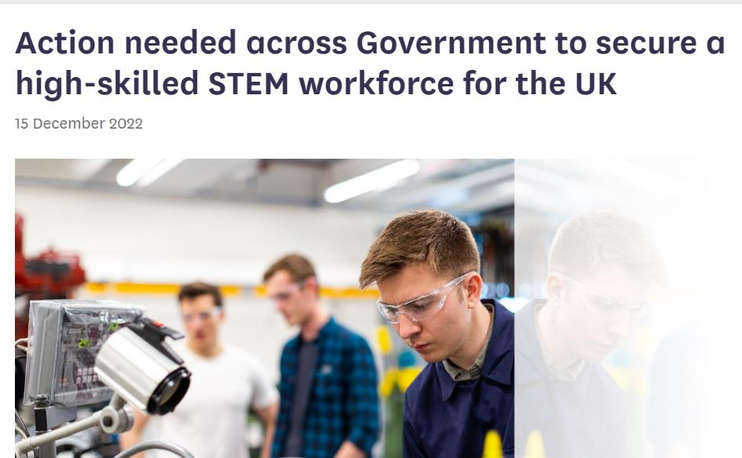
Stem* graduates and society
The issue of the UK’s skills gap is long-running. The shortage of people with the necessary STEM skills impedes improvements to productivity, economic growth and the fulfilment of wider policy goals, such as net zero and energy security. If the UK is to achieve its ambition of becoming a ‘science and technology superpower’ by 2030, urgent action is needed
Published excerpt from a letter rom Baroness Brown of Cambridge to George Freeman MP, Minister of State (Minister for Science, Research and Innovation)
*Science Technology Engineering (and the) Mathematics (sciences)
https://committees.parliament.uk/committee/193/science-and-technology-committee-lords/news/175105/action-needed-across-government-to-secure-a-highskilled-stem-workforce-for-the-uk/
Notes:
Moving on to our project: there remains a widespread, and a generally unchallenged belief, that we need more STEM graduates in both developed and developing nations. As indicated by this quotation [pause to read], the contribution of STEM graduates is principally conceived of their contribution to a nation’s economic development and expansion but reassuringly, in the case of the UK, their contributions to of each of your kingdom’s efforts towards the health of the planet

Slide 4
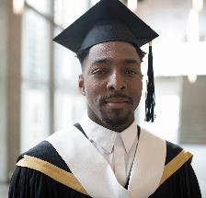
Civics and
citizenship
education
STEM
EDUCATION IN COLLEGES AND UNIVERSITIES
STEM graduates from our colleges and universities will work for the benefit of society and the health of the planet
Notes:
Thus we look to the STEM graduates from our colleges and universities as undertaking work for the benefit of society and the health of the planet We believe that in fostering STEM graduates [CLICK] there is an intersection between STEM education and civics and citizenship education

Slide 5
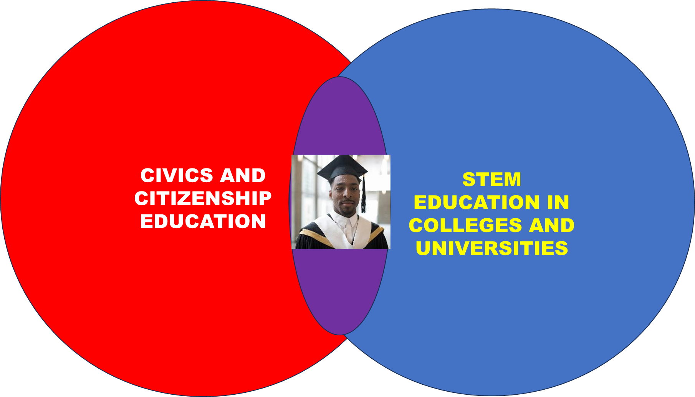
Responsibilities of citizenship
John Dewey, T.H. Marshall, Terence McLaughlin, Walter Parker, John Cogan & Patricia Kubow, Joel Westheimer & Joseph Kahne, Karena Menzie-Ballantyne, and Joan Dejaeghere & Libby Tudball
Notes:
This intersection [CIRCLE] comes from our recognition that STEM professionals are members of a society where such membership is described as being a citizen in a society. As citizens they have the civil, or legal, and political,duties and responsibilities which I have expanded upon here. [CLICK] They also have social responsibilities. The theoretical framework we are using regarding what social responsibility is has been drawn from social philosophers and civics and citizenship education experts some of whom are listed here.

Slide 6
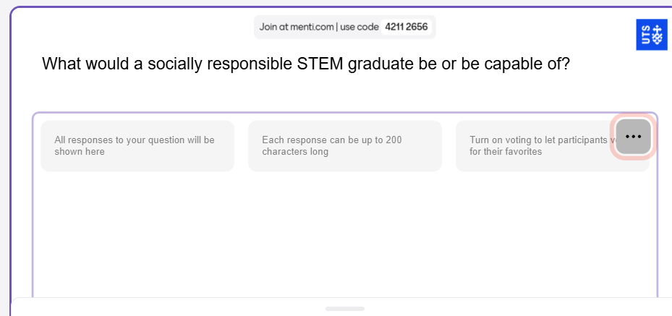
www.menti.com
Notes:
Before I go on to preview what some Australian and New Academics think: I would like to hear from you. I will switch over this Menti and I will publish links in the chat

Slide 7
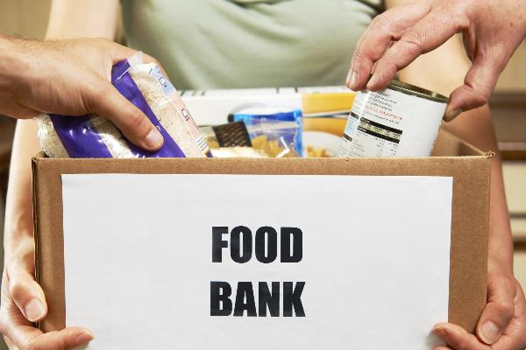
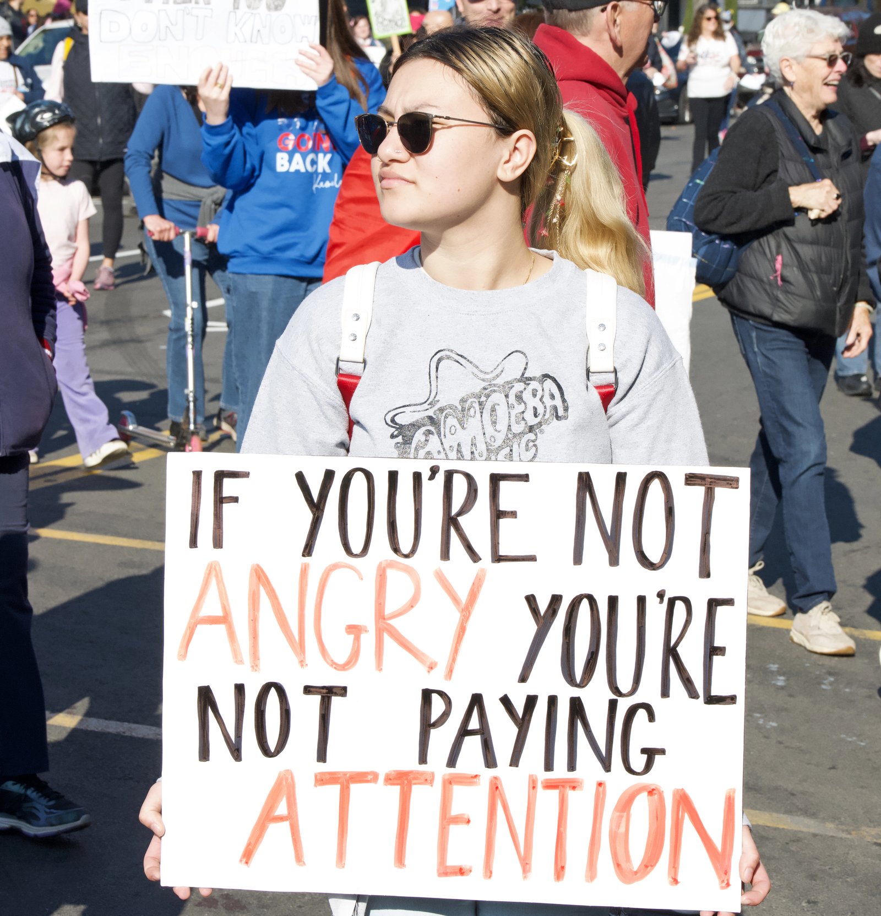
Visions of social responsibility
Personally responsible
Obeys laws
Adheres to societal norms
Participatory
Engaged with the community
Justice-oriented
Investigates societal issues
Social justice advocate
Advocate for the environment
The different visions of socially responsible citizenship are understood as the outcome of different ways that citizenship education could be undertaken
John Dewey, T.H. Marshall, Terence McLaughlin, Walter Parker, John Cogan & Patricia Kubow, Joel Westheimer & Joseph Kahne, Karena Menzie-Ballantyne, and Joan Dejaeghere & Libby Tudball
Notes:
As a guide to how STEM educators could embed social responsibility, we draw on the typology of citizenship education presented by Joel Westheimer & Joseph Kahne. [CIRCLE] Westheimer and Kahne present three visions of citizenship along a spectrum of different conceptions of socially responsible citizens. [GO THROUGH THEM]. It is a spectrum because going along there is an increasing depth in engagement with society and a broader skill set. To explain the typology further Westheimer and Kahne provided a useful analogy [CLICK], [Go through images] [CLICK], The different visions of socially responsible citizenship are understood as the outcome of different ways that citizenship education could be undertaken,

Slide 8
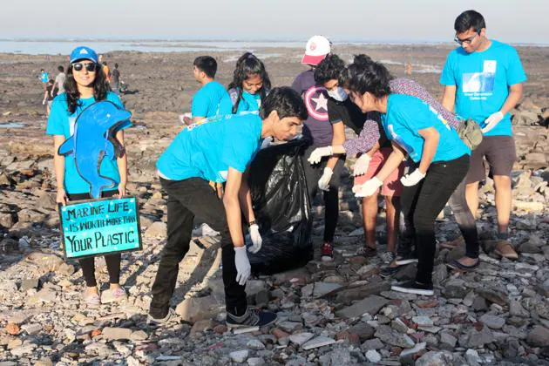
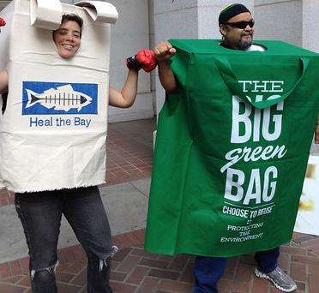
Socially responsible stem graduates
Personally
responsible
Participatory
Justice-oriented
Notes:
We suspect that amongst STEM educators there will be also different conceptions of what constitutes a socially responsible stem graduate. These could be placed on the typology of Westheimer and Kahn .

Slide 9
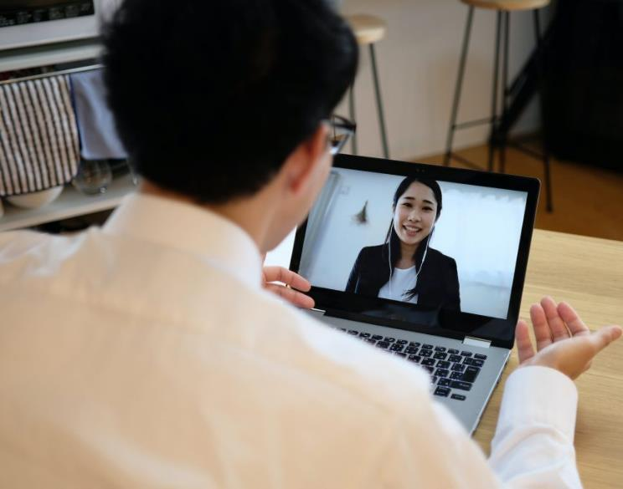
research questions
What do SteMS* academics in Australia and New Zealand think about teaching social responsibility?
How have SteMS academics in Australia and New Zealand embedded social responsibility in their teaching?
*Science and the Mathematical Sciences
Notes:
This leads us to two research questions. Question 1 being [read 1] [CLICK] the approach we took is an anonymous survey. Question 2 being [read 2] [CLICK] I have conducted more than 10 interviews with colleagues. But with time remaining [CLICK] I am going to focus on the survey outcomes

Slide 10
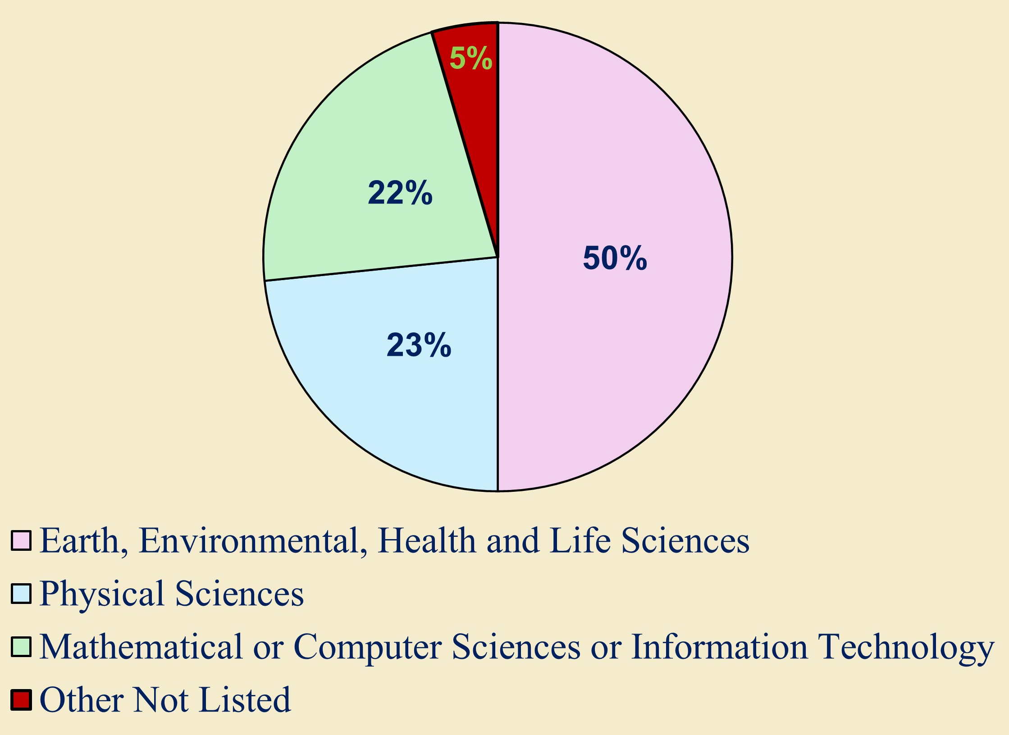
Survey details
Anonymous survey conducted between mid-November 2023 and late January 2025 with the approval of the UTS HREC (# ETH23-8550)
120 completed or partially completed surveys were analysed
Majority (79%) of respondents had continuing or fixed full-time positions, but other employees were represented
Broad range of declared teaching experience (1-45 years). Largest proportion (33%) declared 5-10 years teaching experience
Notes:
Just a quick run through the detail [read first bits of each dot point] We received responses from colleagues across the disciplines of science and the mathematical sciences

Slide 11
Socially responsible stem graduates
Personally
responsible
Participatory
Justice-oriented
Notes:
With this typology of socially responsible STEM graduates in mind. For part of the survey we created a list of possible topics that could be considered as teaching social responsibility with the idea that different levels of social responsibility would necessitate very different learning outcomes which would in turn lead to distinctive caches of content and assessments

Slide 12
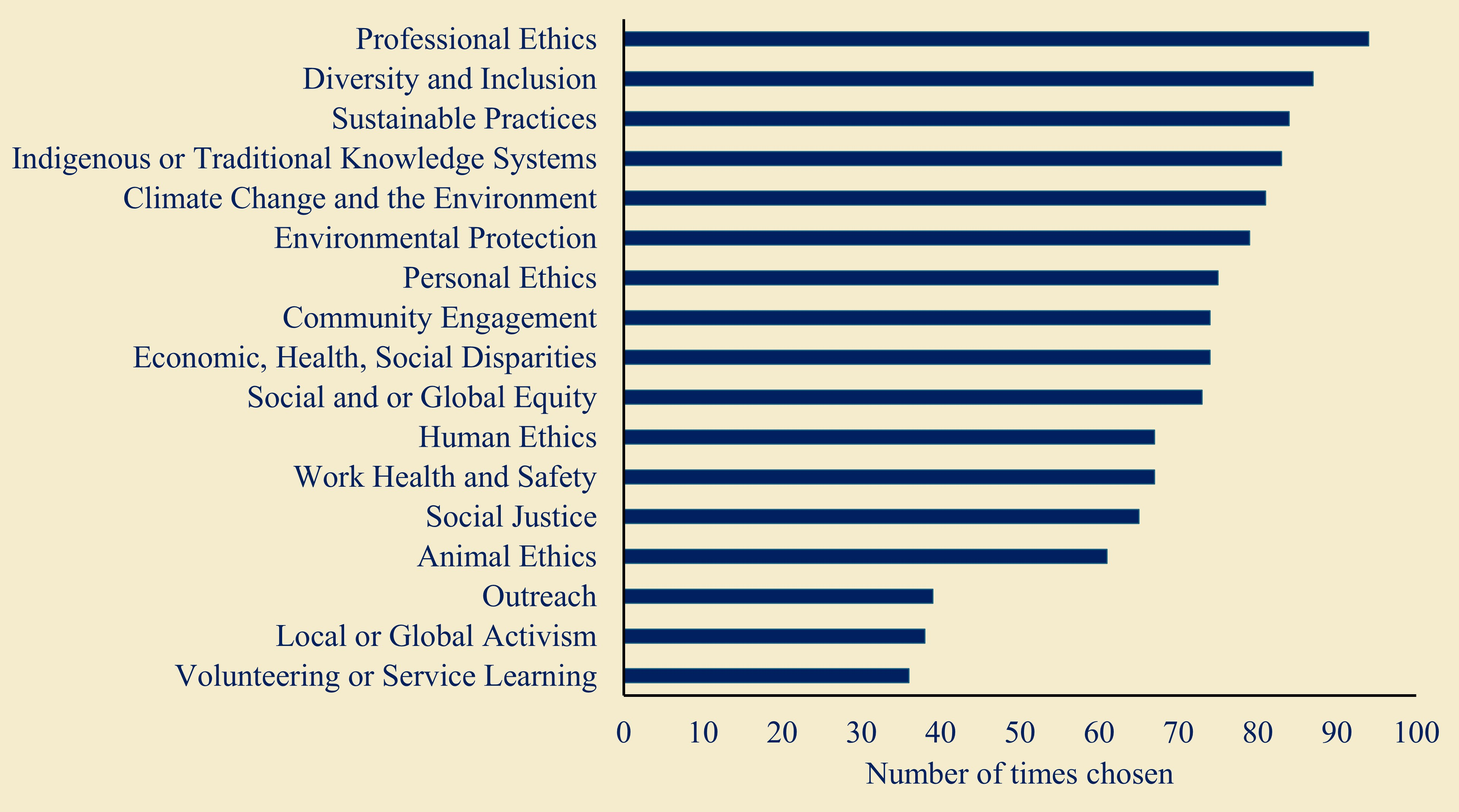
What would be part of embedding social responsibility into university-level science, mathematics and statistics curricula and subjects?
Notes:
Here is the list of options participants had and I’ve ordered the options by number of times chosen. For every option there were numerous participants that chose it. Participants could nominate additional ones. Some of these options [Professional Ethics, Work Health and Safety] are a good fit for typical SteMS curricula. But notably there was support for ones that are more clearly linked to societal impact and societal change. Such items will come with particularly pedagogical challenges.

Slide 13
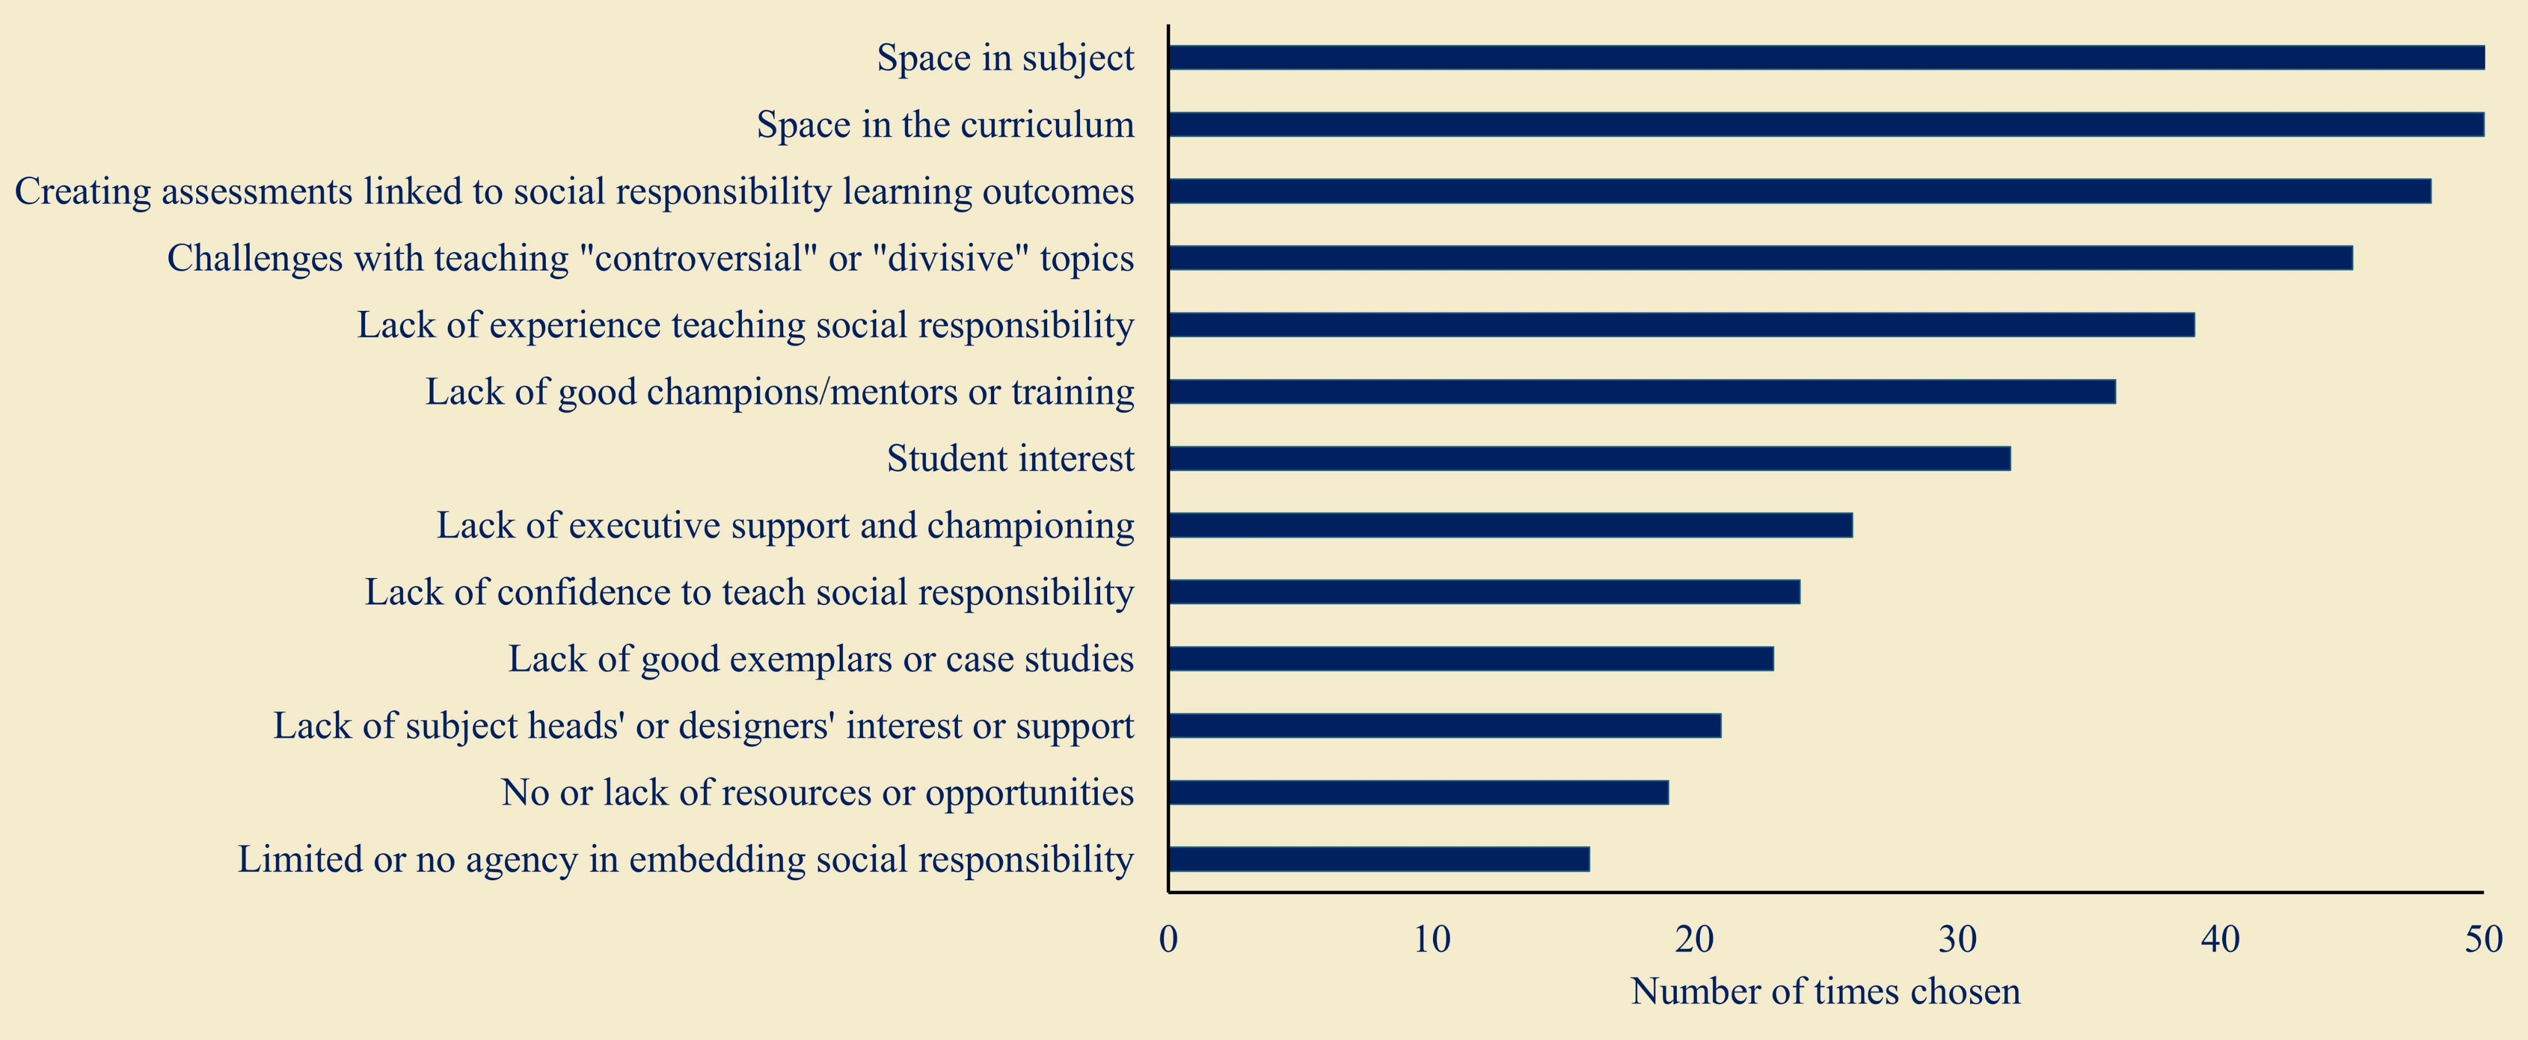
What are, or would be, barriers embedding social responsibility into university-level science, mathematics and statistics subjects and curricula?
Notes:
Drawing on our own experiences we created a checklist of potential barriers, Here is the spread of which ones the respondents opted for, once again orders by number of times chosen. And once again, respondents could nominate others not on the list. We have focused on barriers that relate to the challenges practitioners may face when academics choose to, or are compelled to, teach outside their disciplinary expertise. Some [SPACE, SUPPORT, AGENCY]represent institutional barriers and as such are a challenge to overcome. Others [CONTROVERSIAL TOPICS, CONFIDENCE, RESOURCES] represent areas we believe that communities of practice and professional development can mitigate

Slide 14
other findings
A broad familiarity with graduate attribute/capability frameworks and a widely held belief that social responsibility is a feature of those frameworks
When rating the relevance of teaching social responsibility (0=no to 5=high) The majority of participants gave relevance scores of 4 or 5 regarding the subjects they teach (59%) and the degrees they teach in (75%).
Comments linked to low or not providing a rating included concerns about “tick boxing” and tokenism, and inexperience of disciplined trained staff to teach social responsibility effectively or objectively
Just over 60% of the participants were either Extremely, or Somewhat likely to participate in professional development workshops regarding any embedding
Comments raised concerns about inclusion of socially responsible learning outcomes at the expense of key disciplinary content and training

Slide 15
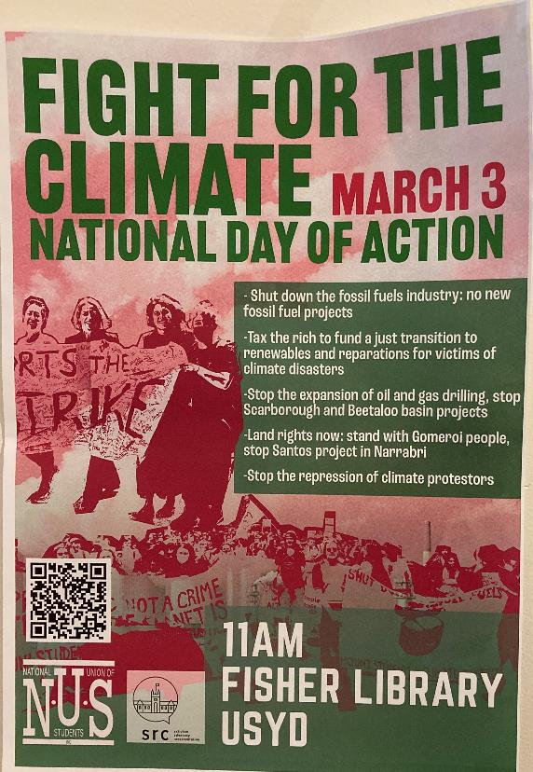
Students as co-creators
As advocates (e.g. via student surveys or in their subject evaluations) for learning outcomes linked to social responsibility
Having space for student created content and learning events regarding the communal/society/planetary impacts of application of the disciplinary knowledge and the practical skills, they are learning
Simulated or low-risk assessment tasks around based on students’ interest to develop other skill/mind sets
Mitigating/preventing negative impacts of graduate practice
Community consultations and engagement
Transdisciplinarity
Advocacy
Lobbying
Activism
.

Slide 16
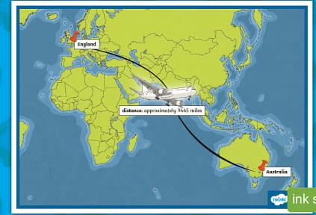
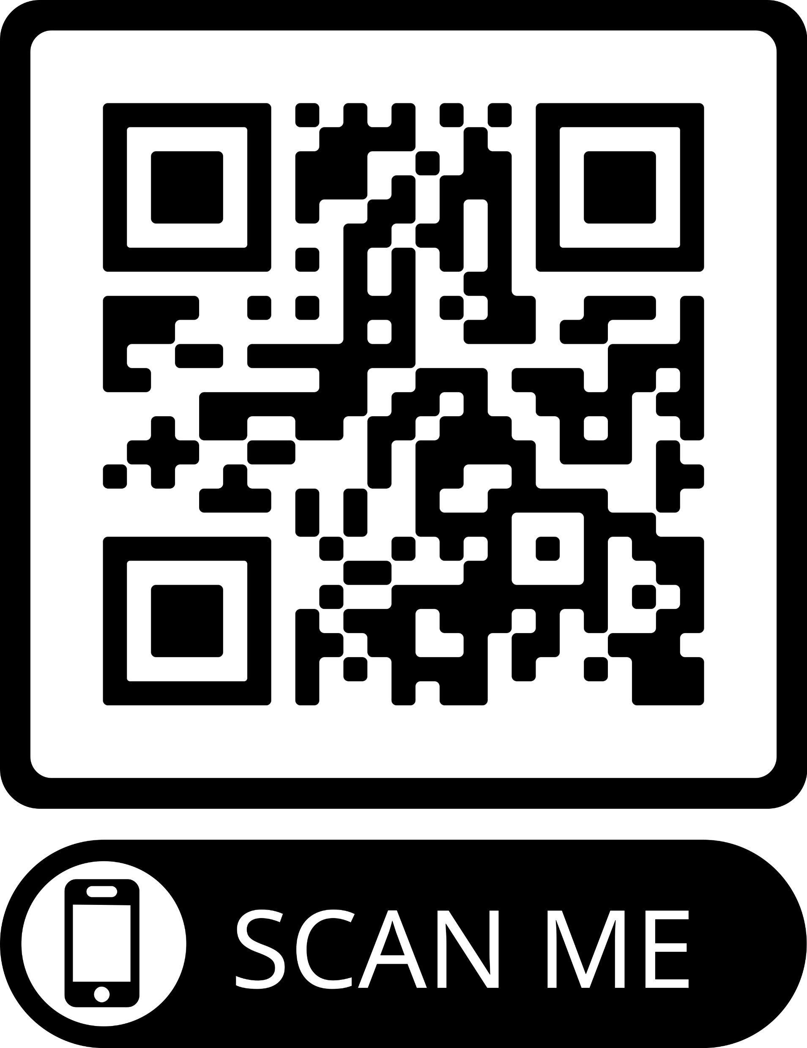
Coming to the UK
Long-service leave from June to December 2025
Staying in the UK from October to just before Christmas
Using London and specifically UoW as a home base
Looking to collaborate or watch or listen or help or present at UoW or other UK and European campuses
Consultations about our draft framework for embedding social responsibility-linked learning outcomes in STEM units, majors or degrees
Peer review of teaching resources/events linked to social responsibility in STEM units
Workshops around embedding social responsibility
Longer (zzz) presentations of our work
Collaborative writing on social responsibility in STEM OR other campus modalities for students to learning to be socially responsible graduates OR the careers of education-focused academics
David.vanreyk@uts.edu.au
https://profiles.uts.edu.au/David.VanReyk
https://www.linkedin.com/in/david-van-reyk-523a37288/

Slide 17
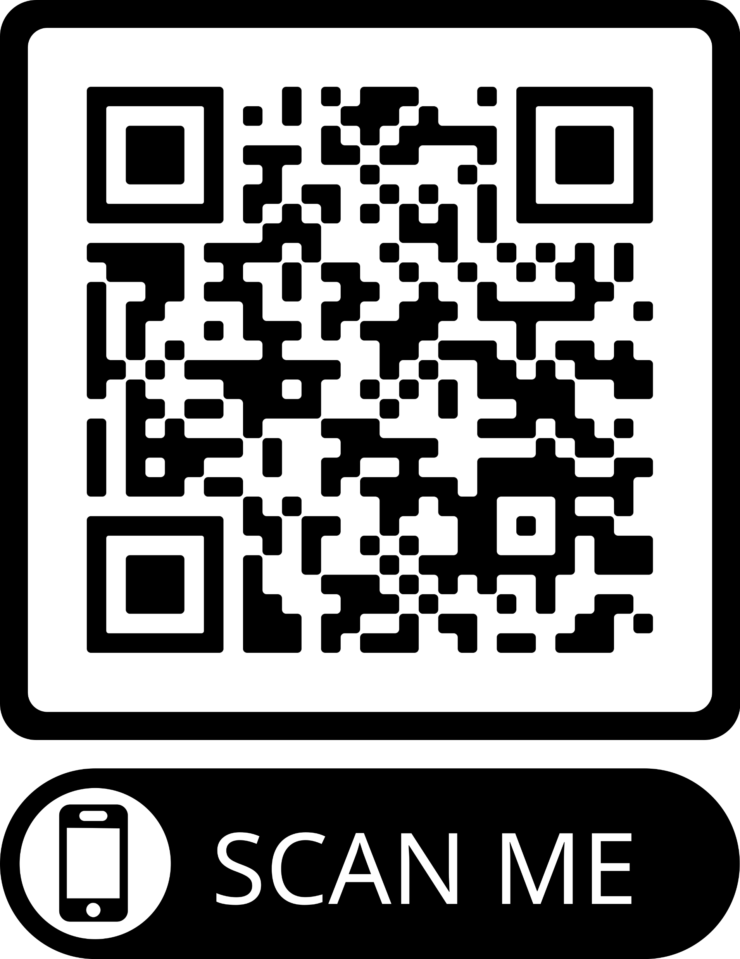
References*
Cogan, JJ, & Kubow, P K (1997). Multidimensional Citizenship: Educational Policy for the Twenty-first Century (Final Report of the Citizenship Education Policy Study Project.). https://digitalcommons.unomaha.edu/slceinternational/2 .
Dejaeghere, JG, & Tudball, L (2007). Looking back, looking forward: Critical citizenship as a way ahead for civics and citizenship education in Australia. Citizenship Teaching & Learning, 3(2), 40-57.
Dewey, J (1916). Democracy and Education. Digireads.com Publishing
Marshall TH & Bottomore T (1992) Citizenship and Social Class. Pluto Classic
McLaughlin, TH (1992). Citizenship, diversity and education: A philosophical perspective. Journal of Moral Education, 21(3), 235-250.
Menzie-Ballantyne, K. (2021). A framework for assessing adolescent-focused, active citizenship programs in the context of global competence. The Social Educator, 39(1), 14-27.
Parker, W (1996). " Advanced" Ideas about Democracy: toward a pluralist conception of citizen education. Teachers College Record, 98(1), 104-125.
Westheimer, J, & Kahne, J (2004). What kind of citizen? The politics of educating for democracy. American Educational Research Journal, 41(2), 237-269
*Access list via
https://drive.google.com/file/d/1vptuXBibMv5gBnN_gGzW2fkUT0LA9dLc/view?usp=sharing
Notes:
These are some background papers regarding teaching social responsibility

Slide 18
Extra slides if needed

Slide 19
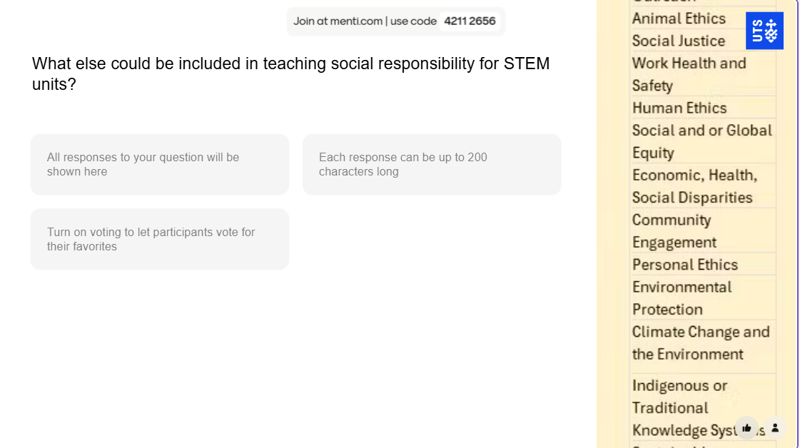

Slide 20
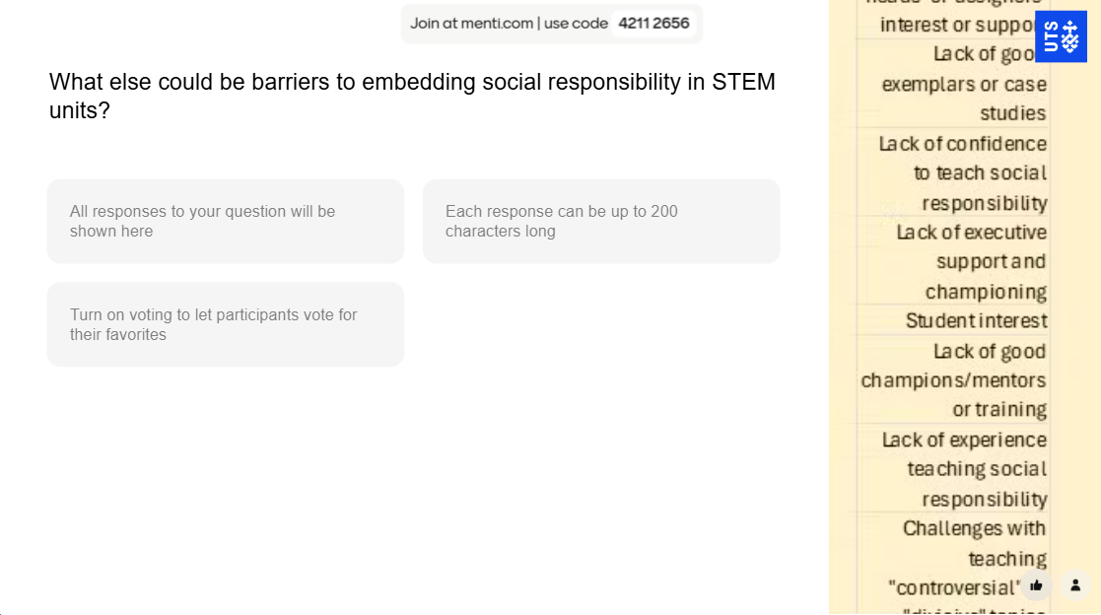

Slide 21
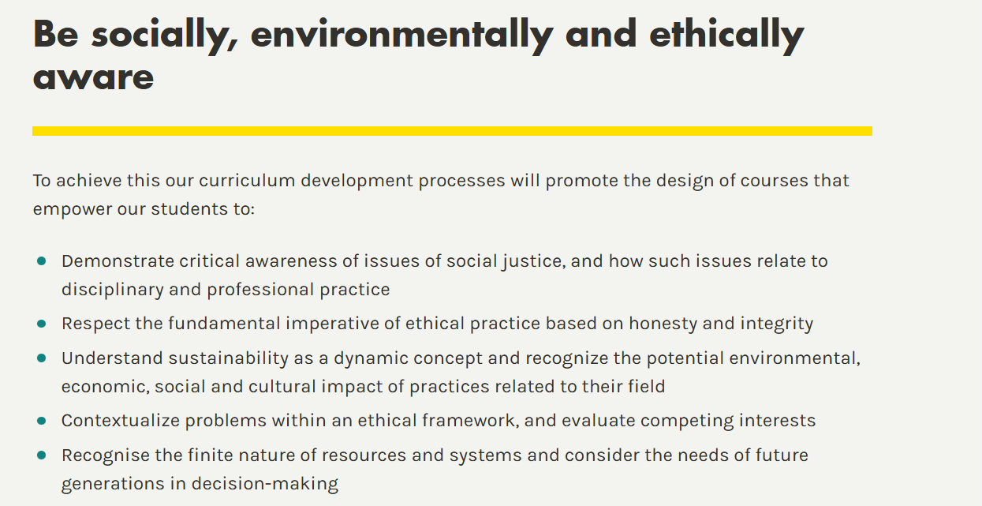
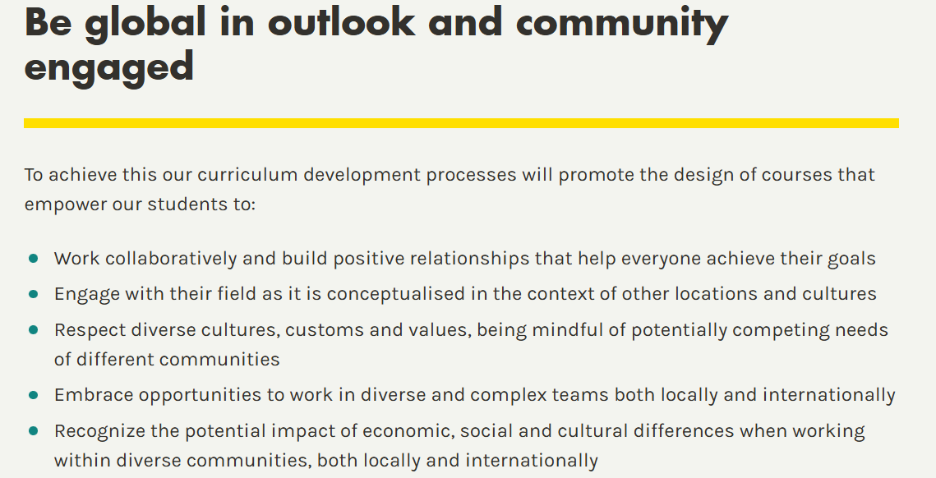
https://www.westminster.ac.uk/about-us/our-university/our-teaching/graduate-attributes-at-the-university-of-westminster
Notes:
This belief regarding the social responsibilities of STEM graduates is one shared by Australian, New Zealand and UK campuses. For example, here are screenshots from the University of Westminster's list of intended attributes of their graduates. I have picked out two where while social responsibility is not mentioned explicitly, for me, the aspirations align with much of our thinking about socially responsible graduates

Slide 22
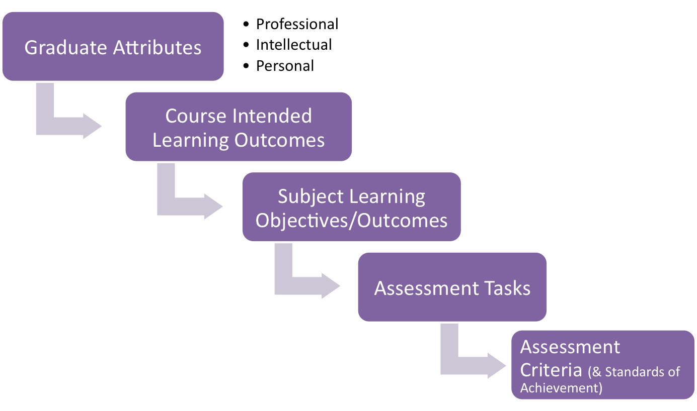
Course = full degree program lasting several years
Subject = single unit of study lasting a single term or semester. Often with one academic with oversight of design and implementation
Notes:
Some of you are unlikely to be familiar with how a set of graduate attributes, sometimes the work abilities is used instead of attributes, is enacted upon. This is a flow chart from my campus which illustrates it. The graduate attributes are aspirational features that each institution creates to capture what their students and the broader society can expect of graduates. [Click] In each Faculty this will be contextualised as CILOs that aligns with the discipline of the degree. So that the same set of graduate attributes will become [Click] a distinct set of CILOs for each degree. [Click] [Click] Then for each subject that is a unit of study within a degree, some but not necessarily all of the degree CILOs, will be recontextualised as SILOs [Click] which serve as the guiding principles for design and implementation of content, training and assessment in that specific subject. This is quite technical would anyone like be go over this with an example?

