Slide 1
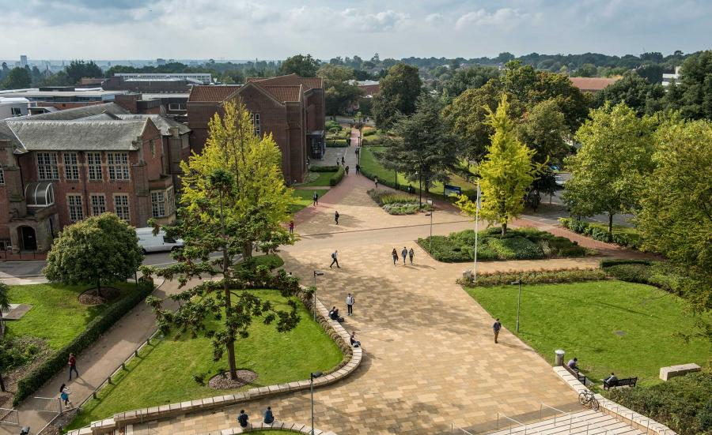
Transitional spaces and collaborative embraces: Partnership at the postgraduate research level
University of Westminster Student as Co-Creators seminar series
Tuesday 4 March 2025

Slide 2
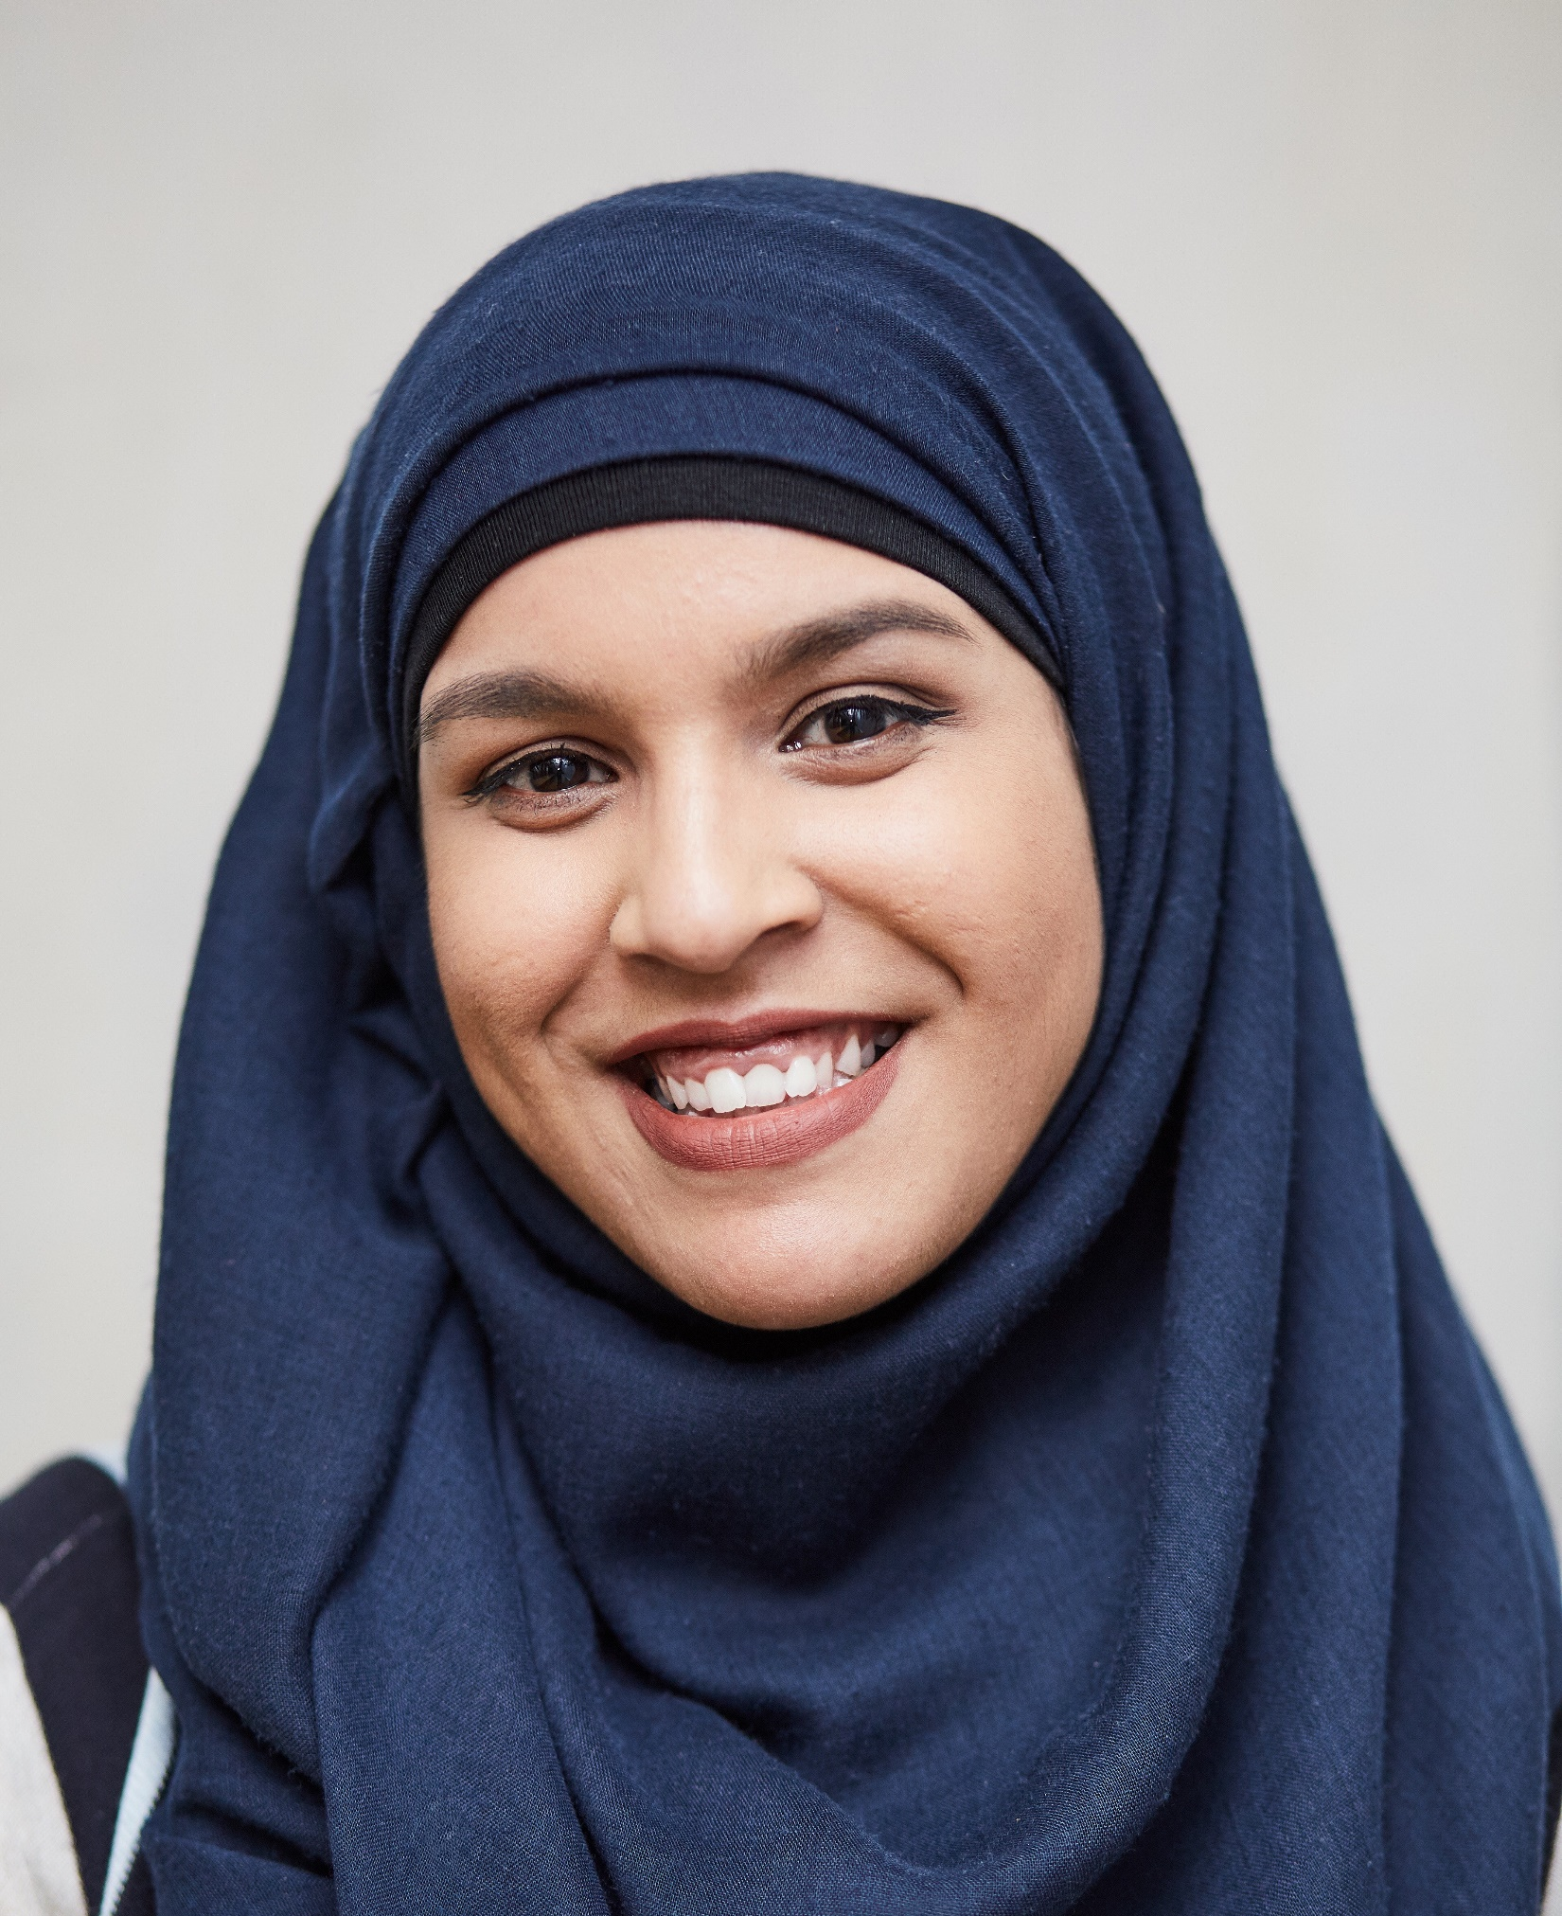
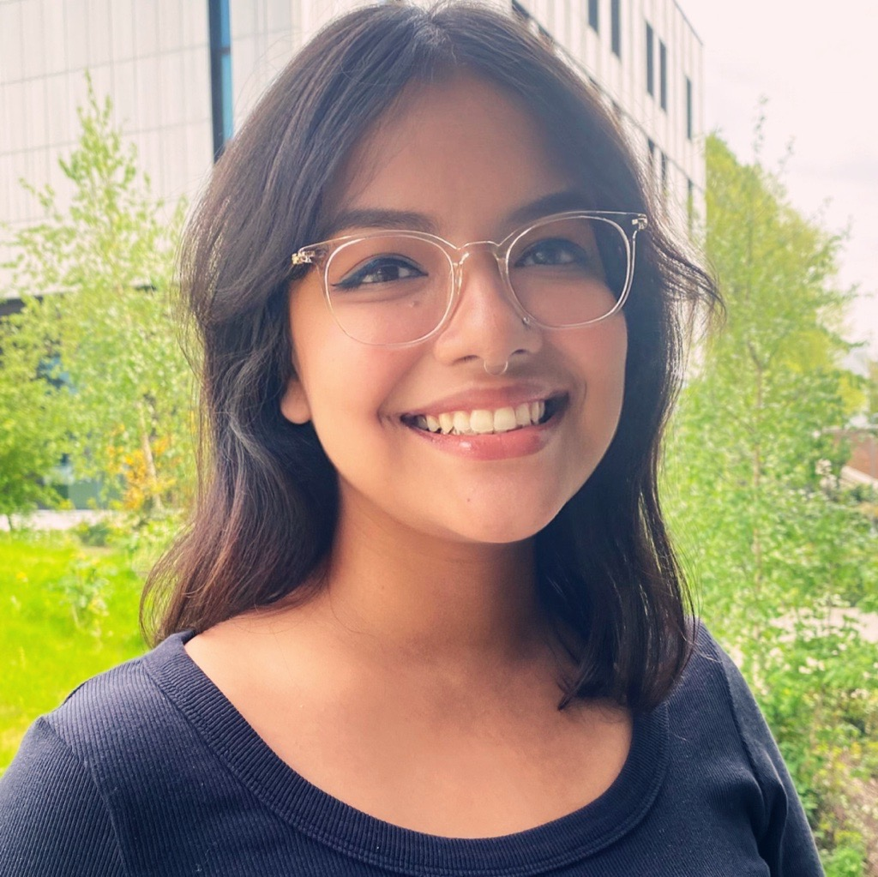
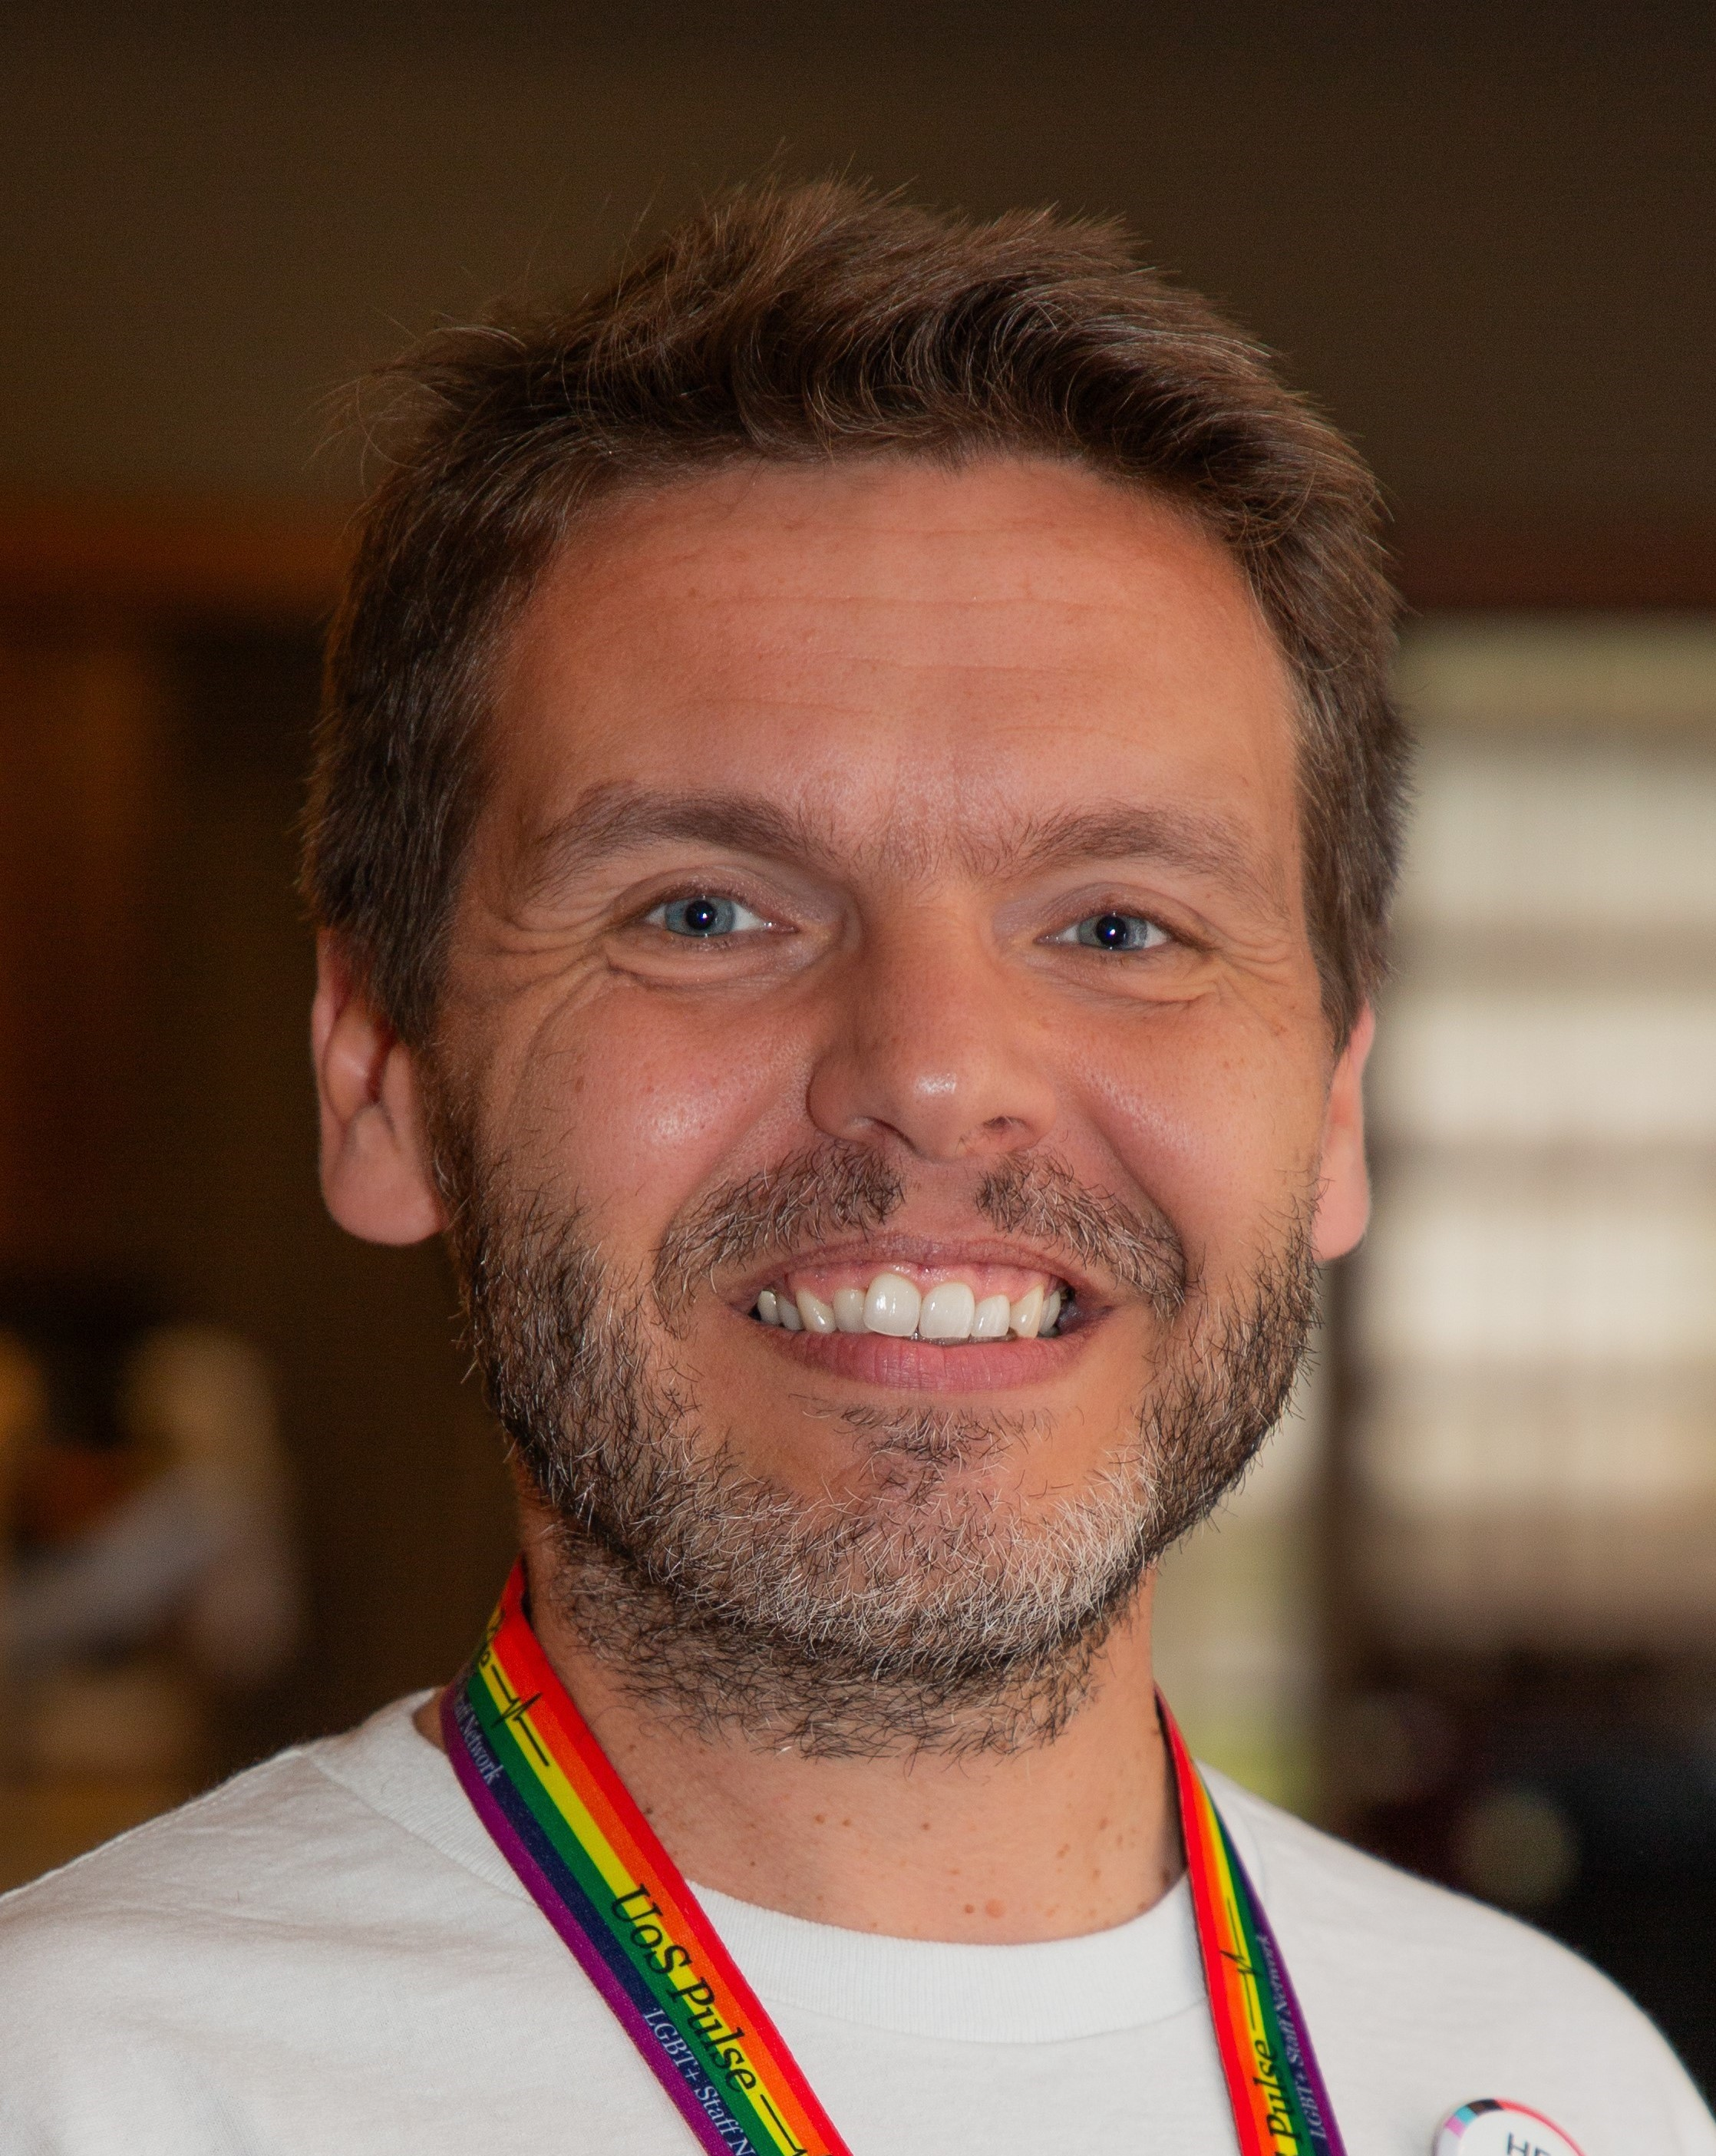
Introductions
Dr Maisha Islam
Doctoral College Research Culture Lead (Equality, Diversity, Inclusion)
Fabien Littel
Postgraduate Researcher and PhD Candidate – Organisation Studies, Southampton Business School
Nandini Das
Postgraduate Researcher and PhD Candidate – Sociology, Social Policy and Criminology
Lilian Odaro
Postgraduate Researcher and PhD Candidate – Department of Gerontology

Slide 3
Bridging the gap – inequalities at PGR and possibilities through partnership
PGR Student Partners Scheme
(June 2023) :
A team of PGR students are hired on a paid, part-time basis (8 hrs/week).
Recruitment has clear focus on equality, diversity, and inclusion (EDI) and encourages representation of minoritised groups.
PGR Student Partners work with and are fully embedded within the Doctoral College.
Access to PGR is rife with multiple challenges (McGloin Smith et al, 2024).
Loneliness, isolation and mental wellbeing concerns = normalised aspects of doctoral study (Pitkin, 2020).
‘Belongingness’ has been negatively impacted for racially minoritised PGRs (ICS, 2022).
Differential access to professional development – particularly impacting racially minoritised and part-time doctoral students (PRES, 2023).
Double neglection = PhD students occupy a liminal space of student and (often) staff → Rarely addressed in student engagement and staff retention discourse.
MI

Slide 4
Overview of PGR Student Partner Cycles
Cycle 1
Recruitment and wider experiences of current UK-domiciled Black and Asian PGR students.
Recruitment experience of prospective doctoral students from underrepresented backgrounds.
Cycle 2
Understanding and developing an inclusive, collaborative, and supportive research culture for PGR students.
Cycle 3
Research Culture (focus on community).
Pipeline into PGR.
PGR Professional Development.
MI

Slide 5
LO
Understanding and exploring the experiences of Black and Asian Postgraduate Research (PGR) students
Key findings
Aim
Survey responses and focus groups revealed complexities in Black and Asian PGR students' journeys.
Although doctoral admissions processes are complex and elusive, PGRs did not report this to be the case at Southampton.
Black students were more forthcoming and critical of their race and intersectional identity, while Asian students described their racialised microaggressions rationally.
To understand the recruitment and wider experience of current UK-domiciled Black and Asian students undertaking a PGR degree at the University of Southampton.
Methods
Online preliminary survey.
Focus group discussion (Split by racialised backgrounds).
Feedback sessions.

Slide 6
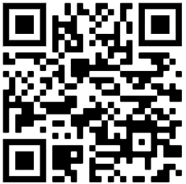
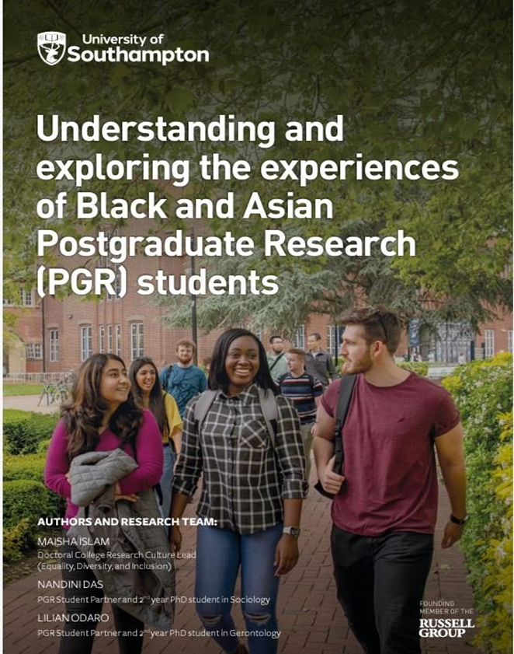
Understanding and exploring the experiences of Black and Asian Postgraduate Research (PGR) students
Developed a high-level report produced by the University of Southampton for wider dissemination.
Recommendations:
Facilitating inter- and cross-peer networking:
Inclusive and accessible social events for PGR students.
Peer shadowing or mentoring scheme for Undergraduate/postgraduate taught students from racially minoritised backgrounds.
2. Enhancing racial representation:
Providing culturally competent and racially diverse mental health and wellbeing services/practitioners.
Embedding content related to race and intersectionality within core modules and curriculum at UG, PGT and PGR (where possible).
LO

Slide 7
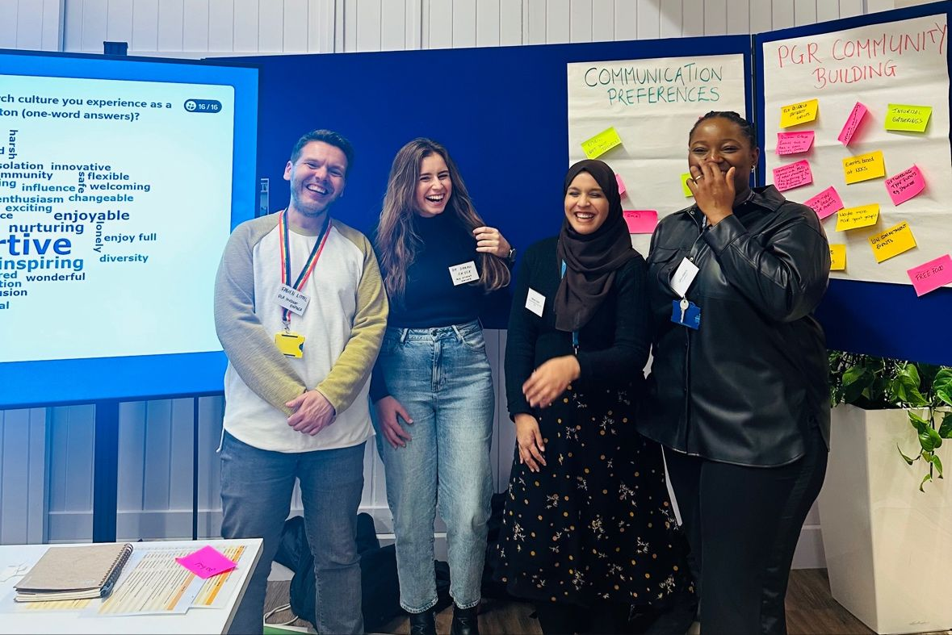
My Student Partner experience / Recommendations
Benefits:
Opportunity for reflexive thinking and enhancing own PhD experience.
Strong sense of belonging.
Professional and academic skills development.
Deeper insight of race, intersectional identity and the experiences of underrepresented PGR students.
Recommendations:
Ensure that PGRs students are not isolated but encouraged to work with peers and staff at different levels in the University.
Ensure that the values of partnership and working patterns with PGR students are discussed and agreed upon at the start of the partnership, whilst leaving room for flexibility as these relationships evolve.

Slide 8
ND
Understanding under-represented students’ motivations for pursuing doctoral study and research-related career – research design and findings
Aim: To understand how the University of Southampton’s ‘PhD offer’ is understood by prospective doctoral candidates from under-represented backgrounds
Methods: Online preliminary survey + online focus group discussions & feedback session
Findings:
Perceptions of PhDs and research-related careers - Concerns related to funding, and lacking knowledge/clarity about PhDs.
Motivations towards PhDs - Driven by their interest in subjects, but also by a desire to excel within it and to make a societal impact
Accessing information on PhDs – They believed there were not enough avenues for discussions related to PhDs. Many continued to have doubts/questions about how/what it means to do a PhD in a particular field.
Preferred communication channels – University websites, current PhD students, and potential supervisors. Challenges in accessing information.
Decisions to progress at the University of Southampton – University’s location and reputation, availability of funding, sense of belonging and community.
ND

Slide 9
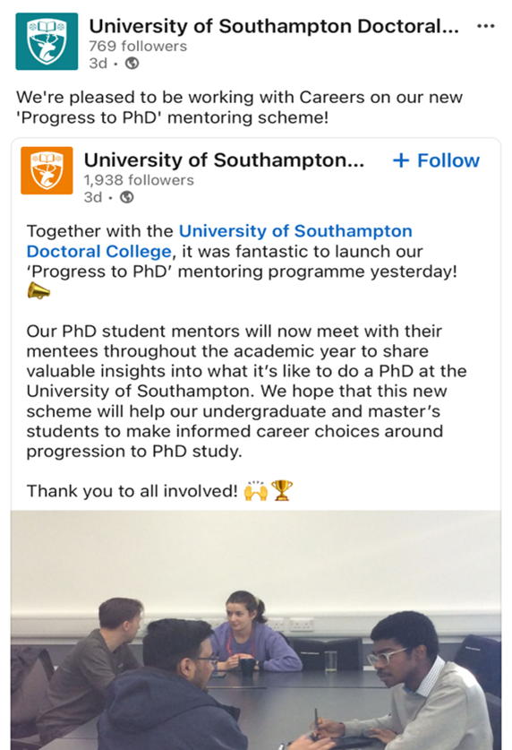
Understanding under-represented students’ motivations for pursuing doctoral study and research-related career – research output
Findings of the research were formally produced in a report which were disseminated internally among stakeholders at the University.
Recommendations:
Structured programmes supporting decisions into PGR
Tailored, faculty-specific information and PhD roadmaps
Social media engagement and representation highlighting current PGRs' research
PhD mentoring/shadowing scheme for prospective PGR students

Slide 10
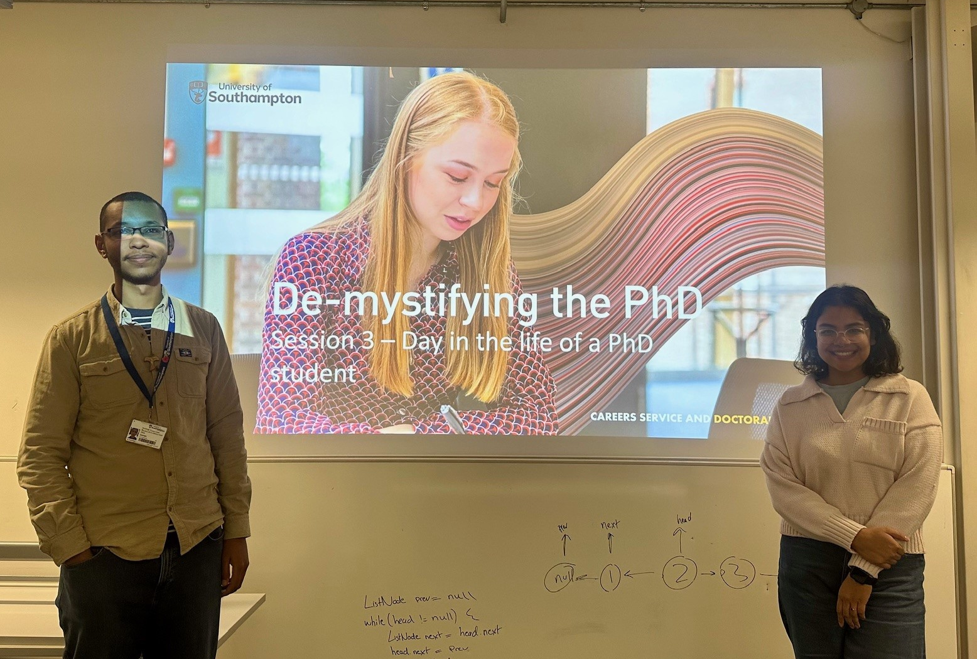
My Student Partner experience / Recommendations
An opportunity to work closely with other PGRs and a platform for mutual un/learning.
A role that is rooted in an equitable partnership model helps create a safe space for dialogues.
Opportunities to directly liaise with members of the Doctoral College equitably, making a lot of the processes participatory.
Exploring research skills as well as job roles beyond the scope of immediate PhD research preparing you for beyond the academia.
ND

Slide 11
PGR research culture project – development
FL
The University’s goal: developing a healthy and inclusive research culture conducive to high-impact outputs.
The Challenge: PGR students report sub-par experiences of research culture.
The Questions: What do PGRs value most as part of a healthy and inclusive research culture? How can the university foster an environment which fulfils these needs?
The Project - A 3-part initiative:
PGR Survey (via SU)
Research culture focused questions
In-person engagement
Research Culture stand at Doctoral College event
PGR Focus groups
Facilitated by PGR Student Partners (also contributors)
Informal discussions, interactive feedback tools, ideas boards
Aspirational and current perspectives on support, inclusion and fulfilment
Early findings as discussion starters

Slide 12
PGR research culture project – output
Insights from 500 PGRs through survey, shaping views and aspirations on research culture.
Practical recommendations gathered relating to students’ communication preferences, engagement and inclusion enablers and blockers, and community-building events.
Actionable output supporting the Doctoral College’s plans and upcoming initiatives.
FL

Slide 13
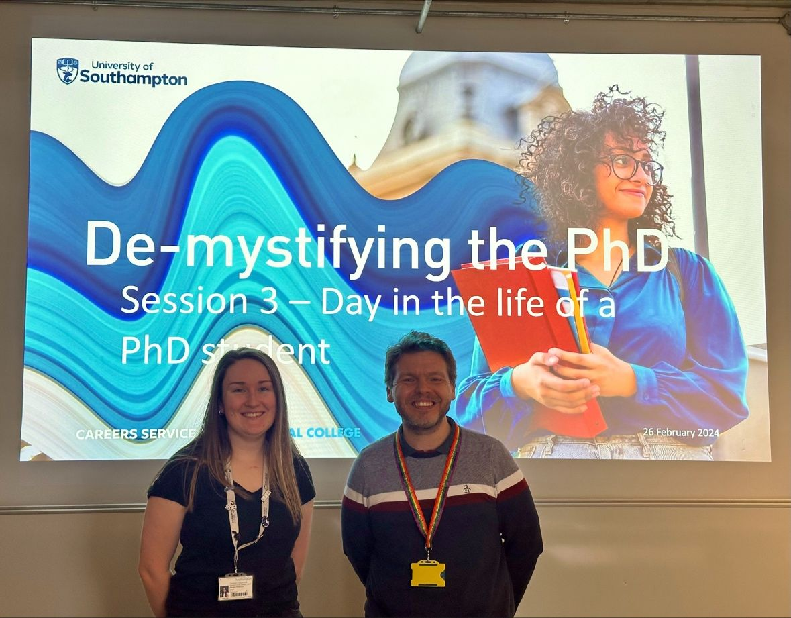
My Student Partner experience
Empowered, valued and recognised.
Meaningful, remunerated work.
Amplifying voices of other PGRs.
Feeling of belonging.
Start of long-lasting relationships and collaboration.
Recommendations
Involve PGRs in the life of your institution in a transparent and open environment.
Establish and maintain co-creation and partnership principles and values.
As an institution, value PGRs’ lived experiences and be open to challenge.
FL

Slide 14
Breakout room discussions (15 minutes)
Question 1:
How do you / will you enact partnership and co-creation with PGR students?
Question 2:
Are there any barriers/challenges you experience to adopting a partnership way of working with PGR students?
Facilitators: Lilian and Fabien
Facilitators: Maisha and Nandini

Slide 15
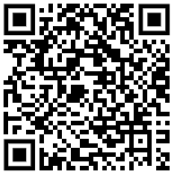
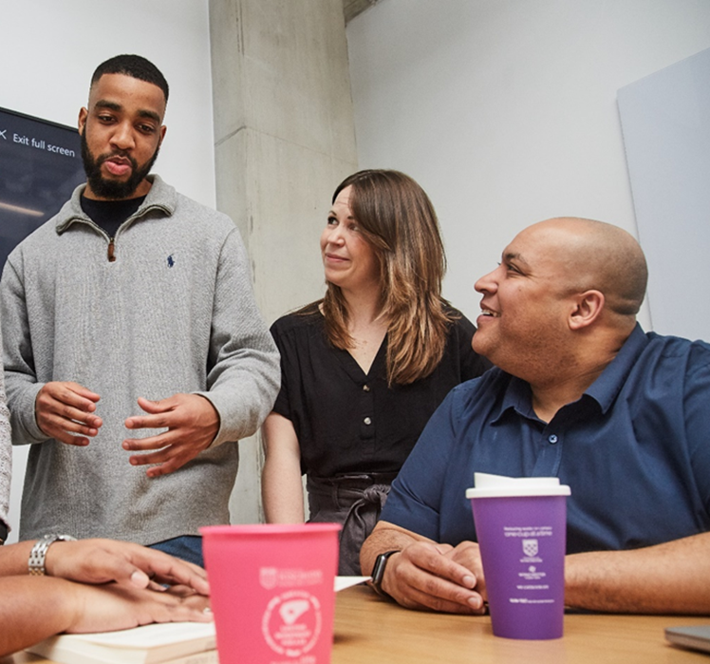
Concluding remarks
Co-Creation is Key – operate through active over passive forms of engagement and recognition.
Budget for Equity – remunerate the expertise and labour of students.
Foster Collaboration – place key emphasis on relationships and cohort-building.
Adopt Critical Frameworks – utilise social justice and equity theories to inform your approach and ensure meaningful impact.
MI

Slide 16
Thank you for listening and feel free to ask any questions!
Dr Maisha Islam
M.Islam@soton.ac.uk
Fabien Littel
F.S.Littel@soton.ac.uk
Nandini Das
N.Das@soton.ac.uk
Lilian Odaro
lii1u18@soton.ac.uk

